Slide 1

Lateral Thoracic Decompression
10 Gauge
Rev A 05162023
Notes:
The following program was created specifically for the ENHANCED ARS™ (Air Release System) decompression needle orientation and training.
For questions, concerns or additional information please contact:
North American Rescue®, LLC
email: info@NARescue.com
Tel: 864.675.9800
Mail: 35 Tedwall Court
Greer, SC 29650-4791
Fax: 864.675.9880

Slide 2

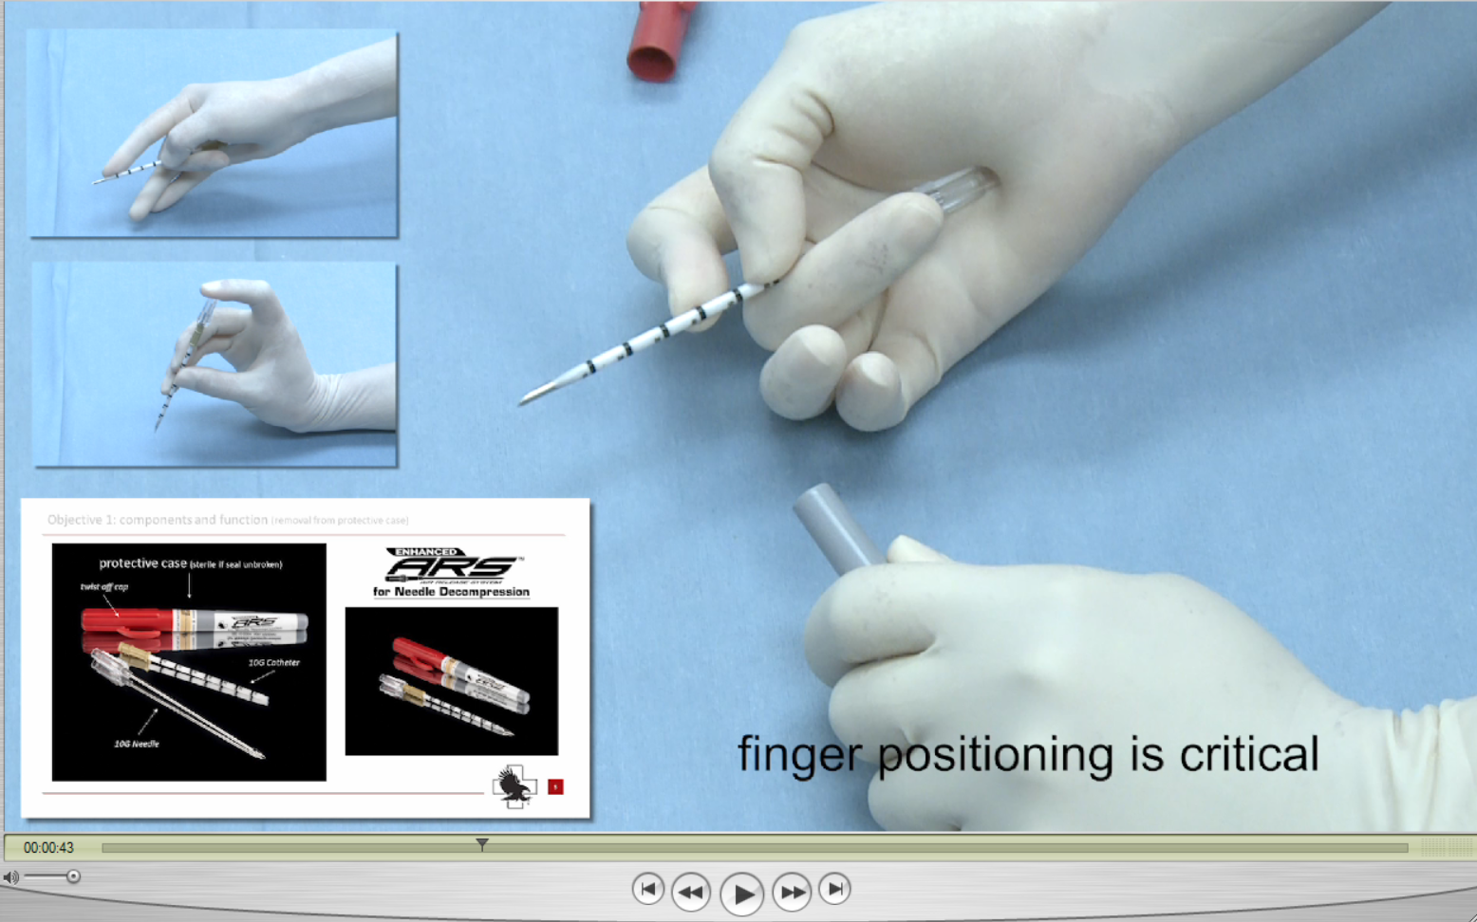
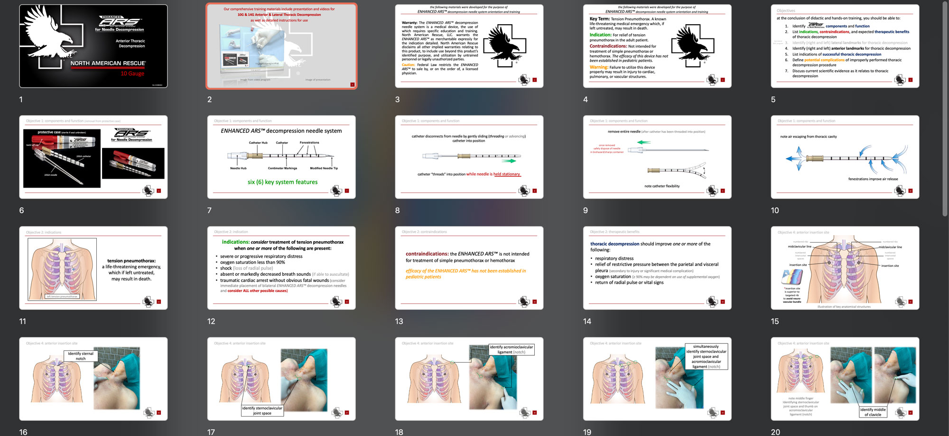
Our comprehensive training materials include presentation and videos for
10G & 14G Anterior & Lateral Thoracic Decompression
as well as detailed instructions for use
image from video program
image of presentation slides
Notes:
Videos, Presentations, and Instructions for Use (IFUs) are part of our complete training program.

Slide 3
the following materials were developed for the purpose of
ENHANCED ARS™ decompression needle system orientation and training
Warranty: The ENHANCED ARS™ decompression needle system is a medical device, the use of which requires specific education and training. North American Rescue, LLC. warrants the ENHANCED ARS™ as merchantable expressly for the indication detailed. North American Rescue disclaims all other implied warranties relating to this product, to include use beyond this product’s identified purpose, and utilization by untrained personnel or legally unauthorized parties.
Caution: Federal Law restricts the ENHANCED ARS™ to sale by, or on the order of, a licensed physician.
Notes:
As with most modern medical devices, the ENHANCED ARS™ decompression needle system meets rigid safety standards, governmental mandates, and the demanding expectation of clinicians worldwide.
The ENHANCED ARS™ decompression needle system was developed with attention to the latest presented and published scientific evidence, as well as guidance from today’s leading experts in the fields of Emergency Medicine, Trauma Surgery, Pulmonology, Critical Care, Combat Care, and Pre-Hospital Emergency Medicine.
The ENHANCED ARS™ Warranty and Advisory should be read and understood as a component of this program.

Slide 4
the following materials were developed for the purpose of
ENHANCED ARS™ decompression needle system orientation and training
Key Term: Tension Pneumothorax. A known life-threatening medical emergency which, if left untreated, may result in death.
Indication: For relief of tension pneumothorax in the adult patient.
Contraindications: Not intended for treatment of simple pneumothorax or hemothorax. The efficacy of this device has not been established in pediatric patients.
Warning: Failure to utilize this device properly may result in injury to cardiac, pulmonary, or vascular structures.
Notes:
The Key Term, Indication and Contraindications are further reinforced within this program.
WARNING: As with all invasive medical devices, usage is predicated on proper orientation and training, careful consideration of the indications, patient condition, review of potential contraindications, and a specific RISK versus BENEFIT analysis.
Failure to utilize this device according to the directions for use, didactic materials provided, and NAR recommended hands-on training MAY CAUSE FURTHER INJURY.

Slide 5

Objectives
at the conclusion of didactic and hands-on training, you should be able to:
  Identify components and function
  List indications, contraindications, and expected therapeutic benefits of thoracic decompression
  Identify (right and left) lateral landmarks for thoracic decompression
  Identify (right and left) anterior landmarks for thoracic decompression
  List indications of successful thoracic decompression
  Define potential complications of improperly performed thoracic decompression procedure
  Discuss current scientific evidence as it relates to thoracic decompression
covered in anterior
insertion program
Notes:
At the conclusion of this specifically developed ENHANCED ARS™ didactic, and NAR recommended hands-on training program, the clinical provider should be able to:
Identify the ENHANCED ARS™ components and function.
List the indications, contraindications, and expected therapeutic benefits of thoracic decompression.
Identify the (right and left) lateral landmarks for thoracic decompression.
Identify the (right and left) anterior landmarks for thoracic decompression. Objective is GRAY on this slide because it will be covered in anterior insertion program. Suggestion – review and become competent with both insertion locations.
List the indications (signs and symptoms) of successful thoracic decompression.
Define the potential complications of an improperly performed thoracic decompression procedure.
Discuss current scientific evidence as it relates to thoracic decompression.
At the completion of clinical training consider offering both a written and skills competency evaluation.

Slide 6
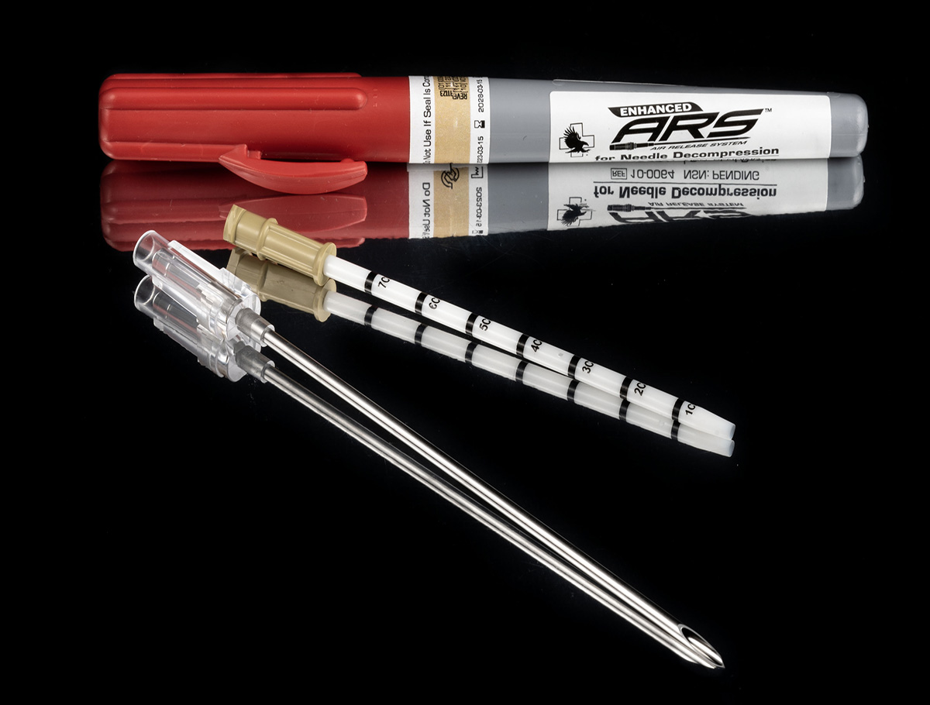

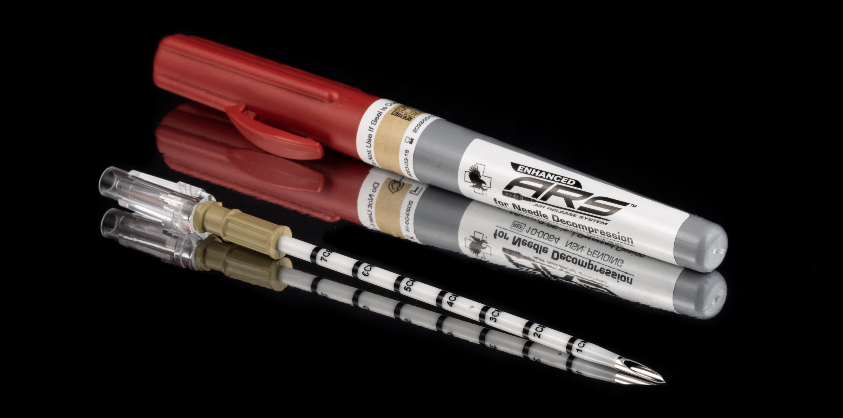
Objective 1: components and function (removal from protective case)
protective case (sterile if seal unbroken)
10GA catheter
10GA needle
Notes:
The ENHANCED ARS™ decompression needle system is packaged in a proven, robust hard-shell case, with an assurance seal indicating sterility and lot number. As with all medical devices, labeling provides additional information regarding device length and size, as well as contact information for North American Rescue®, LLC.
Instructions for use accompany EACH needle set and should be reviewed during training efforts and emergent usage when needed.
To open:
Ensure integrity of safety seal
“Twist off” red cap, breaking safety seal
Remove red case cap, exposing SPEAR™

Slide 7
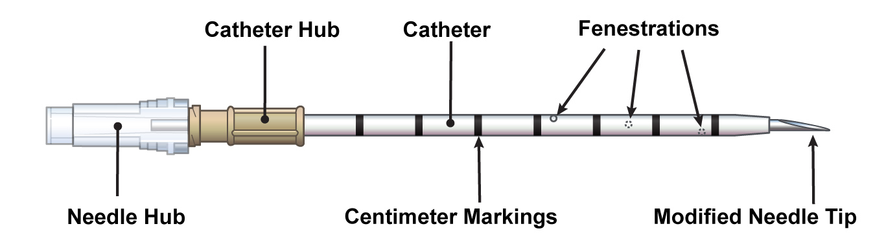
ENHANCED ARS™ decompression needle system
Objective 1: components and function
six (6) key system features
Notes:
ENHANCED ARS™ decompression needle system and training materials meet and exceed 11 April 18 TCCC Guidelines Change 17-02”.
The ENHANCED ARS™ is a robustly packaged complete assembly created to address documented failures and current management challenges in the field and critical care settings.
Length: 3.25 inches (8.25cm) KEY Point: Length is necessary based on an average 2.1 inches ( 5.3 centimeters) of skin to rib depth AND an additional average of 0.5+ inches of rib to pleura depth.
Size & modifications: 10ga (10 French) catheter with distal fenestrations (holes). The fenestrations provide a 314% increase in air outflow when compared to a 14ga catheter, and a 74% increase in air outflow over a non-fenestrated 10ga.
IMPORTANT POINT: 10ga ENHANCED ARS™ catheter walls (external and internal lumen combined) have been shown to remain patent (open) during routine usage.
The catheter additionally has been designed with NVG-friendly centimeter markings along its length for precise depth control (a key factor to improve patient safety) during placement.
Needle tip has been modified to a bi-beveled cutting blade with an adjusted angle of entry to allow for a skin nick, and to improve penetration through varying types of tissue. This modification offers clinicians enhanced entry control (which prevents “explosive entry” and penetration failure, thus improving patient safety).

Slide 8
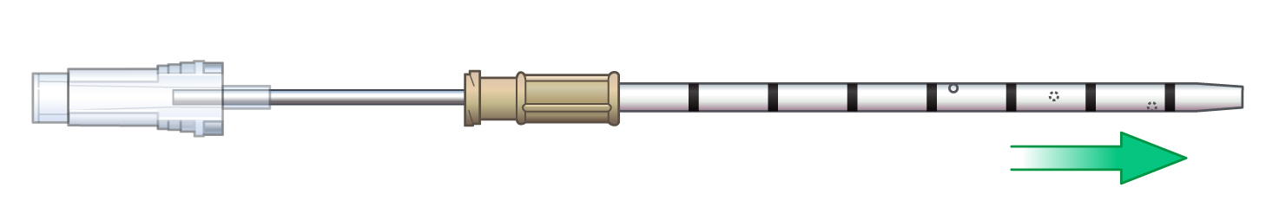
Objective 1: components and function
catheter disconnects from needle by gently sliding (threading or advancing)
catheter into position
catheter “threads” into position while needle is held stationary
Notes:
The ENHANCED ARS™
Once proper insertion depth has been achieved (not deeper than 2 cm beyond parietal pleura), and ENHANCED ARS™ has been oriented toward the mid-clavicle, thread the catheter into position while holding needle stationary.
Catheter should be threaded (advanced) into position along parietal pleural wall for maximal therapeutic benefit.

Slide 9
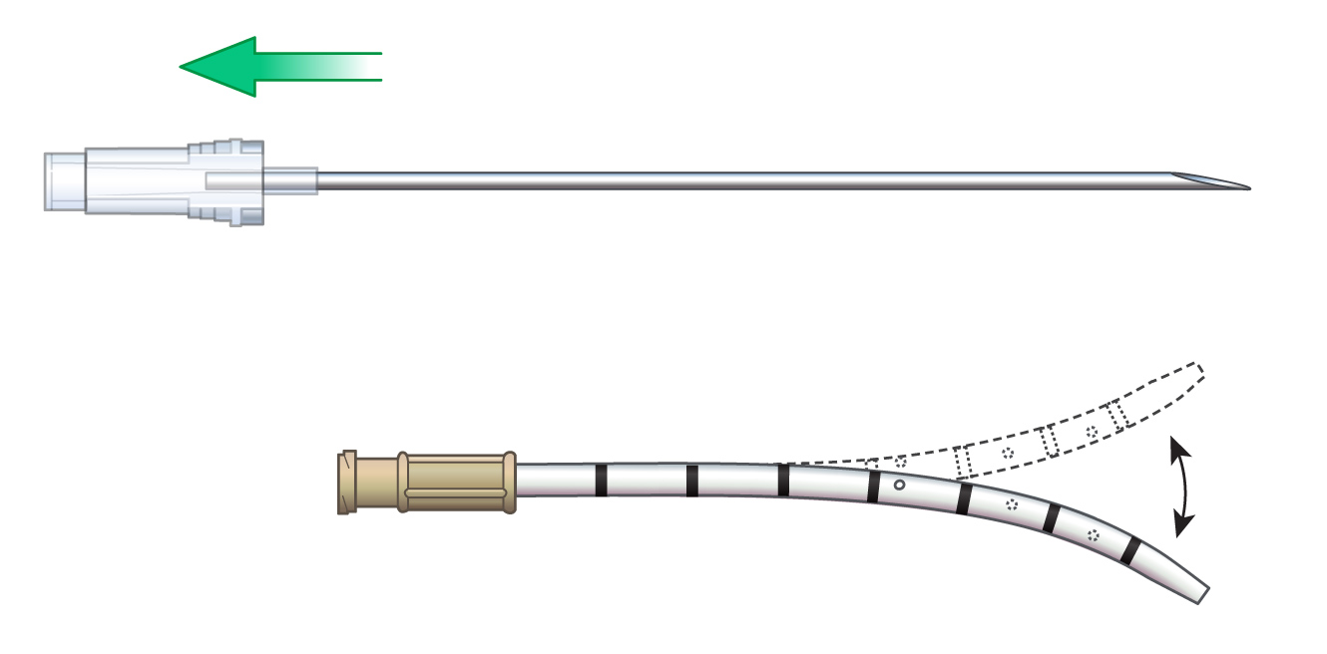
Objective 1: components and function
remove entire needle (after catheter has been threaded into position)
once removed
safely dispose of needle
in biohazard/sharps container
note catheter flexibility
Notes:
Note that ENHANCED ARS™ needle should be removed ONLY when the catheter has been threaded into position (an established failure point for needle decompression).
Note that 10ga catheter has improved flexibility to promote continued relief of thoracic pressure during critical patient management.

Slide 10
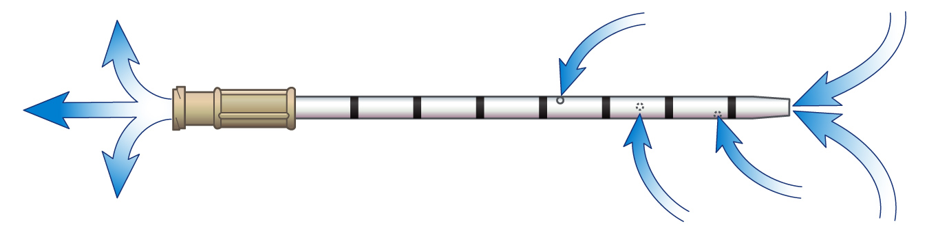
Objective 1: components and function
note air escaping from thoracic cavity
fenestrations improve air release
Notes:
10ga catheter with distal fenestrations (holes). The fenestrations provide a documented increase in opportunity for air outflow (when compared to a non-fenestrated 10ga or any type of 14ga catheter).

Slide 11
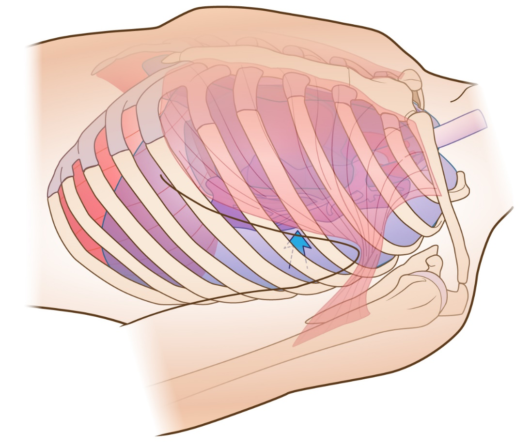
Objective 2: indication
tension pneumothorax:
a life-threatening emergency, which if left untreated,
may result in death.
left tension pneumothorax
Notes:
A tension pneumothorax is known to be a life-threatening emergency, which if left untreated, may result in death.
NOTE: Illustration depicts left lateral view of patient WITH left-sided tension pneumothorax.

Slide 12
Objective 2: indication
indications: consider treatment of tension pneumothorax
when one or more of the following are present:
severe or progressive respiratory distress
oxygen saturation less than 90%
shock (loss of radial pulse)
absent or markedly decreased breath sounds (if able to auscultate)
traumatic cardiac arrest without obvious fatal wounds (consider immediate placement of bilateral ENHANCED ARS™ decompression needles and consider ALL other possible causes)
Notes:
There are MANY reasons a tension pneumothorax may develop. These include both medical issues as well as trauma.
Indications: Treatment of a tension pneumothorax should be considered when one or more of the following are present:
Severe or progressive respiratory distress.
oxygen saturation less than 90%.
Shock.
Absent or markedly decreased breath sounds.
Traumatic cardiac arrest without obvious fatal wounds (consider immediate placement of bilateral ENHANCED ARS™ decompression needles and consider ALL other possible causes).

Slide 13
Objective 2: contraindications
contraindications: the ENHANCED ARS™ is not intended for treatment of simple pneumothorax or hemothorax
efficacy of the ENHANCED ARS™ has not been established in
pediatric patients
Notes:
Contraindications: The ENHANCED ARS™ is not intended for treatment of simple pneumothorax or hemothorax.
Efficacy of the ENHANCED ARS™ has not been established in pediatric patients.

Slide 14
Objective 2: therapeutic benefits
thoracic decompression should improve one or more of the following:
respiratory distress
relief of restrictive pressure between the parietal and visceral pleura (secondary to injury or significant medical complication)
oxygen saturation (≥ 90% may be dependent on use of supplemental oxygen)
return of radial pulse or vital signs
Notes:
thoracic decompression should improve one or more of the following:
Respiratory distress.
Relief of restrictive pressure between the parietal and visceral pleura (secondary to injury or significant medical complication).
Oxygen saturation (≥ 90% may be dependent on use of supplemental oxygen).
Return of radial pulse or vital signs.

Slide 15


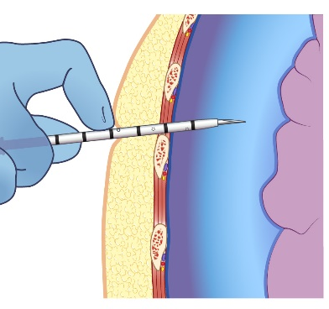
Objective 3: lateral insertion site
numbered
Intercostal
spaces
5
4
3
2
1
5
4
3
2
1
6
5
4
3
2
1
numbered ribs
6
5
4
3
2
1
*insertion site
is superior to targeted rib
to avoid neuro-vascular bundle
4th intercostal space - anterior axillary line
5th intercostal space - anterior axillary line
site located superior to 5th rib
site located superior to 6th rib
Notes:
Lateral land-marking for thoracic decompression is critical for patient safety.
Note that thoracic decompression may be relieved at either the 4th or 5th intercostal space (consult your protocol or standards for specific verification).
IMPORTANT POINT: The images presented on this slide depict intercostal spaces and ribs that are numbered for clinician clarification and discussion.
Providers MUST ensure proper land-marking prior to ENHANCED ARS™ insertion.
NOTE: Insertion site is superior to the rib that is initially targeted. THIS IS A CRITICAL STEP to ensure proper placement location, avoidance of neurovascular bundle beneath each rib, and represents a known, safe starting position, from which the provider can control precise placement and insertion depth.

Slide 16
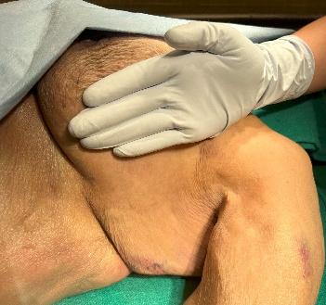
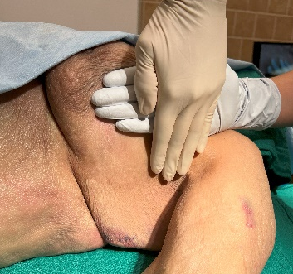
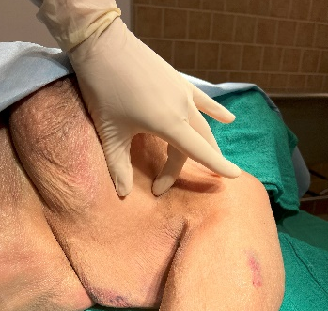

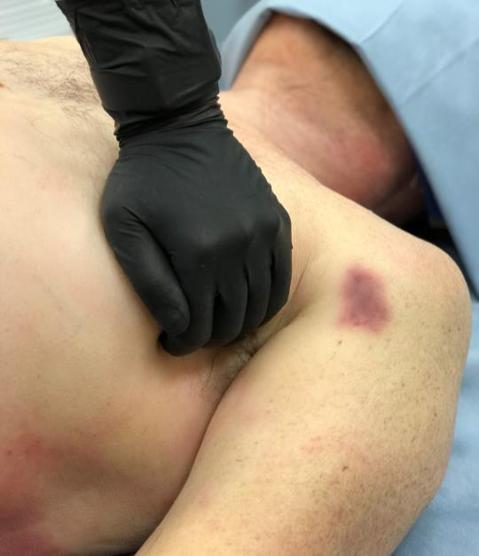

Objective 3: lateral insertion
insertion site
identification
move excess tissue
identify target region
frame insertion site
anterior-axillary
mid-axillary
4th ICS
posterior-axillary
safe zone
mark & cleans site
area over 4th & 5th
intercostal spaces
anterior axillary line
identify 4th or 5th intercostal space
5th ICS
insertion site between anterior and mid axillary lines
Notes:
The insertion sites commonly accepted for lateral decompression include the 4th or 5th intercostal space on the anterior axillary line (traditionally, insertion has also been viewed as acceptable between the anterior and midaxillary lines. Consult protocol or standards for verification).
Once site has been correctly identified, it should be thoroughly cleansed according to protocol and applicable standards of care.

Slide 17

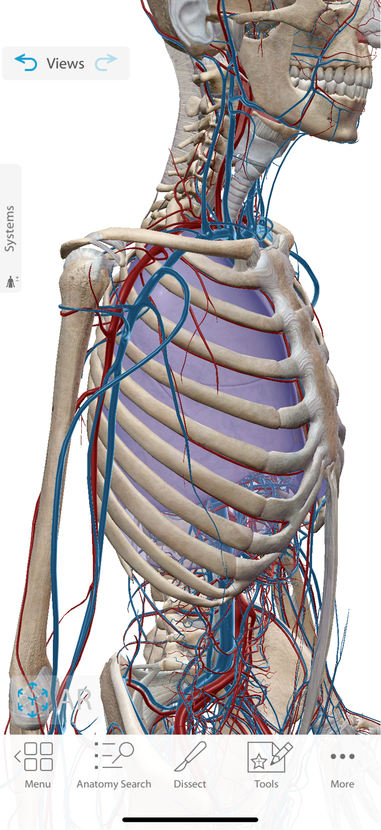
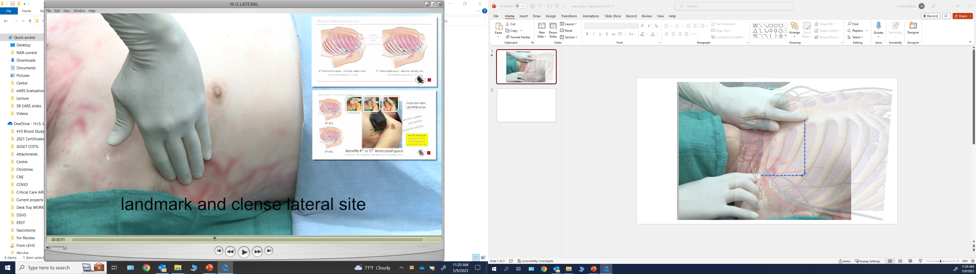
site verification
and framing
site reverification
identify target region
insertion site is superior to targeted rib
Objective 3: lateral insertion
Notes:
Once site has been properly cleansed, preparations for ENHANCED ARS™ insertion can be completed.
Note site “framing” and “reverification” in the image provided. Framing tightens the skin to improve penetration.
Site reverification (of the targeted rib) ensures that the ENHANCED ARS™ needle tip will FIRST be placed against the rib.

Slide 18
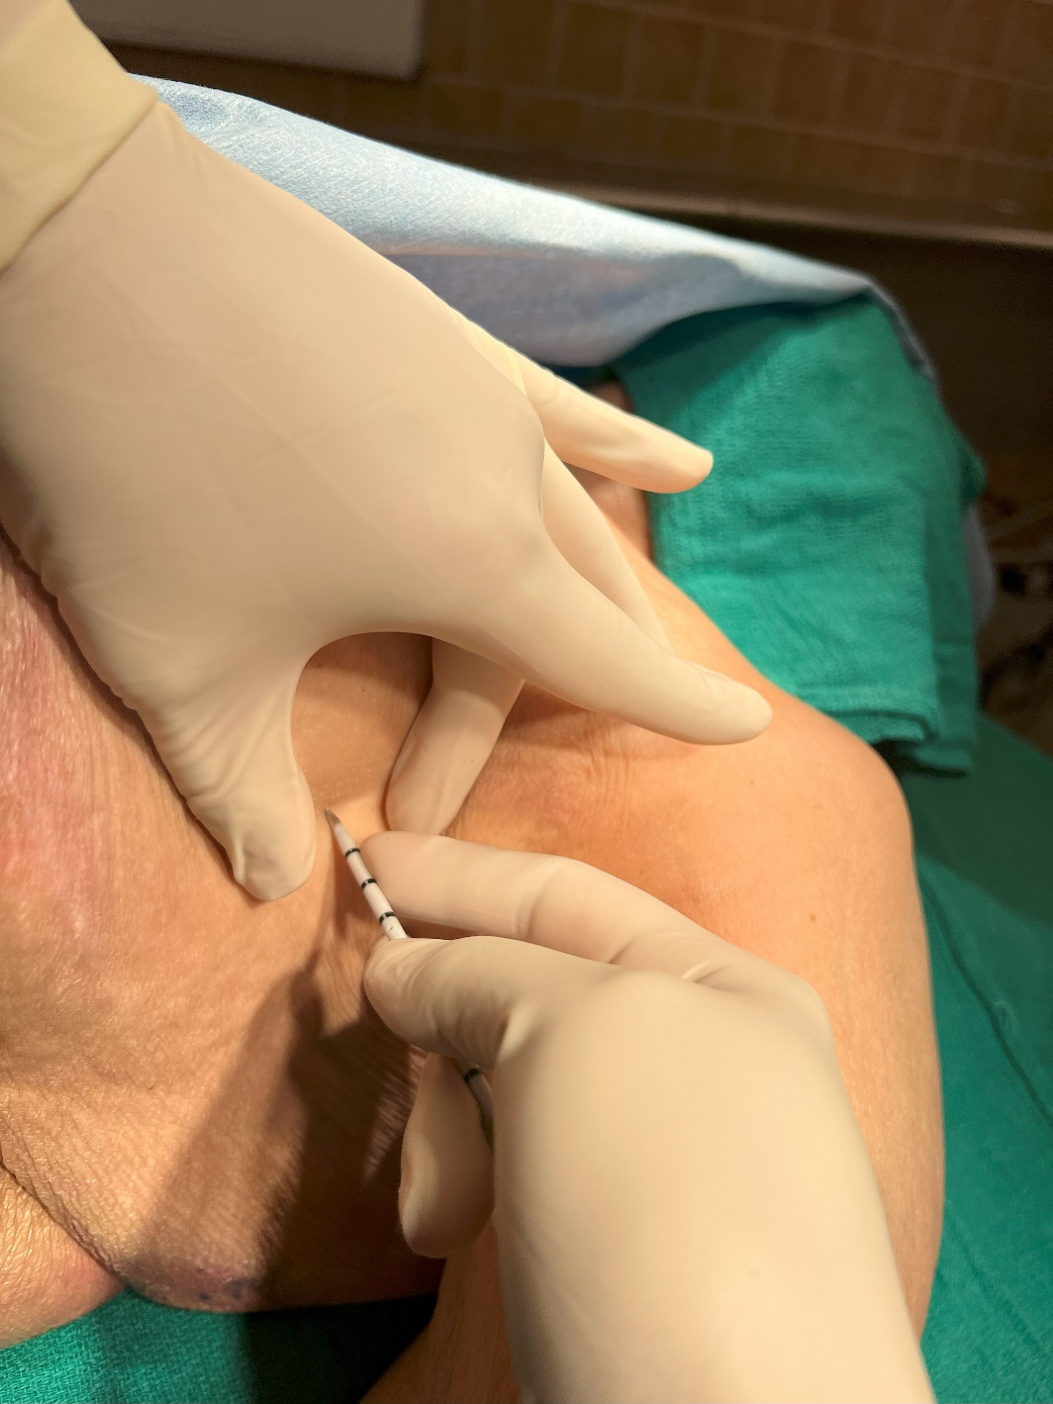
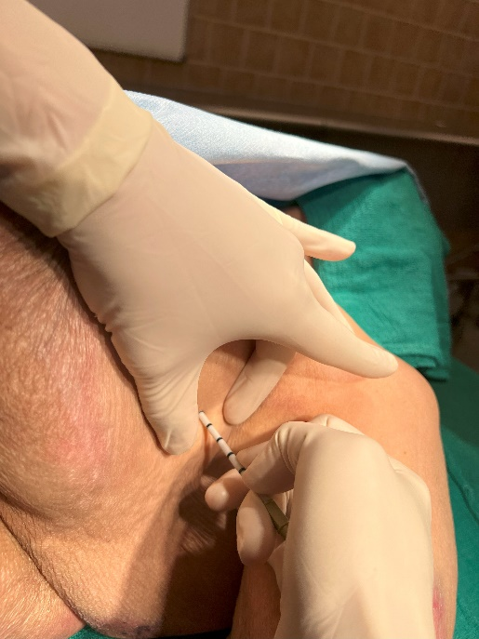

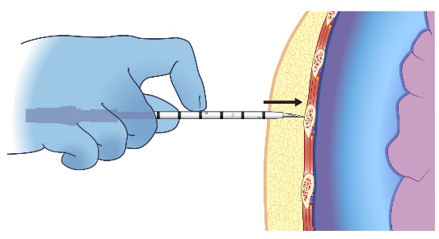
4th ICS
needle set stabilization improves precision placement and
depth control
5th ICS
Objective 3: lateral insertion
Notes:
Once site has been properly cleansed, preparations for ENHANCED ARS™ insertion can be completed.
Note site “framing” and “reverification” in the image provided. Framing (spreading the skin between two fingers) tightens the tissue to improve penetration.
Site reverification (of the targeted rib) ensures that the ENHANCED ARS™ needle tip will FIRST be placed against the rib.
Consider nicking skin with needle tip to ease ENHANCED ARS™ penetration through epidermis and dermis.

Slide 19
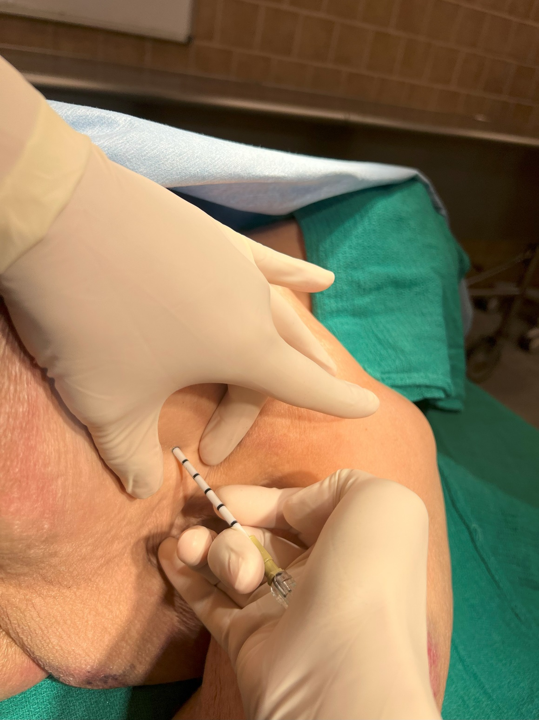
Objective 3: lateral insertion
insertion site
framing
consider nicking skin with needle tip
to ease ENHANCED ARS™ penetration
through epidermis and dermis
needle set must remain
perpendicular to chest wall
during insertion
insertion site is
superior to targeted rib
needle set stabilization
with fingertip depth control
hand stabilization
to prevent
needle/catheter separation
Notes:
Once the ENHANCED ARS™ has penetrated the skin and adipose tissue, it should be firmly placed against the rib (this is a critical identification step to ensure patient safety).
When the ENHANCED ARS™ needle tip has been placed against the targeted rib, the provider should MARK and HOLD 3 centimeters above the skin.
Depth marking is critical to the next phase of insertion (which is entry of the needle set within the pleural space).

Slide 20
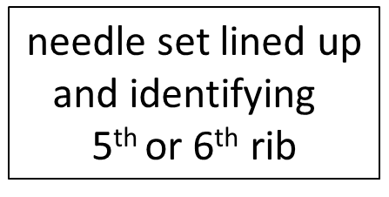

Objective 4: anterior insertion
needle set stabilization
with fingertip depth control
insertion site is
superior to targeted rib
Notes:
Illustration on this slide is for additional clarity of previous point.
Once the ENHANCED ARS™ has penetrated the skin and adipose tissue, it should be firmly placed against the rib (this is a critical identification step to ensure patient safety).
Once the ENHANCED ARS™ needle tip has been placed against the targeted rib, the provider should MARK and HOLD 3 centimeters above the skin.
Depth marking is critical to the next phase of insertion (which is entry of the needle set within the pleural space).

Slide 21
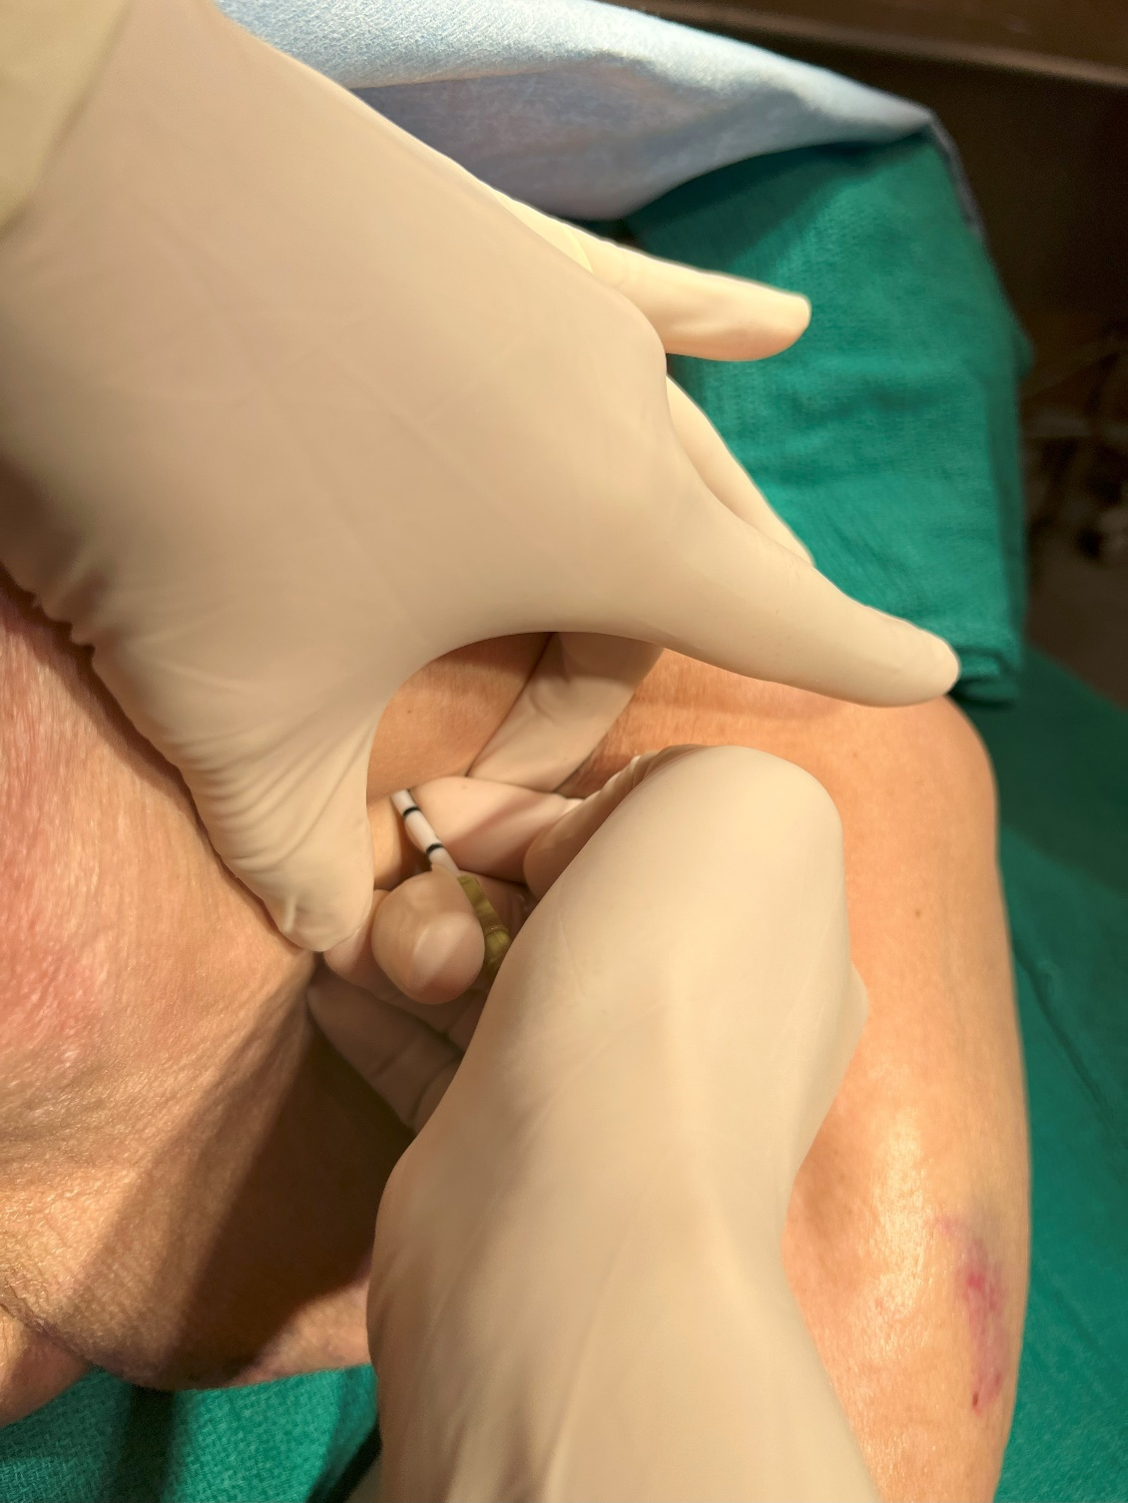
Objective 3: lateral insertion
needle set stabilization
with fingertip depth control
insert ENHANCED ARS™
superiorly
over targeted rib
insert 2 cm into pleural cavity
needle set must remain
perpendicular to chest wall
during insertion
KEY POINT:
stabilization and control
target rib and precisely
penetrate chest wall to
prevent further injury
DO NOT “BURY” OR “HUB”
NEEDLE SET
Notes:
With 3 centimeters identified, the provider must carefully move the ENHANCED ARS™ needle tip superiorly over the targeted rib and guide the assembly into the thoracic cavity. Images on this slide depict two methods. Note that each image in this slide demonstrates the ENHANCED ARS™ being advanced a specific distance with “fingertip control.”
This step is safely accomplished by pinning 3 centimeters above the tissue WHILE the needle tip is against the rib. Note that the provider ASSURES proper insertion depth is achieved (and NOT exceeded).
Critical Point: Ensure that ENHANCED ARS™ placement is accomplished with the needle set perpendicular to the thoracic wall.
It is well established that some experienced providers can appreciate (feel) needle set penetration of the parietal pleura (thus indicating the appropriate initial needle set penetration depth). Regardless of depth control method - DO NOT “BURY” or fully extend ANY decompression needle into the thoracic cavity.
*Air under pressure may release from the thoracic cavity at this point.

Slide 22

Objective 3: lateral insertion
KEY POINT:
stabilization and control
target rib and precisely
penetrate chest wall to
prevent further injury
insert ENHNACED ARS™ superiorly over targeted rib
insert 2 cm into pleural cavity
Notes:
The illustration on this slide is for additional clarity of previous point.
With 3 centimeters identified, the provider must carefully move the ENHANCED ARS™ needle tip superiorly over the targeted rib and guide the assembly into the thoracic cavity. Illustrations on this slide depict needle set entry over the targeted rib. Note that this image shows the ENHANCED ARS™ advanced the correct distance with “finger tip control.”
This step was safely accomplished by pinning 3 centimeter above the tissue WHILE the needle tip was against the rib. Note that the provider ASSURED proper insertion depth was achieved (and NOT exceeded).
Critical Point: Ensure that ENHANCED ARS™ placement is accomplished with the needle set perpendicular to the thoracic wall.
It is well understood and established that some experienced providers can appreciate needle set penetration of the parietal pleura (thus indicating appropriately achieved depth). Regardless of depth control method - DO NOT “BURY” or fully extend ANY decompression needle completely into the thoracic cavity.
*Air under pressure may release from the thoracic cavity at this point.

Slide 23
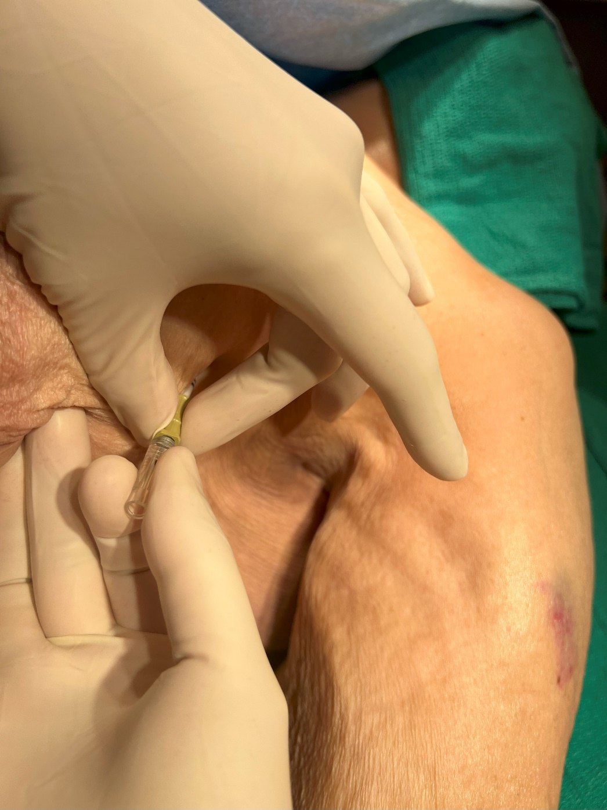
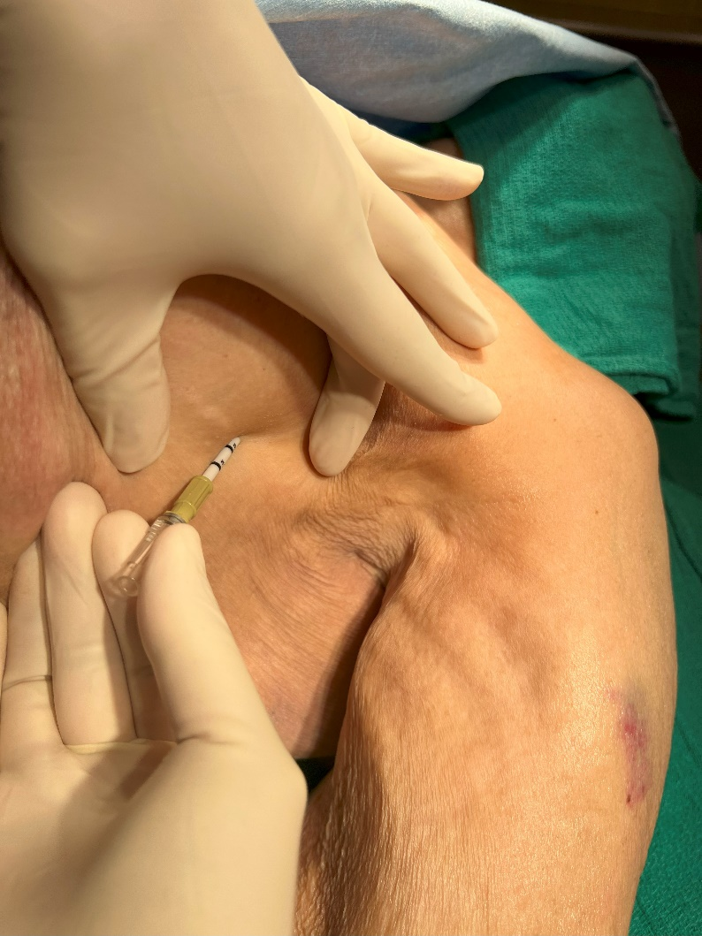

Objective 3: lateral insertion
thread catheter
into position
needle must
remain stationary
thread catheter
toward middle of clavicle
adjust needle set
angle cephalad
Notes:
Once the ENHANCED ARS™ has been placed into the thoracic cavity, DIRECT the assembly toward the middle of the clavicle.
Thread catheter into position, ensuring that the needle remains stationary.
*Air under pressure may release from the thoracic cavity at this point.

Slide 24
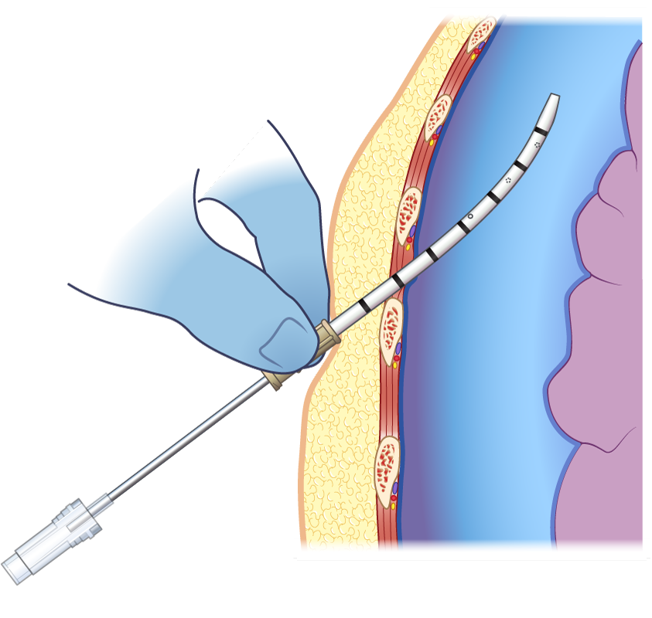
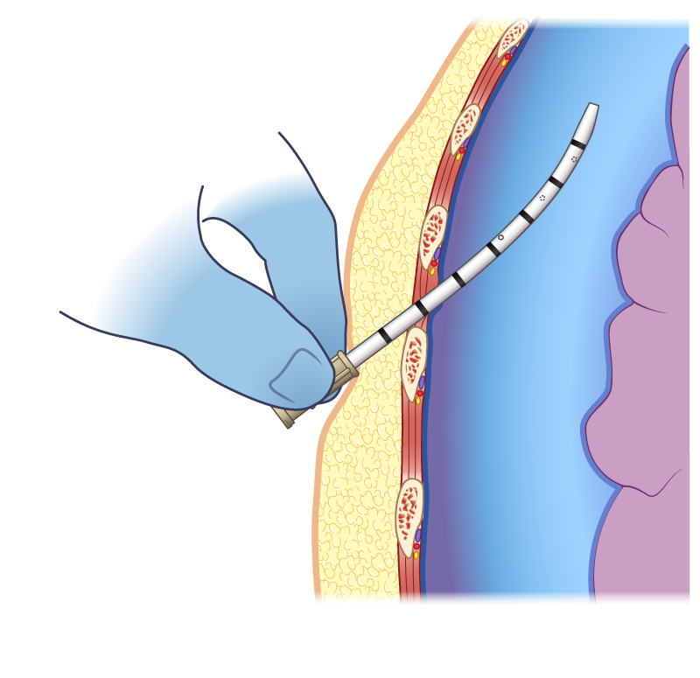
Objective 3: lateral insertion
completely thread catheter
into pleural cavity
thread catheter
toward middle of clavicle
advance catheter while maintaining
needle in stationary position
Notes:
The illustrations on this slide are for additional clarity of previous point.
Once catheter has been released from the needle, advance the catheter while keeping the needle stationary as a catheter guide.
*Air under pressure may release from the thoracic cavity at this point.

Slide 25

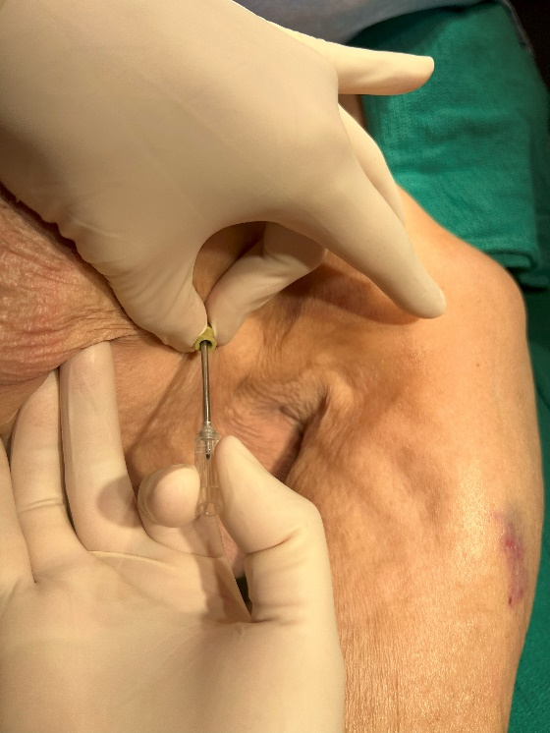
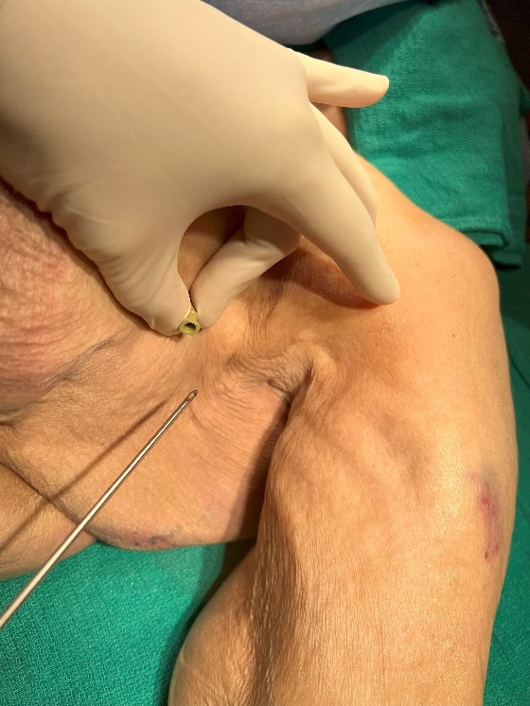
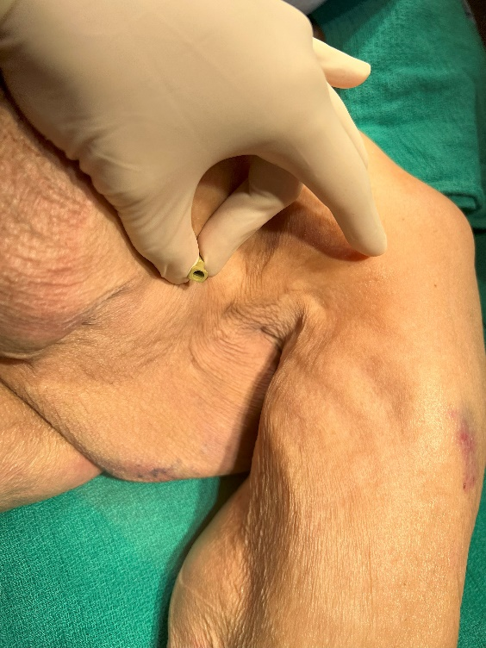

Objective 3: lateral insertion
advance catheter
completely
into pleural cavity
maintain needle in
stationary position
Notes:
The images on this slide are for additional clarity of previous point.
Advance the catheter completely into the pleural cavity.
Critical Point: Ensure that ENHANCED ARS™ placement is accomplished with the needle set perpendicular to the thoracic wall.
*Air under pressure may release from the thoracic cavity at this point.

Slide 26
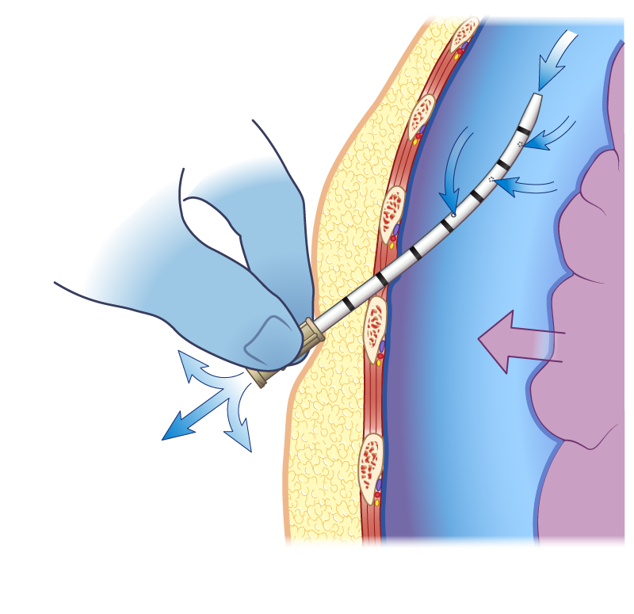
relief of tension
Notes:
The illustration on this slide is for additional clarity of previous point.
Secure the catheter according to local protocol and standards.
Monitor the patient.

Slide 27
Objective 5: indications of successful thoracic decompression
successful thoracic decompression may have occurred if one or more of the following is observed:
improvement of respiratory distress
relief of air from catheter
improvement of oxygen saturation (≥ 90% may be dependent on use of supplemental oxygen)
return of radial pulse or vital signs
Notes:
Successful thoracic decompression may have occurred if one or more of the following is observed:
Improvement of respiratory distress.
Relief of air from catheter.
Improvement of oxygen saturation (≥ 90% may be dependent on use of supplemental oxygen).
Return of radial pulse or vital signs.

Slide 28
Objective 6: complications
following thoracic decompression procedure, continually assess patient for complications:
hemodynamic instability
respiratory distress
unilateral chest expansion
decreased oxygen saturation
bleeding
catheter occlusion
hematoma
if two needle decompression attempts fail to relieve condition consider other causes and potential treatments
IS THIS A CIRCULATORY PROBLEM?
Notes:
A patient should be monitored following any medical procedure. Thoracic decompression (by definition) is a life-saving procedure that is NOT without risk.
With continuous training, as well as safeguards and careful considerations, patient and provider risk can be mitigated.
Following thoracic decompression, continually assess the patient for complications. These should include (but not be limited to):
Hemodynamic instability
Respiratory distress
Unilateral chest expansion
Decreased oxygen saturation
Bleeding
Catheter occlusion
Hematoma
If two needle decompression attempts fail to relieve the suspected problem consider other causes and potential treatments. IS THIS A CIRCULATORY PROBLEM?

Slide 29
Objective 6: complications
potential adverse complications: of improper thoracic decompression
death secondary to cardiac penetration
lung injury
vascular injury
nerve damage
  pain
  numbness
  paralysis of intercostal muscle
infection
Notes:
As with all invasive medical devices, potential adverse complications are a risk that MUST be considered. Most often, complications are the result of improperly performed interventions. Thoracic decompression is NOT WITHOUT RISK.
The FIRST step to avoiding injury is a complete understanding of the indications and contraindications for SPEAR™ usage. Each of the listed complications SHOULD be discussed WITH specific mitigation strategies integrated into the training program.
Complications are bolded in BLACK
Mitigation strategies presented in GRAY
Potential complications include (but are not limited to):
Death secondary to cardiac penetration (clinician should control thoracic penetration and restrict depth of needle set insertion)
Lung injury (insertion of needle set should be 2 cm past the parietal pleura)
Vascular injury (1. insertion site restrictions to the specific locations identified in this training program. 2. maintain proper needle set angle during insertion.
3. avoidance of needle set over penetration.
Nerve damage (ensure proper insertion site location “superior to targeted rib”)
Pain (if time permits, consider local anesthetic per protocol or standard)
Numbness (avoid insertion on the inferior aspect of the rib)
Paralysis of intercostal muscle (avoid insertion on the inferior aspect of the rib)
Infection (use aseptic technique)

Slide 30
Objective 7: scientific evidence
The ENHANCED ARS™ decompression needle system, and this presentation, were developed utilizing the latest published evidence, independent research, and the support of dedicated Military and Civilian medical professionals in Emergency Medicine, Trauma Surgery, Pulmonology, Radiology, and Pathology.
Clinical providers, regardless of their position, must dedicate themselves to the unrelenting truth that critical care is an evolution on behalf of those in need.
Butler F, Holcomb J, Shackelford S, et al. Management of the Suspected Tension Pneumothorax in Tactical Combat Care, TCCC Guidelines Change 17-02. J Spe Op Med. 2018; 18: 19-35.
*The aforementioned publication references ninety-six additional papers worthy of careful review.
Kruse A, Achay J, et al Cross-Over Study Comparing 14G and 10G Needle Decompression in a Cadaver Pneumothorax Model SOMA Training, Education & Scientific Assembly 2023, Presentation.
Notes:
The ENHANCED ARS™ decompression needle system, and this presentation, were developed utilizing the latest published evidence, independent research, and the support of dedicated Military and Civilian medical professionals in Emergency Medicine, Trauma Surgery, Pulmonology, Radiology, and Pathology.
Clinical providers, regardless of their position, must dedicate themselves to the unrelenting truth that critical care is an evolution on behalf of those in need.
Butler F, Holcomb J, Shackelford S, et al. Management of the Suspected Tension Pneumothorax in Tactical Combat Care, TCCC Guidelines Change 17-02. J Spe Op Med. 2018; 18: 19-35.
Kruse A, Achay J, et al Cross-Over Study Comparing 14G and 10G Needle Decompression in a Cadaver Pneumothorax Model SOMA Training, Education & Scientific Assembly 2023, Presentation.
*The aforementioned publication references ninety-six additional papers worthy of careful review.

Slide 31
Objective 7: scientific evidence
Nine Key Facets of Tactical Combat Care Guidelines Change 17-02
Continuation of aggressive approach to suspecting and treating tension pneumothorax
Emphasis of bilateral decompression in traumatic arrest
Addition of 10 Gauge catheter
Designates either Lateral or Anterior sites as acceptable for thoracic decompression
Addition of procedural elements (critical procedural differences are included within this material)
Defines successful thoracic decompression
Recommends ONLY two needle decompressions be attempted before moving on to circulation
Addition of materials that recommend consideration of tension pneumothorax in presentations of shock
Addition of finger thoracostomy (if presentation warrants - following two unsuccessful needle decompression attempts - and provider is trained)
Butler F, Holcomb J, Shackelford S, et al. Management of the Suspected Tension Pneumothorax in Tactical Combat Care, TCCC Guidelines Change 17-02. J Spe Op Med. 2018; 18: 19-35.
Notes:
There are nine Key Facets to thoracic decompression in the Tactical Combat Care Guidelines Change 17-02 that should be considered: Slide numbers correspond to Anterior Insertion Program
Continuation of aggressive approach to suspecting and treating tension pneumothorax.
There is discussion and some evidence that unwarranted needle decompressions have presented complications. While this is a valid concern, failure to recognize and treat tension pneumothorax remains a lethal reality.
Emphasis of bilateral decompression in traumatic arrest.
Failure to completely address ALL possible causes of traumatic arrest continues to present as a lethal concern.
Adds 10 Gauge.
Designates either Lateral or Anterior sites as acceptable for thoracic decompression.
Defines successful thoracic decompression.
Recommends ONLY two needle decompressions be attempted before moving on to circulation.
Addition of materials that recommend consideration of tension pneumothorax in presentations of shock.
Addition of finger thoracostomy when presentation warrants. Provider has attempted two needle decompressions without success and is authorized to perform procedure.

Slide 32

For additional information
about the ENHANCED ARS™
email: info@NARescue.com
Tel: 864.675.9800
Mail: 35 Tedwall Court
Greer, SC 29650-4791
Fax: 864.675.9880
Notes:
Thank you for participating in the ENHANCED ARS™ decompression needle system orientation and training.
If you have any questions, concerns or would like additional information please contact:
North American Rescue®, LLC
email: info@NARescue.com
Tel: 864.675.9800
Mail: 35 Tedwall Court
Greer, SC 29650-4791
Fax: 864.675.9880

