Slide 1
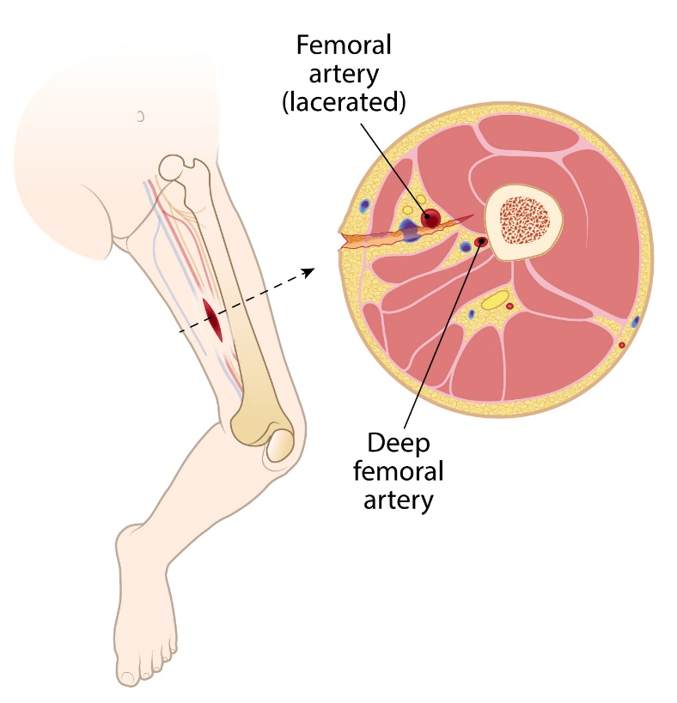
Direct
Pressure
Digital
Pressure
Wound
Packing
Pressure
Dressing
Tourniquet
Application
Small Limb Hemorrhage Control
REV 020720
Notes:
The following program was created specifically for orientation and training in the treatment and management of small limb (small extremity) hemorrhage (bleeding).
For questions, concerns or additional information please contact:
North American Rescue®, LLC
email: info@NARescue.com
Tel: 864.675.9800
Mail: 35 Tedwall Court
Greer, SC 29650-4791
Fax: 864.675.9880

Slide 2

Warranty: The proper use of hemorrhage (bleeding) control products necessitates reasonable familiarization and training. North American Rescue, LLC. warrants its hemorrhage control product line as merchantable expressly for the indications detailed. North American Rescue disclaims all other implied warranties relating to these products, to include use beyond their identified purpose, or when utilized by the untrained.
Notes:
Warranty: The proper use of hemorrhage control products necessitates reasonable familiarization and training.
“Reasonable” suggests some familiarity with anatomy and various medical supplies such that an end-user would be able to access and properly utilize select skills and products in an emergent setting.
Small extremities appear to challenge some laypeople and first responders who render care. This PERCEIVED difficulty (meaning unfounded, and not supported by scientific evidence) can occur regardless of the first responder’s position along the healthcare spectrum.
This program was designed to eliminate mystery, clarify issues, and offer evidenced based, scientifically supported solutions.
North American Rescue, LLC. warrants its hemorrhage control product line as merchantable expressly for the indications detailed. North American Rescue disclaims all other implied warranties relating to these products, to include use beyond their identified purpose, or when utilized by the untrained.
Training for bleeding emergencies is a nationally-recognized priority.
There are numerous websites available which contain helpful information. For example, consider visiting the American College of Surgeons website: www.bleedingcontrol.org
Participating in this bleeding management program, and then sharing the information - WILL SAVE LIVES. PLEASE PASS THIS INFORMATION TO OTHERS!
North American Rescue, LLC. offers this program (and many others) to eliminate misunderstanding and prepare tomorrow’s responders.

Slide 3
The following materials were developed for the purpose of hemorrhage control
(bleeding management) education and training when presented with small limbs.
Key Terms: Small Limb, Direct Pressure, Digital Pressure, Wound Packing, Pressure Bandage, Tourniquet.
Indication: Hemorrhage control is indicated anytime continuous blood flow is observed from a wound.
Contraindications: There are no contraindications for hemorrhage control.
Warning: Failure to properly manage severe bleeding may lead to further injury, infection, or death.
Consider visiting this helpful website: https://www.bleedingcontrol.org/
Notes:
Key Terms:
Small Limb – Any extremity that appears to be smaller than an average-sized adult. This may include a newborn, infant, toddler, preschooler, adolescent or teen, small adult, or the elderly.
Direct Pressure – The pressure placed directly on a wound to stop minimal bleeding, cover the injury, and prevent further contamination.
Digital Pressure – Generally implies physical entry (or specifically directed pressure) into a wound with fingertip(s) compressing a bleeding vessel directly against a bone.
Wound Packing – A method or process that places sterile material (known as dressing) directly into a wound cavity (or wound bowl). Wound packing (with and without hemostatic impregnated gauze) targets bleeding vessels AND MUST completely fill the void. Packing is specifically intended to maintain pressure on disrupted tissues and vessels.
Pressure Bandage – An elastic bandage that is circumferentially wrapped around an extremity to maintain pressure on the wound AND hold dressings in position.
Tourniquet – Designed and applied to specifically STOP ALL BLOOD FLOW below its application site.
Indication: Hemorrhage control is indicated anytime continuous blood flow is observed from a wound.
Contraindications: There are no contraindications for hemorrhage control.
Warning: Failure to properly manage severe bleeding may lead to further injury, infection, or death.

Slide 4
Objectives
At the conclusion of this didactic and recommended hands-on training session, you should be able to:
List five established methods to control hemorrhage.
Describe small limb anatomy and related challenges to hemorrhage control.
Discuss and demonstrate direct pressure for minimal bleeding.
Discuss and demonstrate digital pressure for hemorrhage control.
Discuss and demonstrate wound packing for hemorrhage control.
Discuss and demonstrate use of a pressure bandage for hemorrhage control.
Discuss and demonstrate tourniquet usage for hemorrhage control.
Shown in two locations:
Junctional
Extremity
“Uncontrolled bleeding is the number one cause of preventable death from trauma. The greater the number of people who know how to control bleeding in an
injured patient, the greater the chances a victim has of surviving that injury.” Pons PT, Jacobs L. (2017.) What everyone should know to stop bleeding after an injury.
BleedingControl.org. Retrieved from www.bleedingcontrol.org/~/media/bleedingcontrol/files/stop%20the%20bleed%20booklet.ashx.
Notes:
Objectives:
At the conclusion of this didactic and recommended hands-on training session, you should be able to:
List five established methods to control hemorrhage.
Describe small limb anatomy and related challenges to hemorrhage control.
Discuss and demonstrate direct pressure for minimal bleeding.
Discuss and demonstrate digital pressure for hemorrhage control.
Discuss and demonstrate wound packing for hemorrhage control.
Discuss and demonstrate use of a pressure bandage for hemorrhage control.
Discuss and demonstrate tourniquet usage for hemorrhage control.
Note: Objectives four and five discuss and demonstrate bleeding control for TWO locations Junctional and Extremity.

Slide 5
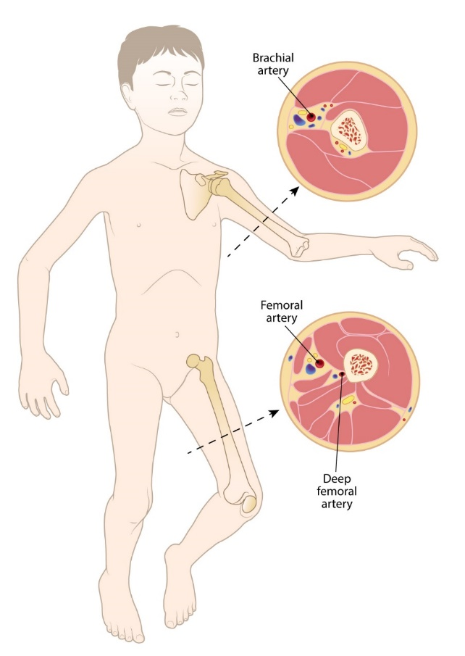
Objective 1: List five established methods to control hemorrhage.
Direct pressure: Application of dressing material and pressure directly on a wound (for minimal bleeding).
Digital pressure: Identification (visual or tactile) of bleeding vessel(s) with fingertip(s) pressing vessel(s) against the bone (for moderate to severe bleeding).
Wound packing: In conjunction with digital pressure, dressing material is systematically placed under fingertip(s) into wound cavity. Packing of wound is complete when cavity is entirely full (for moderate to severe bleeding).
Pressure bandage: Applied in conjunction with dressing or wound packing material, to maintain pressure on injury site (for moderate to severe bleeding).
Tourniquet: Applied to eliminate ALL extremity circulation (for life-threatening bleeding).
Junctional
bleeding
Extremity
bleeding
Junctional and extremity bleeding
Notes:
Objective 1: List five established methods to control hemorrhage.
Note : This illustration begins the conversation regarding differences between Junctional and Extremity bleeding control.
There are five established, evidenced based methods to control bleeding discussed and demonstrated within this program.
Direct pressure: Application of dressing material and pressure directly on a wound (for minimal bleeding).
Digital pressure: Identification of bleeding vessel(s) (accomplished visually and deliberately {see and compress}, or tactilely / blindly {feel for and compress anything wet and warm}) with fingertip(s) pressing bleeding vessel(s) against the bone (for moderate to severe bleeding).
Wound packing: In conjunction with digital pressure, is the methodical process of placing dressing material systematically under finger-tip(s) into, and then completely filling, a wound cavity. Packing of wound is complete - ONLY - when the cavity is entirely full (for moderate to severe bleeding).
Pressure bandage: Applied, in conjunction with dressing or wound packing material, to maintain pressure on injury site and hold would packing in position. (for moderate to severe bleeding)
Tourniquet: Applied to eliminate ALL circulation to an extremity (for life-threating bleeding).

Slide 6
Small Limb Anatomy
Notes:
Introduction to small limb anatomy.
The following section is the CORNERSTONE for this program. Understanding the scientific reality of small limb related anatomy, various types of injuries, and their management, is critical to saving lives.
Folklore and baseless information are some of the biggest challenges to bleeding management. These challenges can be overcome with scientific evidence and training.
In the next few slides we will explore the anatomy of small extremities (as well as junctional bleeding) and begin the process of truly understanding hemorrhage control.

Slide 7
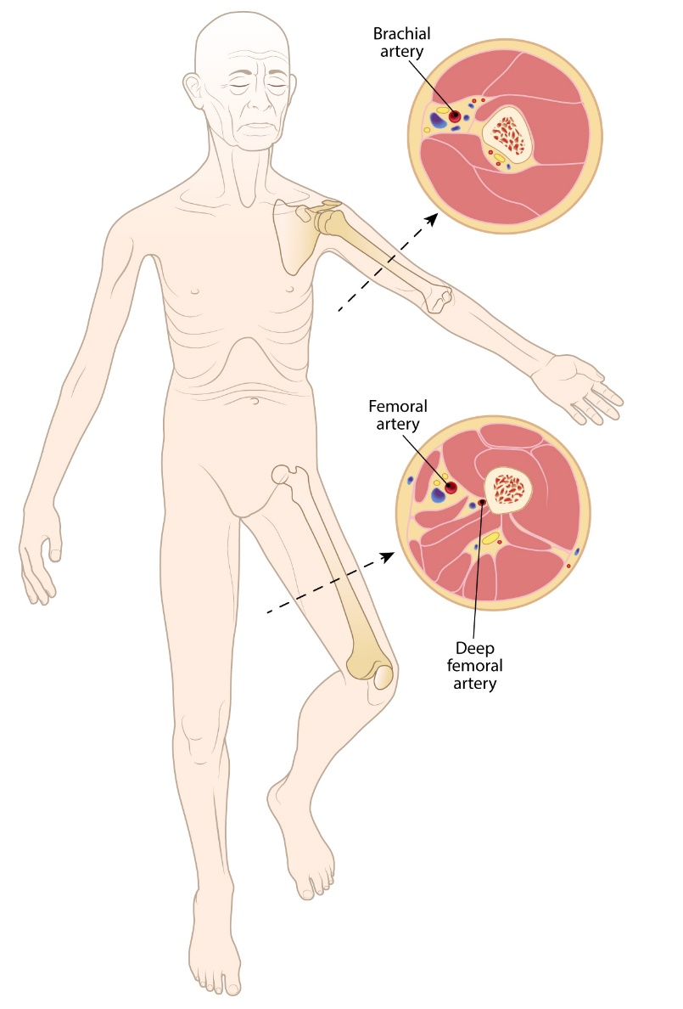
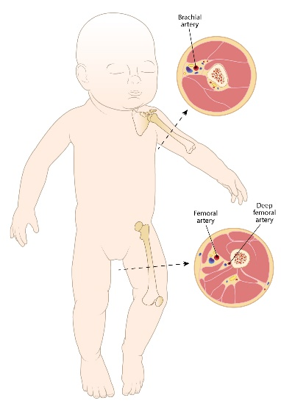
Objective 2: Describe small limb anatomy and related challenges to hemorrhage control.
Small limbs are present in every age group and may present hemorrhage control challenges for the untrained.
Vascular structures of the extremities
are in the same locations
regardless of age or size.
Infant
Child
Elderly
Stopping blood flow on a smaller patient is critical! Let’s look at science and solutions in the following slides!
Notes:
Small limbs are present in every age group.
Smaller patient sizes can present perceived challenges for the untrained. This is because select bleeding supplies appear to be designed or intended for the adult of average size.
Knowing if the challenge is actual or imagined will eliminate barriers and complications with the management of bleeding emergencies.
Importantly, most bleeding control supplies WILL work on smaller patients.
Helpful scientific reality: Younger patients have lower intrinsic blood pressures – which (fortunately) means it takes LESS EFFORT to control their bleeding.
On rare occasions, one may need to modify the application of certain supplies to control bleeding, but this is in fact rare, and would likely only be necessary for patients considered “newborn” in size.
This program is designed to explain and train bleeding management techniques for those who may encounter small extremities.
KEY POINT: Vascular structures of the extremities are in the same locations regardless of a patient’s age or size.
FACT: Published evidence demonstrates that standard bleeding supplies (carried by US Armed Forces and their allies) have been effective in the treatment of injured children. Harcke HT et al

Slide 8

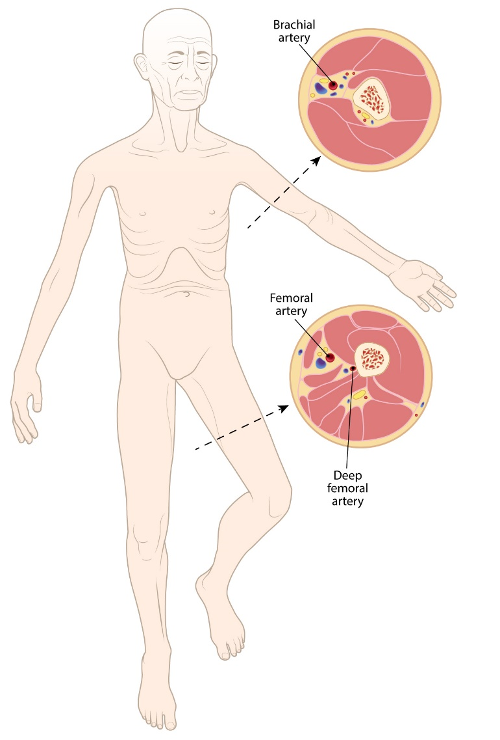
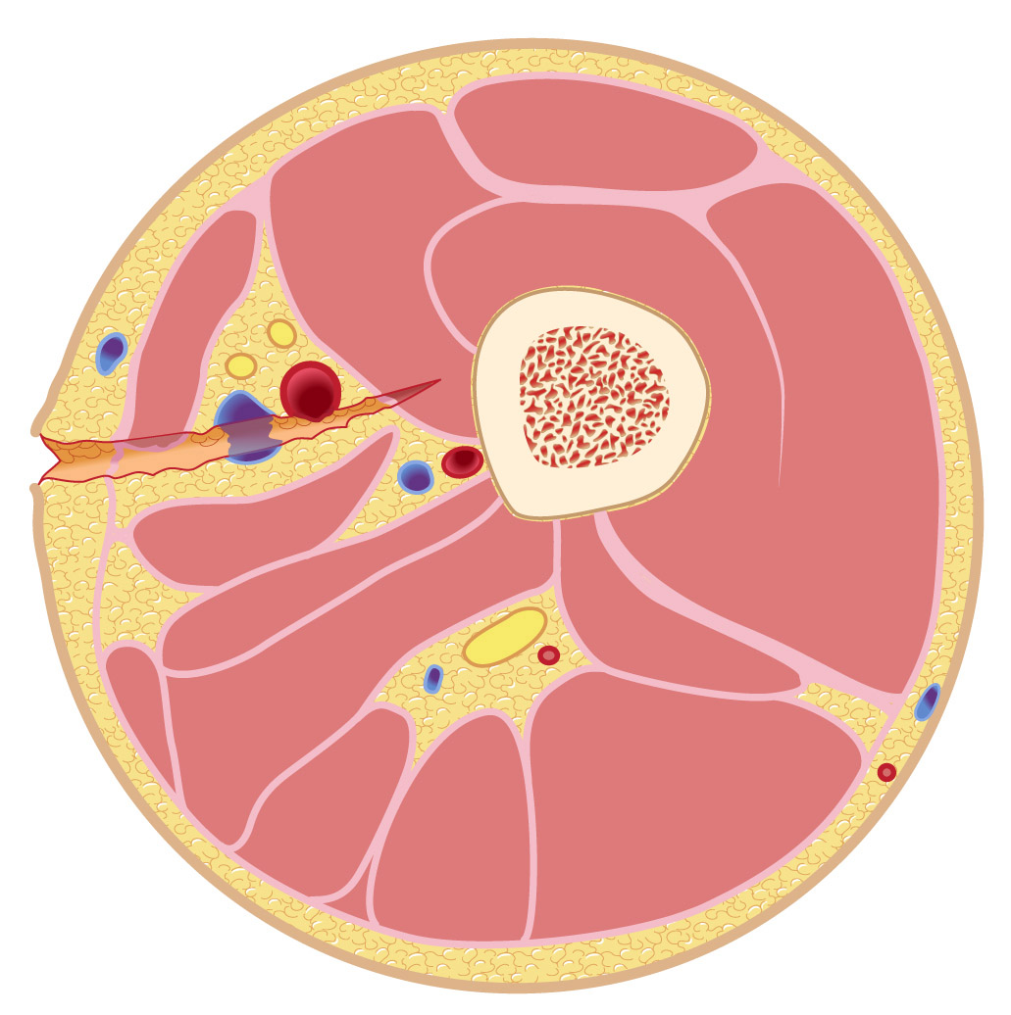
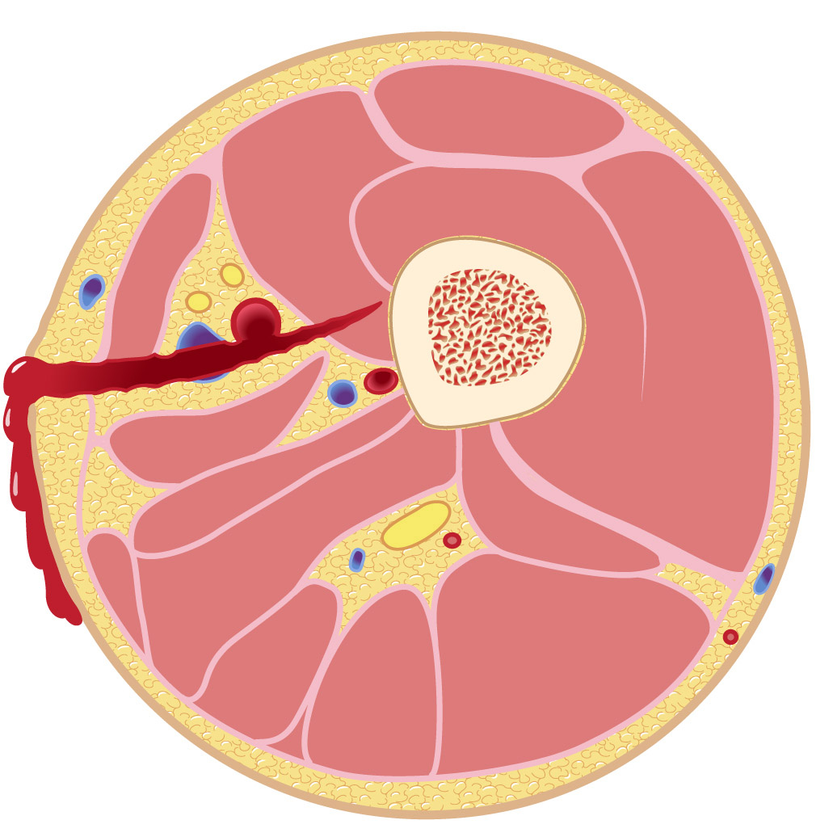

Objective 2: Describe small limb anatomy and related challenges to hemorrhage control.
Infant
Child
Elderly
Significant vascular injury requiring compression for hemorrhage control
Regardless of age or size, our goal is to stop the bleed!
Notes:
This slide begins the conversation that small limbs are present in every age group.
Note the mid-shaft femur (transverse) illustration on the right. This illustration depicts a significant injury that involves multiple tissue layers (containing small blood vessels) as well as large vessels. This injury would be life-threating without proper management.
KEY POINT: Regardless of age or size our goal must be to STOP THE BLEED.

Slide 9


Objective 2: Describe small limb anatomy and related challenges to hemorrhage control.
Let’s look at this child for example
An injury like this would require specific and immediate action.
To stop the bleed we must compress bleeding structures against a bone!
Notes:
Let’s use an elementary school age child as an example (for the purpose of this discussion, our illustration depicts a six years old child within the 50th percentile for height and weight).
KEY POINT: TO STOP THE BLEED, we need to firmly compress bleeding vessels against a solid structure (bone).

Slide 10
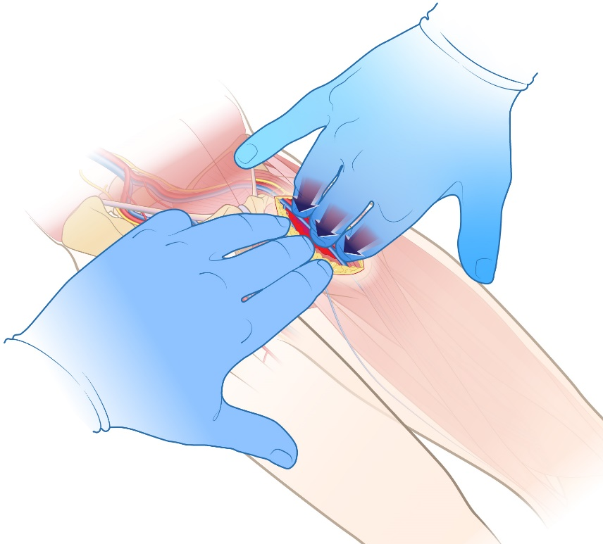
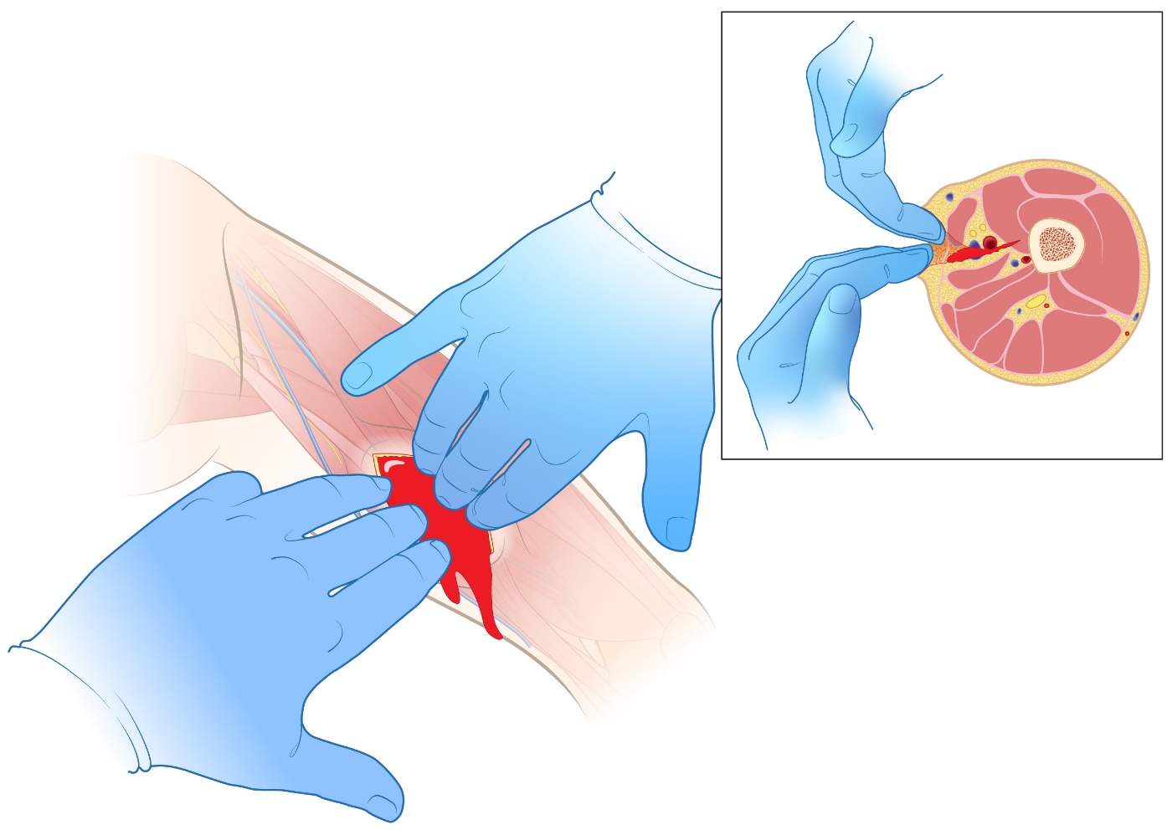
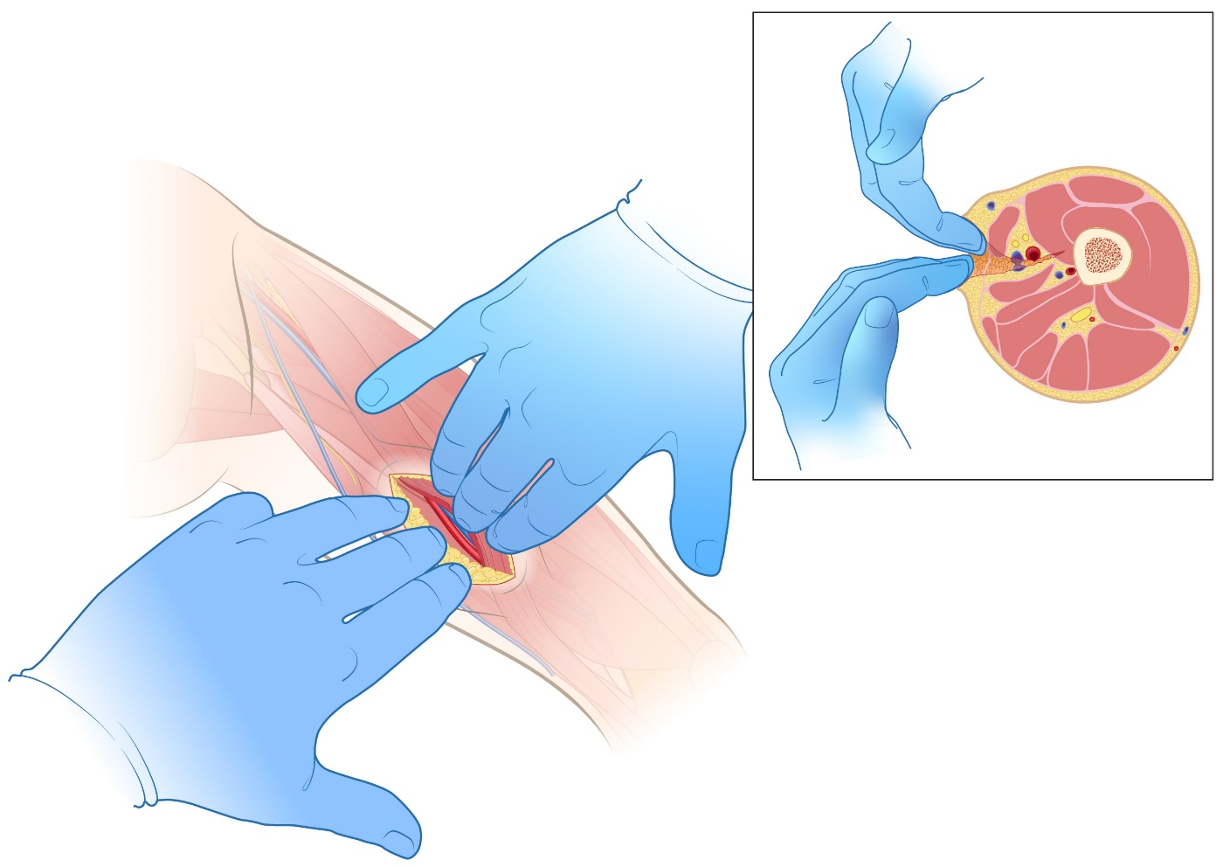
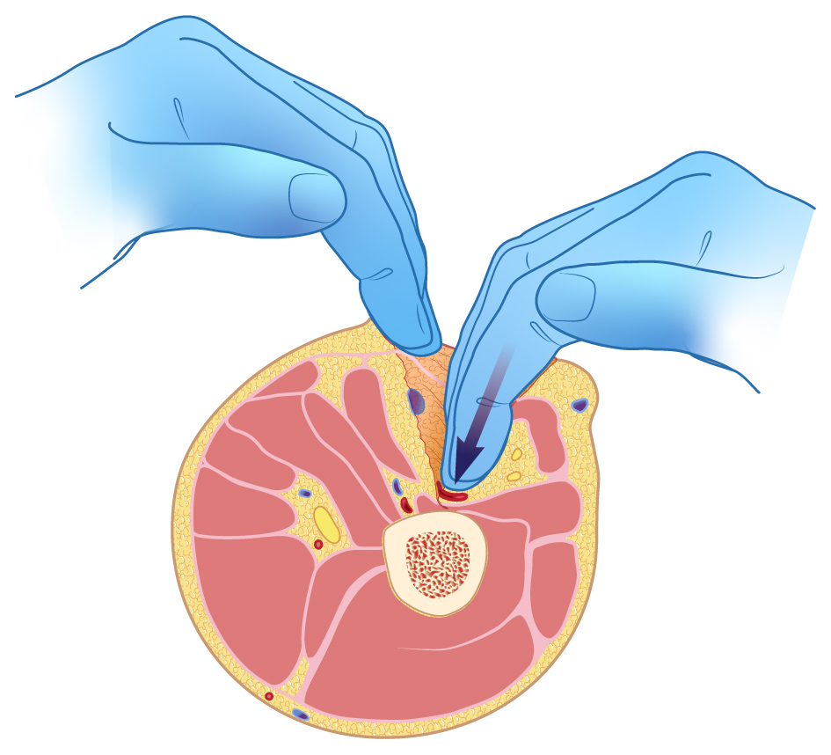
Objective 2: Describe small limb anatomy and related challenges to hemorrhage control.
Ensure your safety
2. Compress the bleeding vessels
against bone
All bleeding control begins with
two simple steps.
1. Identify the source
of bleeding
Significant vascular injury requiring compression for hemorrhage control.
There are multiple methods to stop bleeding from small limbs! Let’s look at each proven method.
Notes:
All life-threating situations, where bleeding control IS THE primary problem, are accomplished by:
Ensuring your safety (safe place, safe practice. Example: quickly move to a safe location and wear gloves and eye protection if available).
Rapidly identifying the source of bleeding.
Immediately compressing the bleeding vessels against a bone.
The American College of Surgeons has adopted the “ABC Approach” for their national Stop The Bleed efforts.
A. Alert 911
B. Identify Bleeding
C. Compress bleeding
Let’s look at the following material (in each specific section of this program) to fully understand how common sense and training, in concert with certain medical supplies, can SAVE LIVES.

Slide 11
Direct pressure
Notes:
The following slides discuss direct pressure.
Direct pressure is often used to stop minimal bleeding and to prevent further wound contamination.
Minor wounds that exhibit minimal bleeding, which can be controlled with direct pressure (meaning that the wound STOPS actively bleeding), may STILL need evaluation and care by medical professionals.
Superficial wounds, while potentially serious, may exhibit significant disruption of tissue but DO NOT profusely or continuously bleed. This is because the injury does NOT involve large blood vessels.
KEY POINT: Superficial wound bleeding does NOT exhibit spurting or heavy flow. These injuries generally stop bleeding within 3-5 minutes from the application of direct pressure (for patients who do not take anticoagulants or have bleeding disorders).
CAUTION: A wound that initially appears superficial, yet exhibits spurting, heavy flow, or causes immediate swelling within the extremity, IS NOT superficial.

Slide 12
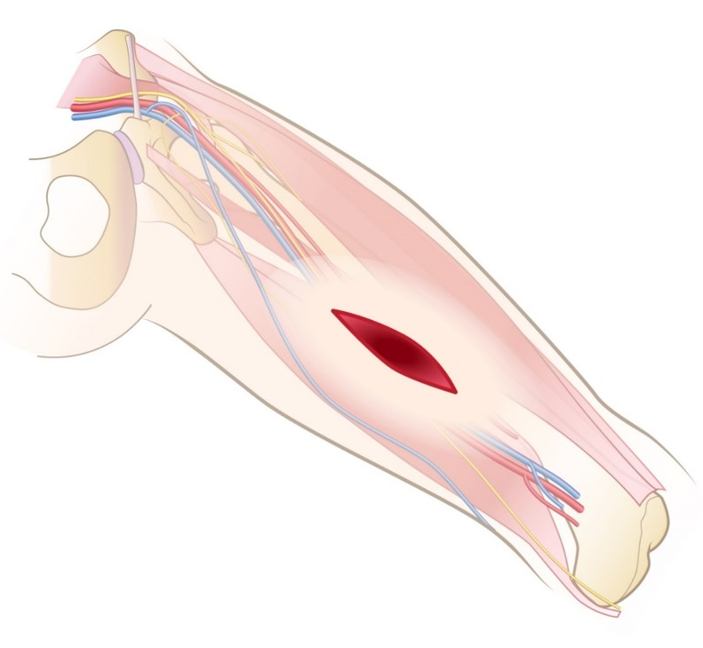
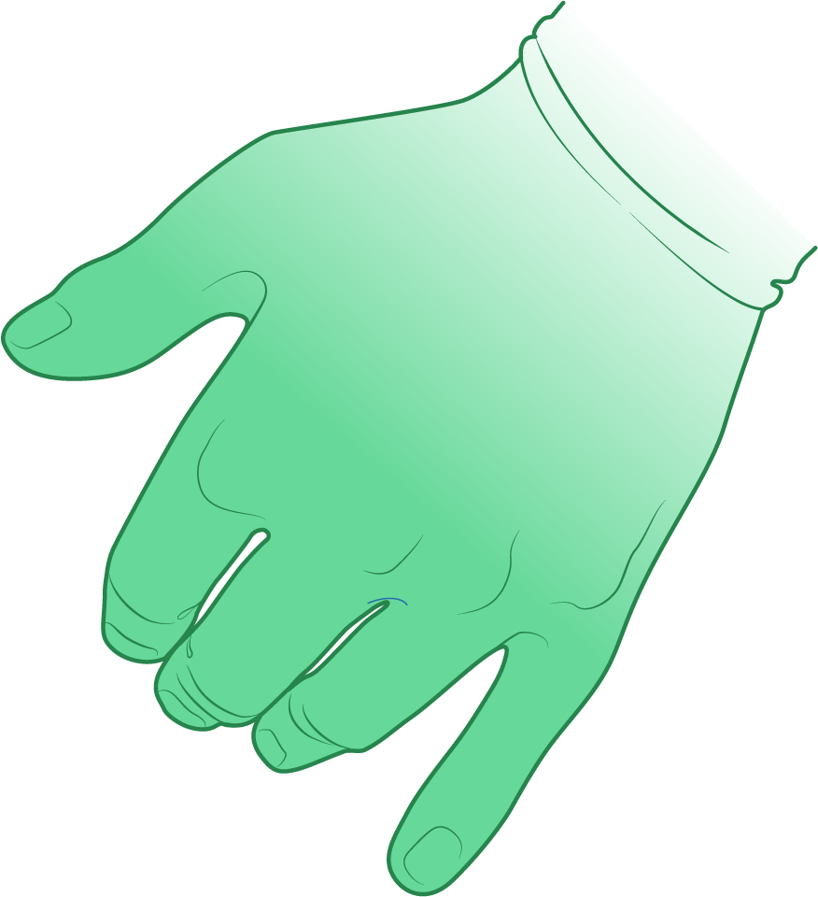

Objective 3: Discuss and demonstrate direct pressure for minimal bleeding.
At times minimal lacerations
may need some attention.
Place gauze (dressings)
directly on wound.
Hold direct pressure on the site until bleeding stops.
Seek medical advice.
Hold pressure in direction of bone.
Notes:
Superficial lacerations (wounds that DO NOT exhibit continues blood flow, spurting, or immediate swelling) may still require professional attention.
Note that sterile dressings (4x4s for example) are placed directly onto a superficial wound. The dressing should be accompanied by direct pressure (shown here with a gloved hand). This can be followed by a pressure bandage (to hold the dressing in position) relieving the provider for other responsibilities.
KEY POINTS:
By placing sterile dressings directly on the wound, you will help prevent further wound contamination and possibly infection.
By holding direct pressure on the sterile dressings, you should be able to easily control minimal bleeding.
IMPORTANT: Bleeding that soaks a dressing or continues, even with direct pressure, REQUIRES more aggressive management (techniques for managing significant injuries are described in the materials that follow).
Again: Superficial wound bleeding does NOT exhibit spurting or heavy flow. These injuries generally stop bleeding within 3-5 minutes from the application of direct pressure (for patients who do not take anticoagulants or have bleeding disorders).
CAUTION: A wound that initially appears superficial, yet exhibits spurting, heavy flow, or causes immediate swelling within the extremity, IS NOT superficial and requires more aggressive management.

Slide 13
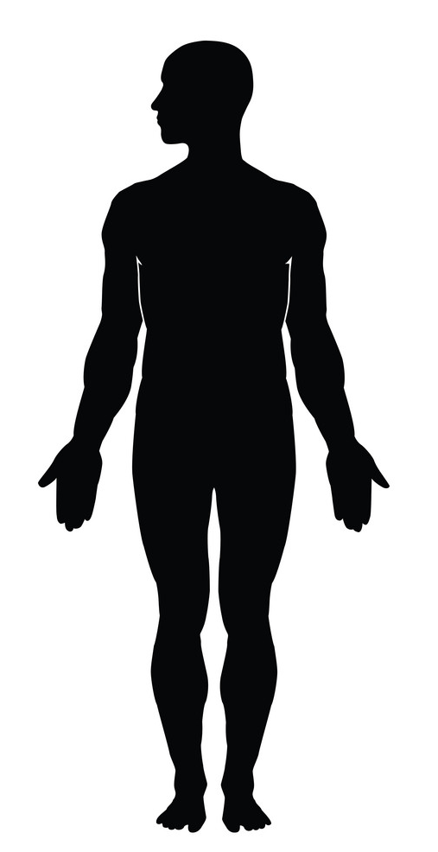
Digital Hemorrhage Control
Shown in two locations:
Junctional
Extremity
Notes:
The following slides discuss digital (fingertip) hemorrhage control.
Digital hemorrhage control is used to immediately stop potentially life-threatening bleeding by directly compressing large vessels against bone.
If there is ANY DOUBT (and the wound is on an extremity), attempt to control the bleeding WHILE simultaneously AND immediately placing and a tourniquet above the injury.
The following slides will discuss digital control of junctional and extremity wounds.
Discuss the difference between junctional and extremity locations as well as WHY bleeding control for these two regions can be markedly different.
Junctional: (specific locations, directly between the body and the extremities, where large vessels pass through a limited amount of space) requiring digital and wound packing control (because a tourniquet cannot be applied to these regions).
Extremity (arms and legs) requiring direct pressure and an immediate tourniquet (or, with digital pressure, wound packing and pressure dressing if wound is easily controllable).
KEY POINT: Life-threatening bleeding may (or may not) exhibit spurting or heavy flow. These injuries may not stop bleeding with attempts to digitally compress the vessels. These wounds (if on an extremity) likely require a tourniquet.

Slide 14
Let’s start with junctional bleeding
Notes:
Let’s begin with junctional bleeding control.
KEY POINT: Life-threatening bleeding may (or may not) exhibit spurting or heavy flow. These injuries may not stop bleeding with attempts to digitally compress the vessels.
If the wound is located within the junctional region (neck, armpit or groin), you will need to aggressively pack the injury AND maintain firm pressure over the site.

Slide 15
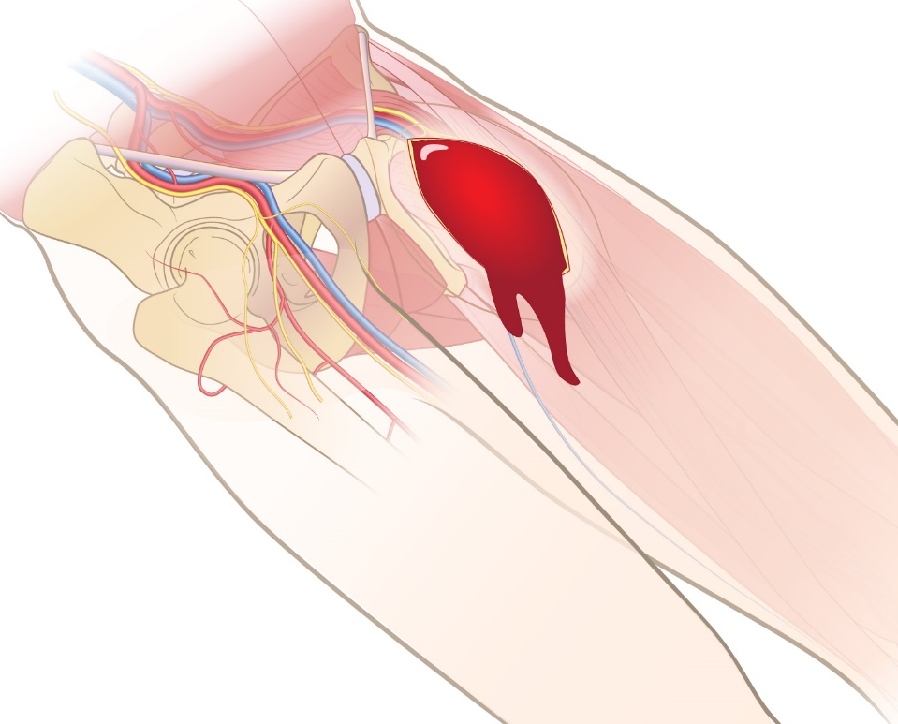
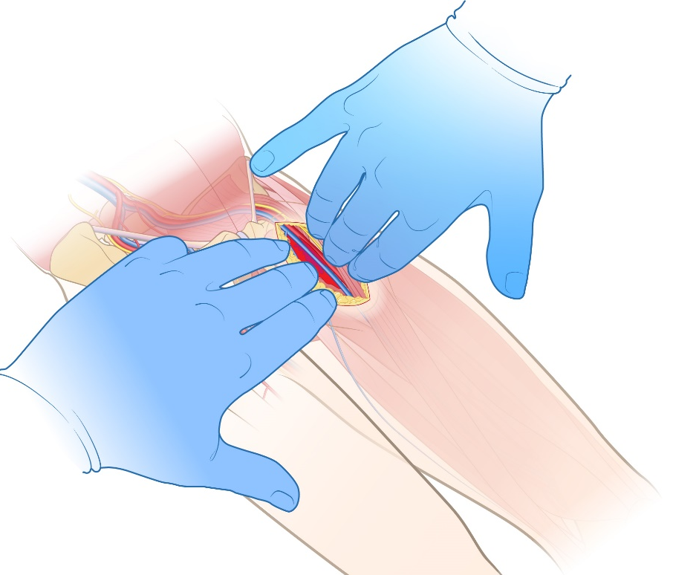
Objective 4: Discuss and demonstrate digital pressure for hemorrhage control. (junctional)
Compress vessels
against bone
1. Identify bleeding
2. Compress vessels
against bone
It may be necessary to
“sweep blood out of the way”
Open wound if able
Important: Serious injuries may occur in locations where tourniquets cannot be applied.
In these situations initial digital control may be YOUR ONLY OPTION.
Compress bleeding vascular structures against bone regardless of age or size.
Notes:
This slide discusses digital hemorrhage control of junctional injuries. These are injuries that may include the groin (depicted here), the armpit or neck (not shown).
Important: Serious injuries may occur in locations where tourniquets cannot be applied. In these situations, initial digital control (and aggressive wound packing) may be YOUR ONLY OPTIONS.
It may be necessary to “sweep” blood out of the wound in order to momentarily see the source of bleeding.
It may be necessary to manually open (spread apart) the wound to both visualize and gain access to the injured vessels.
Once bleeding vessels are identified, compress them directly against the bony structures of the leg or pelvis (or arm and torso if an upper extremity, or spinal column if junctional injury is on the neck).
KEY POINT: Significant wound bleeding may exhibit spurting or heavy flow. These injuries may not stop bleeding with direct pressure – and - likely require digital pressure and aggressive wound packing (again, because a tourniquet cannot be applied in these areas).

Slide 16
Let’s take care of extremity bleeding
Notes:
The following slides will discuss digital hemorrhage control of extremity injuries.
KEY POINT: Life-threatening bleeding may (or may not) exhibit spurting or heavy flow. These injuries might not stop bleeding with attempts to digitally compress the vessels and may be difficult to control.
If the injury presents on an extremity it might be safer to immediately apply a tourniquet (and then reevaluate the situation).

Slide 17
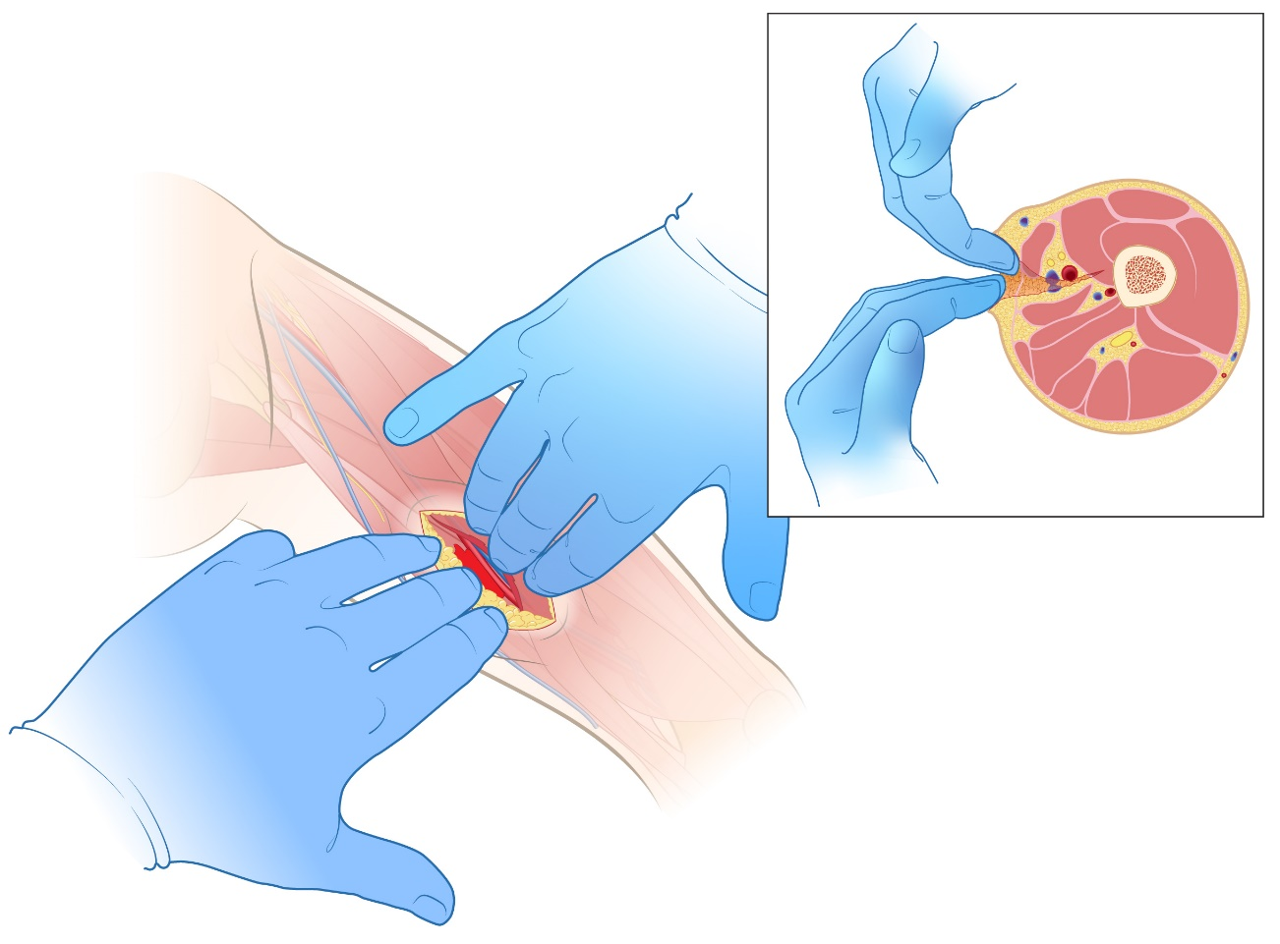
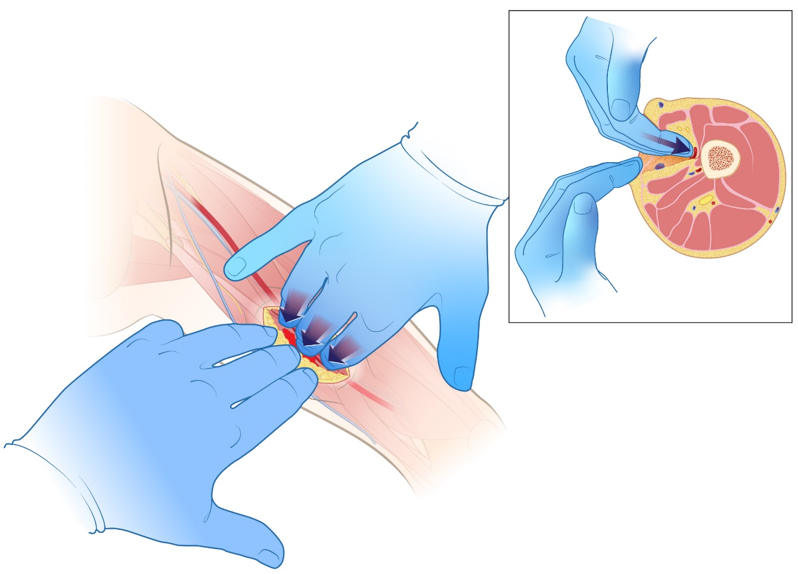
Objective 4: Discuss and demonstrate digital pressure for hemorrhage control. (extremity)
It may be necessary to
“sweep blood out of the way”
1. Identify bleeding
2. Compress vessels against bone
Open wound
Compress bleeding vascular structures against bone regardless of age or size.
Notes:
This slide discusses digital control of extremity injuries. These injuries may include the leg (shown here) or the arm (not shown).
Important: Serious injuries may occur in locations where tourniquets can, and likely should, be applied. In these situations it may be life-saving to first apply a tourniquet and then consider other options.
It may be necessary to “sweep blood out of the wound” in order in momentarily identify the source of bleeding.
It may also be necessary to manually open the wound to visualize and gain access to the injured vessel(s).
Once the bleeding vessel(s) are identified, compress them directly against the bony structures of the leg (or arm).
KEY POINT: Significant wound bleeding may exhibit spurting or heavy flow. These injuries may not stop bleeding with direct pressure and will likely require digital control of the vessel(s). Even with digital control one should rapidly consider application of a tourniquet.

Slide 18
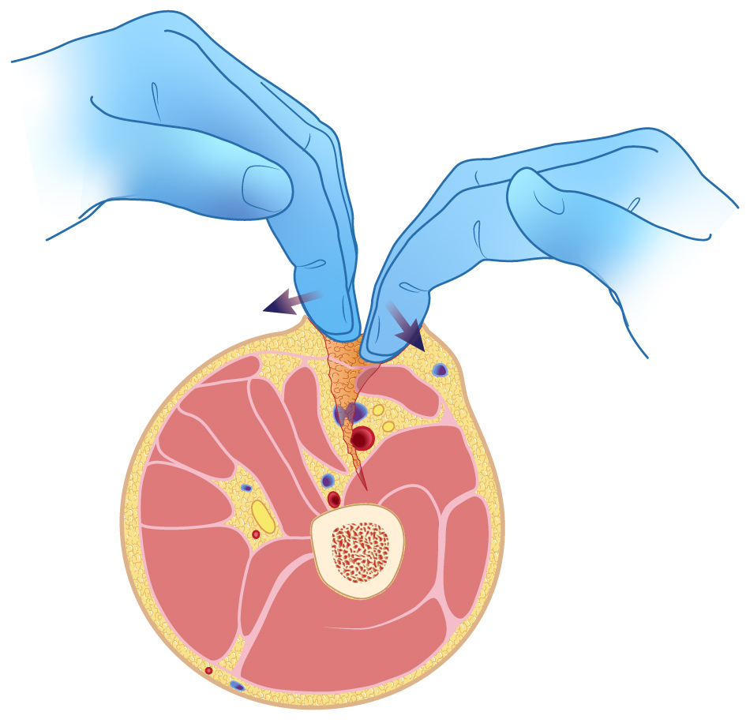
Objective 4: Discuss and demonstrate digital pressure for hemorrhage control. (extremity)
Open wound
1. Identify bleeding
2. Compress vessels against bone
Compress bleeding vascular structures against bone regardless of age or size.
Notes:
This slide more closely examines digital control of extremity injuries. These may include injuries of the leg (cross section of the mid-shaft femur illustrated here) or the arm (not shown).
Important: Serious injuries may occur in locations where tourniquets can, and likely should, be applied. In these situations it may be life-saving to first apply a tourniquet and then consider other options.
It may be necessary to “sweep” blood out of the wound in order in momentarily see the source of bleeding.
It may be necessary to manually open the wound to both visualize and gain access to the injured vessel(s).
Once the bleeding vessels are identified compress them directly against the boney structures of the leg (or arm).
KEY POINT: Significant wound bleeding may exhibit spurting or heavy flow. These injuries may not stop bleeding with direct pressure and will likely require digital control of the vessel(s). Even with digital control one should rapidly consider application of a tourniquet.

Slide 19
Wound packing
Junctional
Notes:
The following slides discuss wound packing of the junctional region.
KEY POINT: Significant wound bleeding may (or may not) exhibit spurting or heavy flow. These injuries may not stop bleeding with direct pressure and likely require digital pressure and aggressive wound packing.

Slide 20

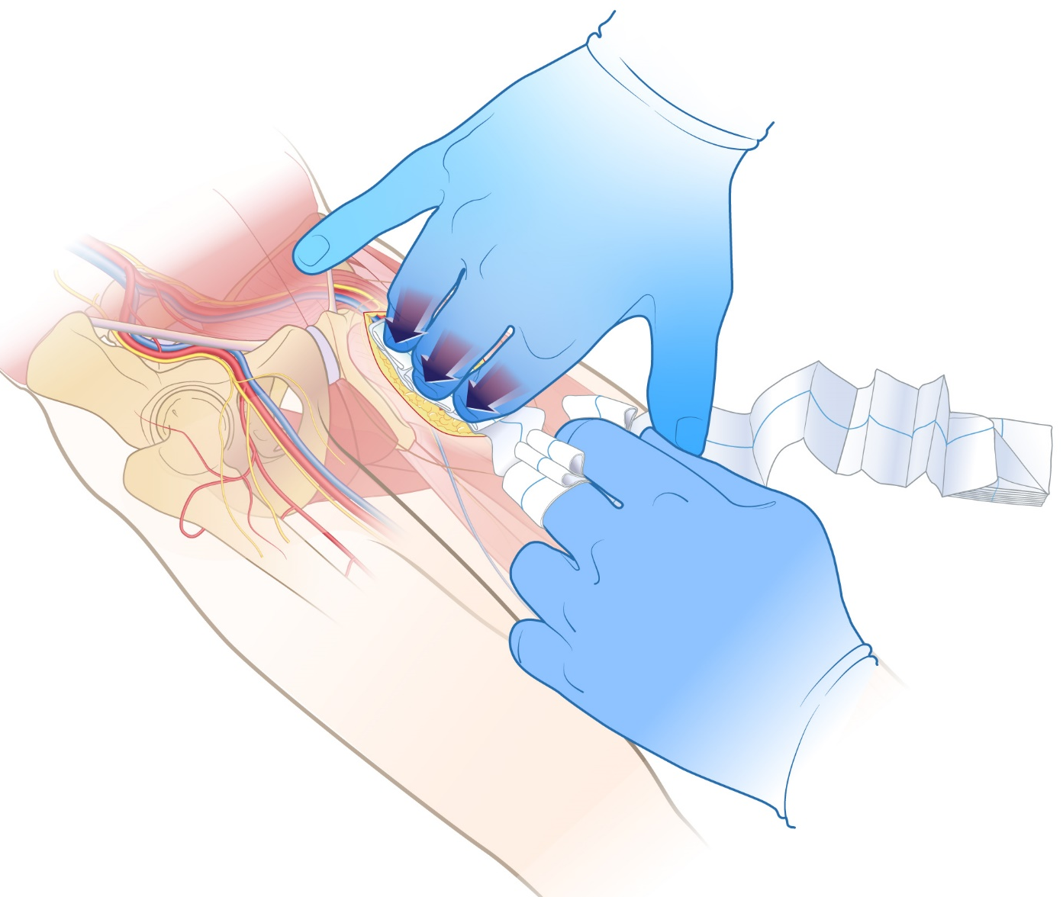
Objective 5: Discuss and demonstrate wound packing for hemorrhage control. (junctional)
Vessels compressed against bone
COMPLETELY PACK INJURY
MAINTAIN PRESSURE
Compress and pack bleeding vascular structures against bone regardless of age or size.
Notes:
A junctional wound in the groin (shown here), armpit or neck (not shown) may be life-threatening.
Bleeding in these regions CANNOT be controlled with a tourniquet (simply because the area cannot be circumferentially compressed).
Steps to control bleeding in this region include:
Sweep blood out of the way as needed.
Manually open the wound to identify the source of bleeding.
Digitally compress bleeding vessels against bony structures.
Pack the wound with sterile gauze.
Packing a wound is a process accomplished by maintaining pressure (with fingertips) WHILE “systematically pushing gauze under fingertips and on top of bleeding vessels.”
This packing process is continuously repeated – while maintaining pressure – until the ENTIRE WOUND CAVITY IS COMPLETELY FULL and wound packing material is overflowing above the wound.
KEY POINT: Wound packing is EFFECTIVE ONLY IF ENTIRE WOUND CAVITY IS COMPLETELY FULL AND PRESSURE IS MAINTAINED ON VESSELS!

Slide 21
Wound packing
Extremity
Notes:
The following slides discuss wound packing of extremity injuries.
KEY POINT: Significant wound bleeding may (or may not) exhibit spurting or heavy flow. These injuries may not stop bleeding with direct pressure and likely require digital pressure, aggressive wound packing, or a tourniquet depending on the location.
Important: Serious injuries may occur in locations where tourniquets can and likely should, be applied. In these situations it may be life-saving to immediately apply a tourniquet and then consider other options.

Slide 22
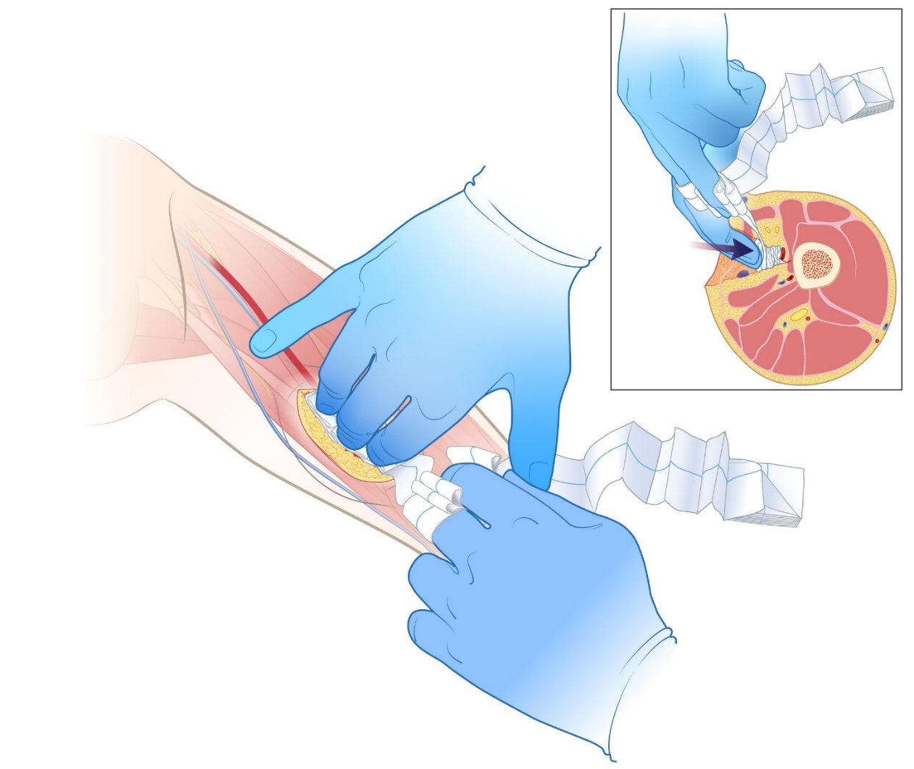

Objective 5: Discuss and demonstrate wound packing for hemorrhage control. (extremity)
If it won’t quit Tourniquet!
Compress and pack bleeding vascular structures against bone regardless of age or size.
Notes:
Important: Serious injuries may occur in locations where tourniquets can and likely should, be applied. In these situations it may be life-saving to immediately apply a tourniquet and then consider other options.
A wound of the lower extremity (shown here) or upper extremity (not shown) may be life-threatening.
Steps to control bleeding in this region include:
Sweep blood out of the way as needed.
Manually open the wound to identify the source of bleeding.
Digitally compress bleeding vessel(s) against bony structures.
Pack the wound with sterile gauze.
Packing a wound is a process accomplished by maintaining pressure (with fingertips) WHILE “systematically pushing gauze under fingertips and on top of bleeding vessels.”
This packing process is continuously repeated – while maintaining pressure – until the ENTIRE WOUND CAVITY IS COMPLETELY FULL and dressing materials is overflowing above the wound.
KEY POINT: Wound packing is EFFECTIVE ONLY IF ENTIRE WOUND CAVITY IS COMPLETELY FULL AND PRESSURE IS MAINTAINED ON VESSELS!

Slide 23
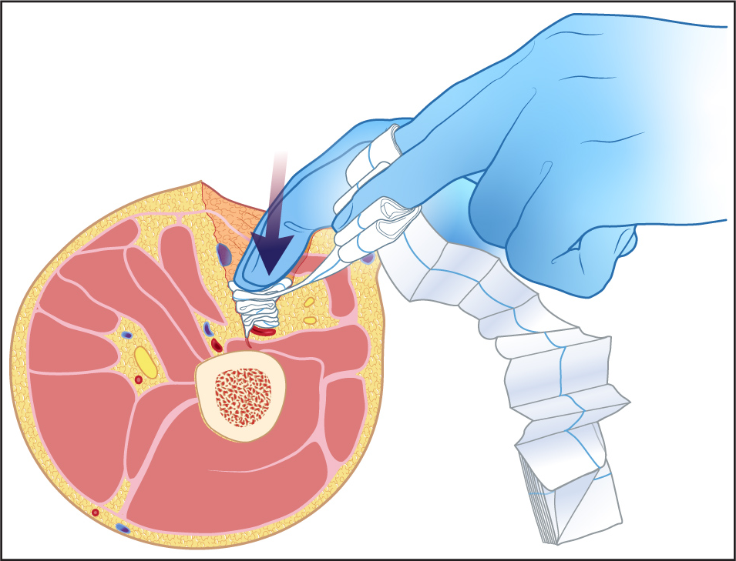
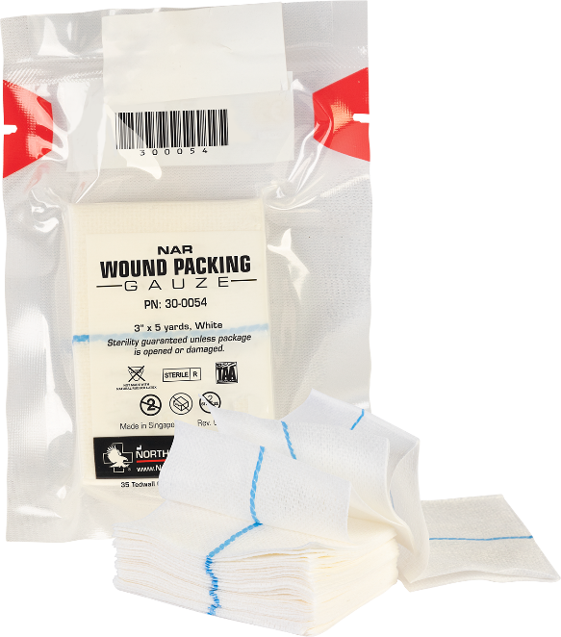
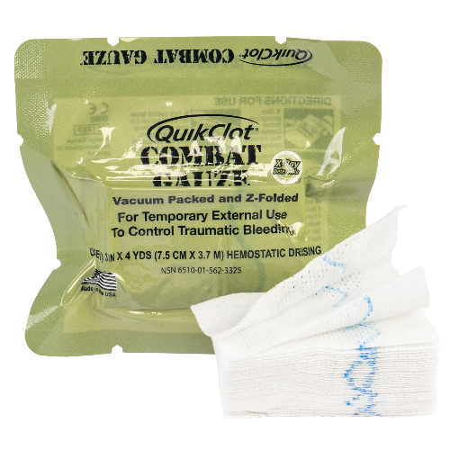
Objective 5: Discuss and demonstrate wound packing for hemorrhage control. (extremity)
If it won’t quit Tourniquet!
Wound packing gauze
Follow Manufacturers Instructions For Use
Pack entire wound cavity while maintaining vessel pressure against bone.
Once FULLY PACKED, hold for three (3) minutes before placing pressure bandage.
Notes:
Important: Serious injuries may occur in locations where tourniquets can and likely should, be applied. In these situations it may be life-saving to immediately apply a tourniquet and then consider other options.
A wound of the lower extremity (cross-section of mid-thigh shown here) or upper extremity (not shown) may be life-threatening.
Steps to control bleeding in this region include:
Sweep blood out of the way as needed.
Manually open the wound to identify the source of bleeding.
Digitally compress bleeding vessel(s) against bony structures.
Pack the wound with sterile gauze.
Packing a wound is a process accomplished by maintaining pressure (with fingertips) WHILE “systematically pushing gauze under fingertips and on top of bleeding vessels.”
This packing process is continuously repeated – while maintaining pressure – until the ENTIRE WOUND CAVITY IS COMPLETELY FULL and dressing materials is overflowing above the wound.
Once wound cavity has been completely packed – HOLD PRESSURE for at least three (3) minutes before placing pressure bandage into positioning.
KEY POINT: Wound packing is EFFECTIVE ONLY IF ENTIRE WOUND CAVITY IS COMPLETELY FULL AND PRESSURE IS MAINTAINED ON VESSELS!

Slide 24
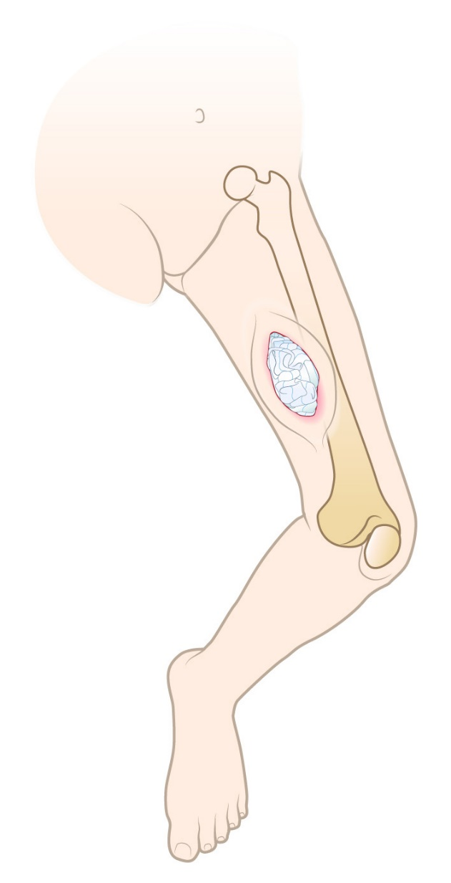

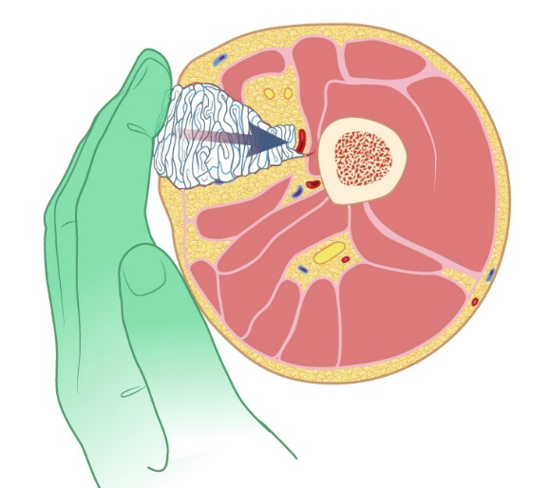

Objective 5: Discuss and demonstrate wound packing for hemorrhage control. (extremity)
Once FULLY PACKED
Hold pressure for three
(3) minutes before placing pressure bandage.
Tight packing and
maintenance of direct
pressure are critical!
Notes:
Important: Serious injuries may occur in locations where tourniquets can and likely should, be applied. In these situations it may be life-saving to immediately apply a tourniquet and then consider other options.
A wound of the lower extremity (cross-section of mid-thigh shown here) or upper extremity (not shown) may be life-threatening.
Steps to control bleeding in this region include:
Sweep blood out of the way as needed.
Manually open the wound to identify the source of bleeding.
Digitally compress bleeding vessel(s) against bony structures.
Pack the wound with sterile gauze.
Packing a wound is a process accomplished by maintaining pressure (with fingertips) WHILE “systematically pushing gauze under fingertips and on top of bleeding vessels.”
This packing process is continuously repeated – while maintaining pressure – until the ENTIRE WOUND CAVITY IS COMPLETELY FULL and dressing materials is overflowing above the wound.
Once wound cavity has been completely packed – HOLD PRESSURE for at least three (3) minutes before placing pressure bandage into positioning.
KEY POINT: Wound packing is EFFECTIVE ONLY IF ENTIRE WOUND CAVITY IS COMPLETELY FULL AND PRESSURE IS MAINTAINED ON VESSELS!

Slide 25
Pressure Bandage
Notes:
The following slides discuss the use of a pressure bandage.
KEY POINT: Significant bleeding from an extremity wound may exhibit spurting or heavy flow. These injuries may not stop bleeding with direct pressure, wound packing or a pressure dressing. Extremity injuries such as this likely require a tourniquet.

Slide 26
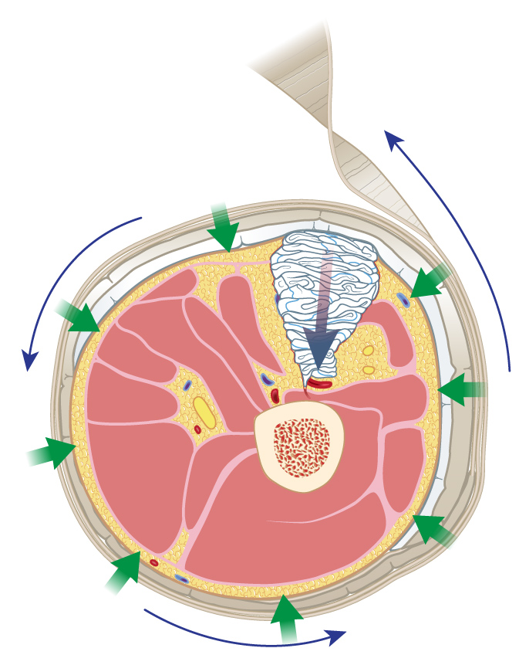
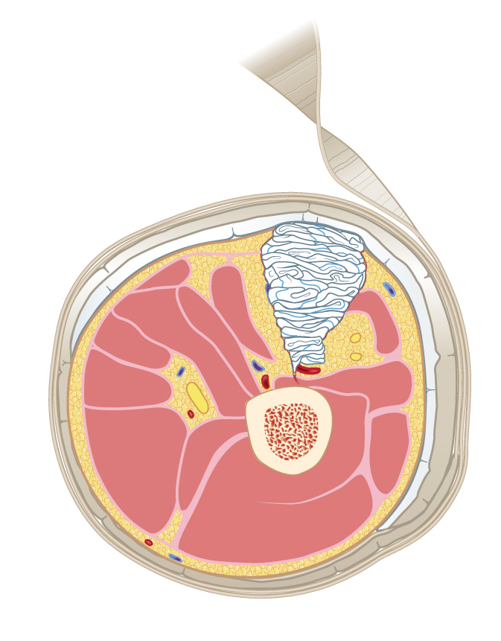
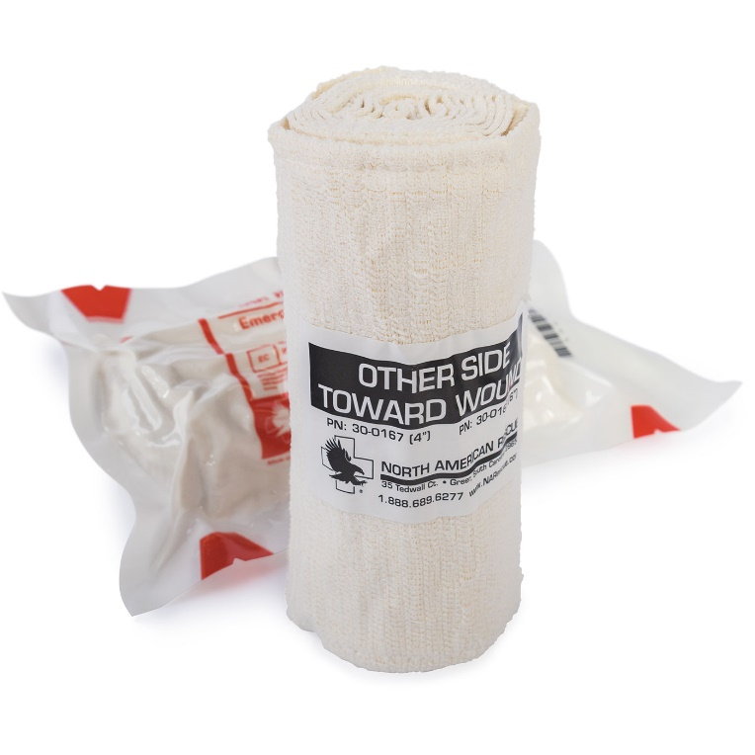
Objective 6: Discuss and demonstrate use of a pressure bandage for hemorrhage control.
Pressure bandage applied to create additional pressure on wound packing material
- AND -
prevent additional blood loss.
Pressure Dressings
Notes:
A pressure bandage, such as the one depicted in this slide, is generally applied circumferentially to an extremity for two reasons:
To maintain pressure on the wound
To hold a dressing (wound packing) in position
Additionally, a pressure bandage might be utilized if other tasks must be accomplished and the provider needs to manage other patient care needs or leave the injured patient.
It is important to ensure that the pressure dressing does not cut off circulation to the extremity. This can be accomplished by checking the distal pulse or capillary refill.

Slide 27
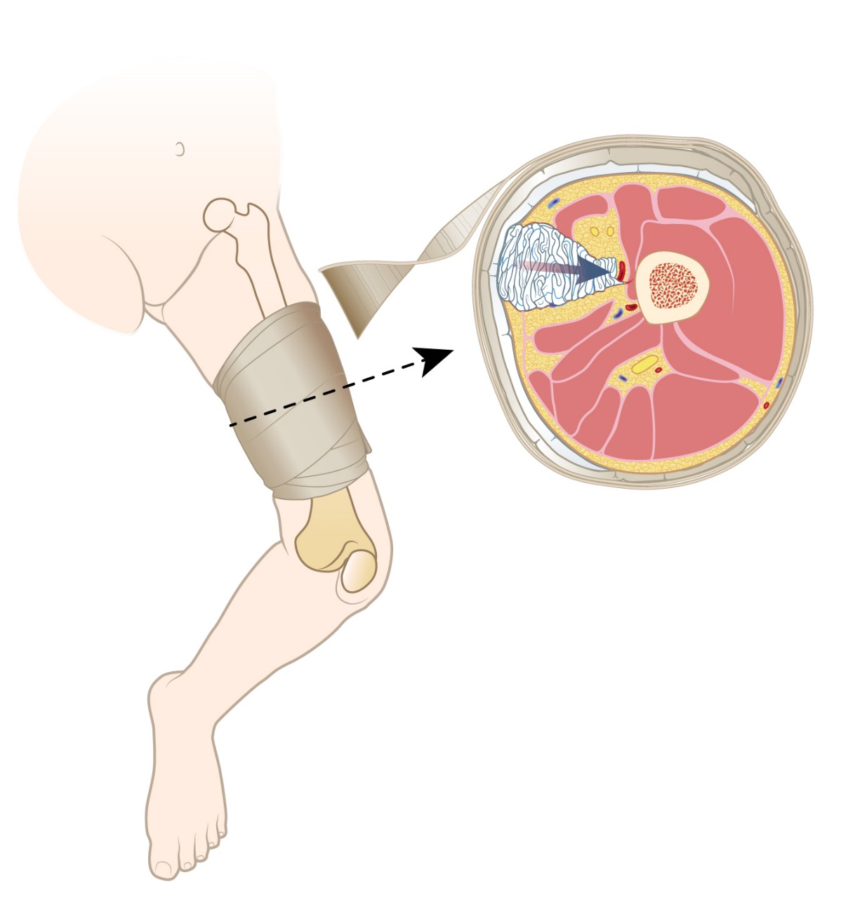

Objective 6: Discuss and demonstrate use of a pressure bandage for hemorrhage control.
After the application of
pressure bandage
continue to apply manual pressure and reassess patient for bleeding.
Notes:
A pressure bandage, such as the one depicted in this slide, is generally applied circumferentially to an extremity for two reasons:
To maintain pressure on the wound
To hold a dressing (wound packing) in position
Additionally, a pressure bandage might be utilized if other patient care tasks need to be accomplished or the provider must leave the injured patient.
It is important to ensure that the pressure dressing does not cut off circulation to the extremity. This can be accomplished by checking the distal pulse or capillary refill.

Slide 28
Tourniquet Usage
Notes:
The following slides discuss the use of a tourniquet.
KEY POINT: Significant bleeding from an extremity wound may (or may not) exhibit spurting or heavy flow.
These injuries may not stop bleeding with direct pressure, wound packing, or a pressure dressing.
Injuries like this require a tourniquet.

Slide 29
Limitation of Liability:
C-A-T® Resources, LLC, its parent company Composite Resources, Inc., its employees, agents, contractors, suppliers, and distributors shall assume no liability for injury or damages arising from the application and use of the Combat Application Tourniquet®. The user assumes all risk of liability. The tourniquet should only be used as directed by user’s military service component guidelines, EMS authority, or under the supervision of a physician.
Notes:
Limitation of Liability:
C-A-T® Resources, LLC, its parent company Composite Resources, Inc., its employees, agents, contractors, suppliers, and distributors shall assume no liability for injury or damages arising from the application and use of the Combat Application Tourniquet®.
The user assumes all risk of liability.
The C-A-T® tourniquet should only be applied as directed by user’s military service component guidelines, EMS (or local medical) authority, or under the supervision of a physician.

Slide 30
Standard Use Guidelines:
When applied in accordance with directions, the Combat Application Tourniquet® is a safe and effective device for controlling life-threatening extremity bleeding. If you cannot be sure or cannot take the additional time to examine where the bleeding is coming from, based on the situation, the tourniquet can be effectively applied over clothing as high on the arm or leg as possible. The tourniquet must NOT be applied over solid objects within the clothing. As soon as the situation permits, the injured limb should be evaluated and the C-A-T® re-positioned 2”-3” above the injury, directly to the skin.
Notes:
Standard Use Guidelines:
When applied in accordance with directions, the Combat Application Tourniquet® is a safe and effective device for controlling life-threatening extremity bleeding.
If you cannot be sure or cannot take the additional time to examine where the bleeding is coming from, based on the situation, the tourniquet can be effectively applied over clothing as high on the arm or leg as possible.
The tourniquet must NOT be applied over solid objects within the clothing.
As soon as the situation permits, the injured limb should be evaluated and the C-A-T® repositioned 2”- 3” above the injury, directly to the skin.
IMPORTANT END-USER TIP: When attempting repositioning C-A-T® - one should place a second tourniquet proximal to the injury as described above – AND THEN release and remove the originally placed device. Failure to apply the second tourniquet, then release “originally placed tourniquet” (in this sequence), WILL LEAD to additional bleeding.

Slide 31
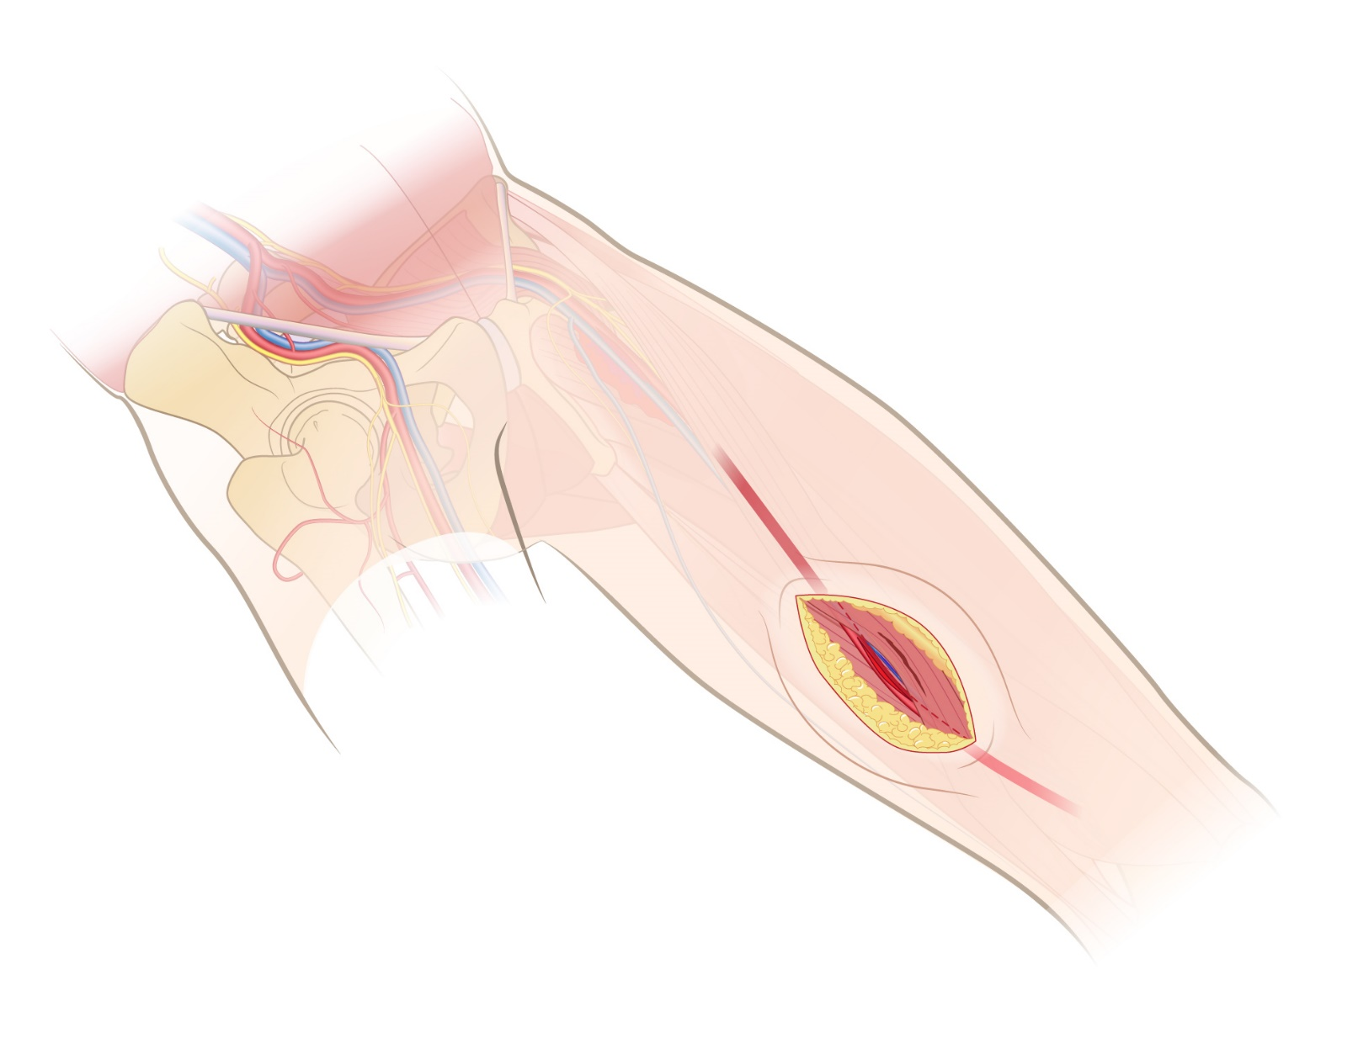
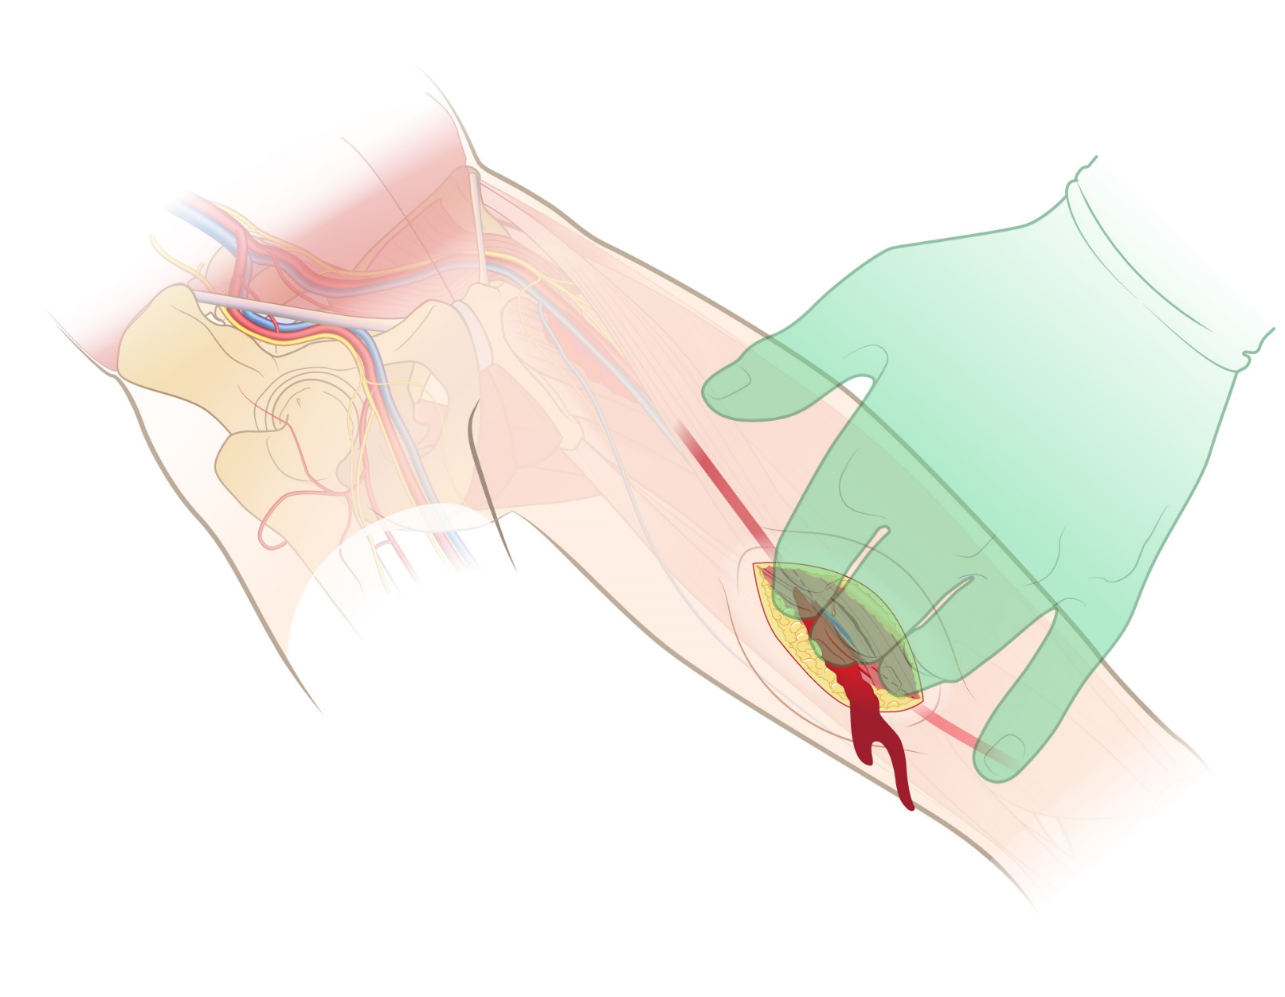
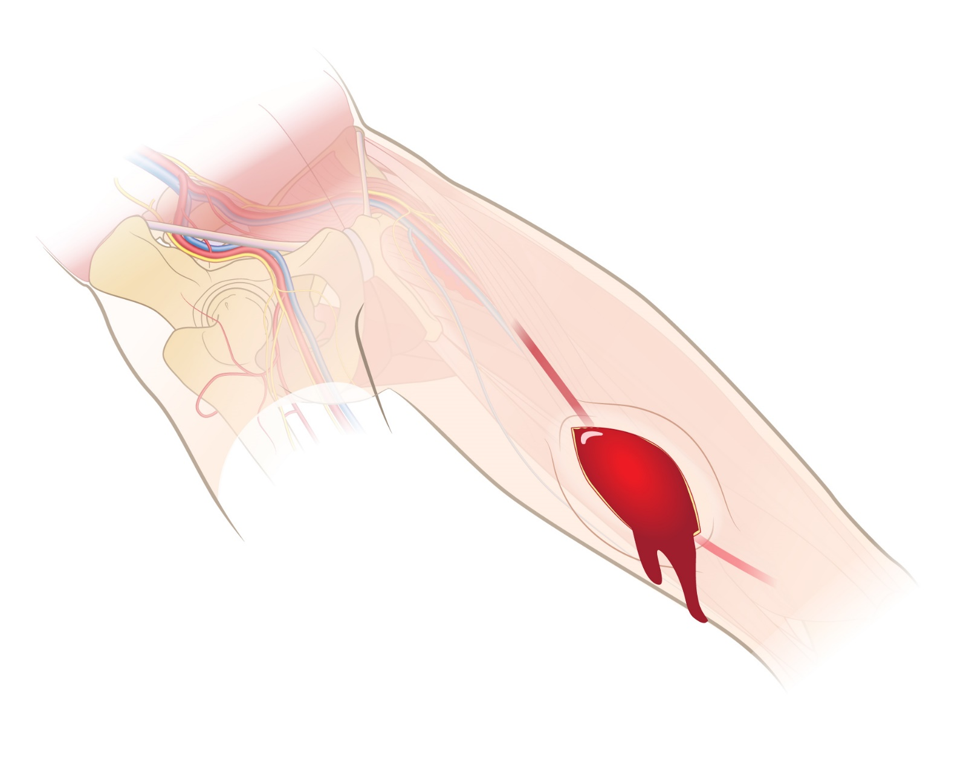
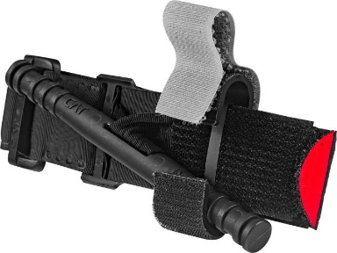
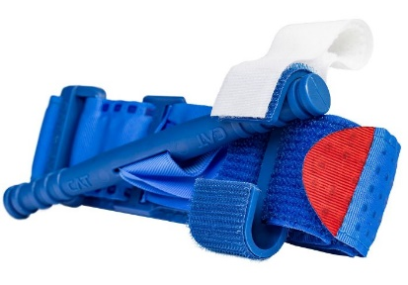
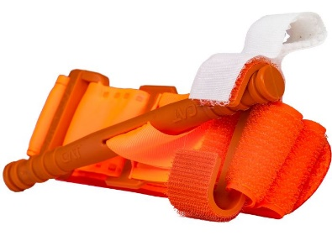
Objective 7: Discuss and demonstrate tourniquet usage for hemorrhage control.
If able,
compress vessels
against bone while preparing to apply
C-A-T® Tourniquet.
MAINTAIN PRESSURE
during tourniquet
application.
Scientific evidence supports
C-A-T® Tourniquet use with
school-age children (small limbs)
C-A-T® Tourniquets
Harcke, H.T. et al. Adult Tourniquet for Use in School-Age Emergencies; Pediatrics 2019 143(6). See reference section.
Notes:
Tourniquets have been scientifically proven to be safe and effective when used to control life-threatening bleeding from small limbs.
This means that C-A-T® Tourniquets CAN be effectively applied to any age group.
Harcke, H.T. et al. Adult Tourniquet for Use in School-Age Emergencies; Pediatrics 2019 143(6).
KEY POINT: If the resting circumference of the limb is less than eight (8) inches you may need to modify the application process. This could include:
Circumferentially wrapping a dressing (or similar item) around the extremity (thus increasing the extremity’s diameter) and then applying the tourniquet.
Placing a firm bulky dressing (or similar item) under the tourniquet, yet over the artery, before tightening the rod.
When a situation warrants the application of a tourniquet, important steps must be taken (eight (8) steps are described in the following slides):
1. Attempt to identify the source of bleeding AND maintain direct or digital pressure on the wound.

Slide 32
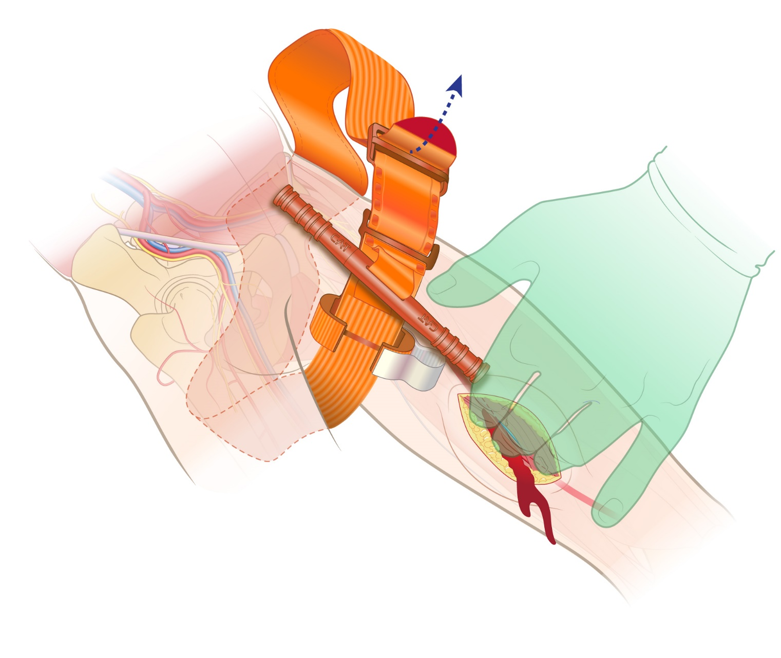
Objective 7: Discuss and demonstrate tourniquet usage for hemorrhage control.
Route tourniquet band
around limb.
Pass RED TIP (free end of band) through buckle slit.
Position tourniquet
2-3 inches above injury.
*Or as high as possible on extremity
if unsure where injury is located.
MAINTAIN PRESSURE
on bleeding vessel(s)
during tourniquet placement
While placing tourniquet, and if able, compress bleeding vascular structures against bone regardless of age or size.
Notes:
Tourniquets have been scientifically proven to be safe and effective when used to control life-threatening bleeding from small limbs.
Important steps:
Attempt to identify the source of bleeding AND maintain direct or digital pressure on the wound.
Route the tourniquet band around the limb. Pass the RED TIP through the buckle slit. POSITION the tourniquet 2”- 3” above the injury (or as high as possible on extremity if unsure where injury is located).

Slide 33
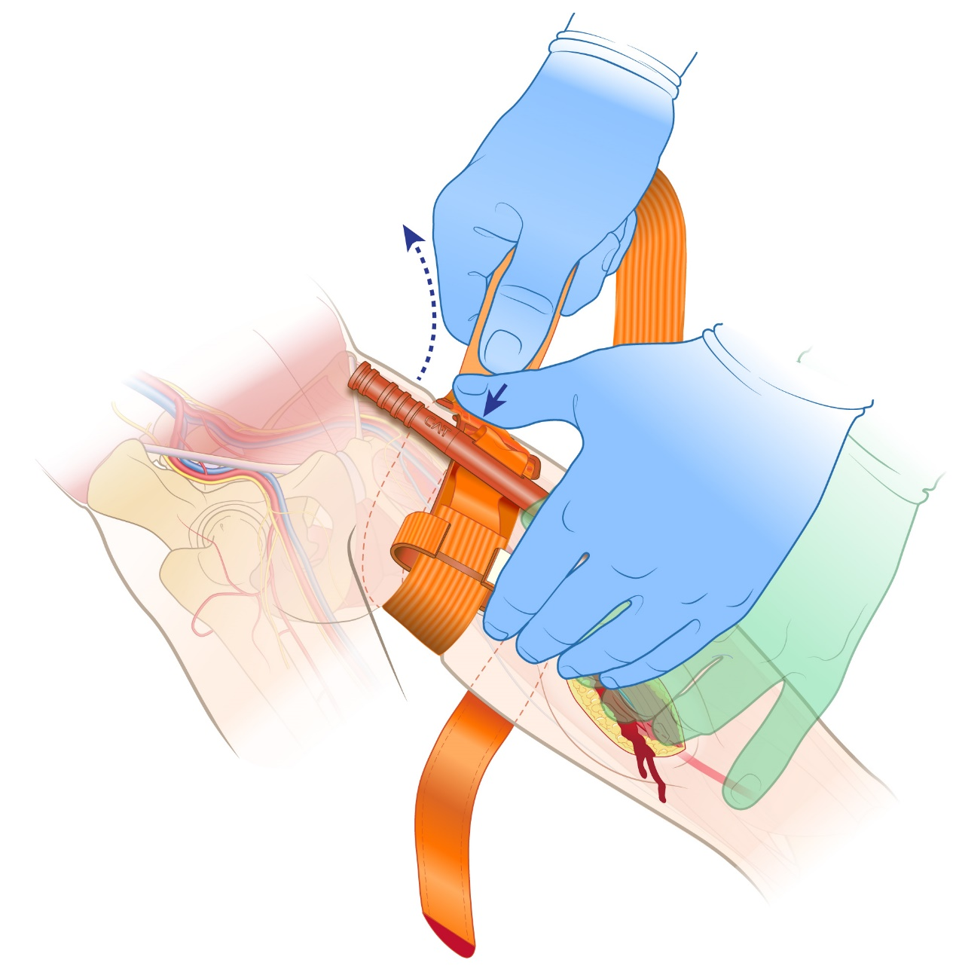
Objective 7: Discuss and demonstrate tourniquet usage for hemorrhage control.
Pull tourniquet band tightly
while pressing buckle
against skin.
Fasten band back on itself
around limb.
Tourniquet band MUST BE TIGHT on extremity
BEFORE turning rod.
MAINTAIN PRESSURE
on bleeding vessel(s)
during tourniquet placement
While placing tourniquet, and if able, compress bleeding vascular structures against bone regardless of age or size.
Notes:
Tourniquets have been scientifically proven to be safe and effective when used to control life-threatening bleeding from small limbs.
Important steps:
Attempt to identify the source of bleeding AND maintain direct or digital pressure on the wound.
Route the tourniquet band around the limb. Pass the RED TIP through the buckle slit. POSITION the tourniquet 2-3 inches above the injury (or as high as possible on extremity if unsure where injury is located).
Ensure tourniquet band is tight BEFORE turning rod.

Slide 34
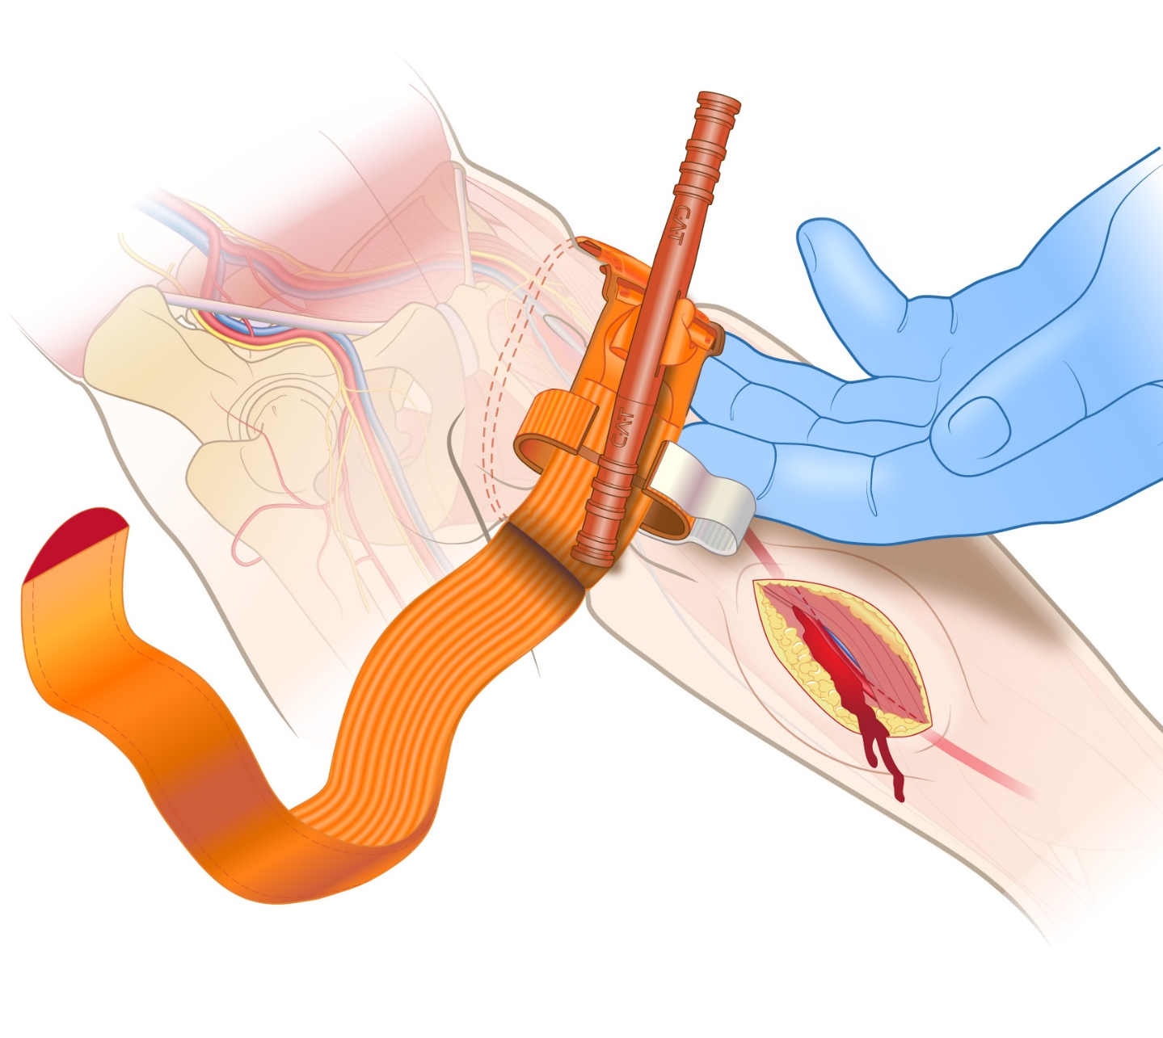

Objective 7: Discuss and demonstrate tourniquet usage for hemorrhage control.
Tourniquet band
MUST BE TIGHT
before turning rod.
Band should be tight enough
that tips of three (3) fingers CANNOT be slid between the band and limb. If the tips of three (3) fingers slide under band, retighten and re-secure tourniquet.
MAINTAIN PRESSURE
on bleeding vessel(s)
during tourniquet placement
While placing tourniquet, and if able, compress bleeding vascular structures against bone regardless of age or size.
Notes:
Tourniquets have been scientifically proven to be safe and effective when used to control life-threatening bleeding from small limbs.
Important steps:
Attempt to identify the source of bleeding AND maintain direct or digital pressure on the wound.
Route the tourniquet band around the limb. Pass the RED TIP through the buckle slit. POSITION the tourniquet 2-3 inches above the injury (or as high as possible on extremity if unsure where injury is located).
Ensure the tourniquet band is tight BEFORE turning rod. Band should be tight enough that tips of three (3) fingers CANNOT be slid between the band and limb. If the tips of three (3) fingers slide under band, retighten and re-secure tourniquet.

Slide 35
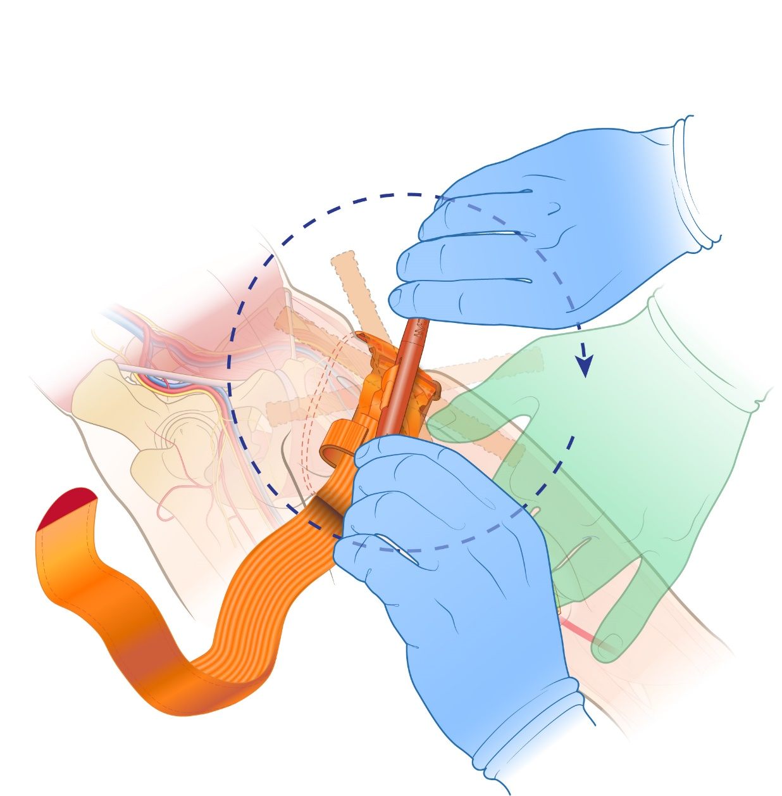
Objective 7: Discuss and demonstrate tourniquet usage for hemorrhage control.
Twist rod until bleeding stops.
Rod may be turned either direction.
MAINTAIN PRESSURE
on bleeding vessel(s)
during tourniquet placement
While placing tourniquet, and if able, compress bleeding vascular structures against bone regardless of age or size.
Notes:
Tourniquets have been scientifically proven to be safe and effective when used to control life-threatening bleeding from small limbs.
Important steps:
Attempt to identify the source of bleeding AND maintain direct or digital pressure on the wound.
Route the tourniquet band around the limb. Pass the RED TIP through the buckle slit. POSITION the tourniquet 2-3 inches above the injury (or as high as possible on extremity if unsure where injury is located).
Ensure the tourniquet band is tight BEFORE turning rod. Band should be tight enough that tips of three (3) fingers CANNOT be slid between the band and limb. If the tips of three (3) fingers slide under band, retighten and re-secure tourniquet.
Twist the tourniquet rod until the bleeding stops (rod may be turned either direction).

Slide 36
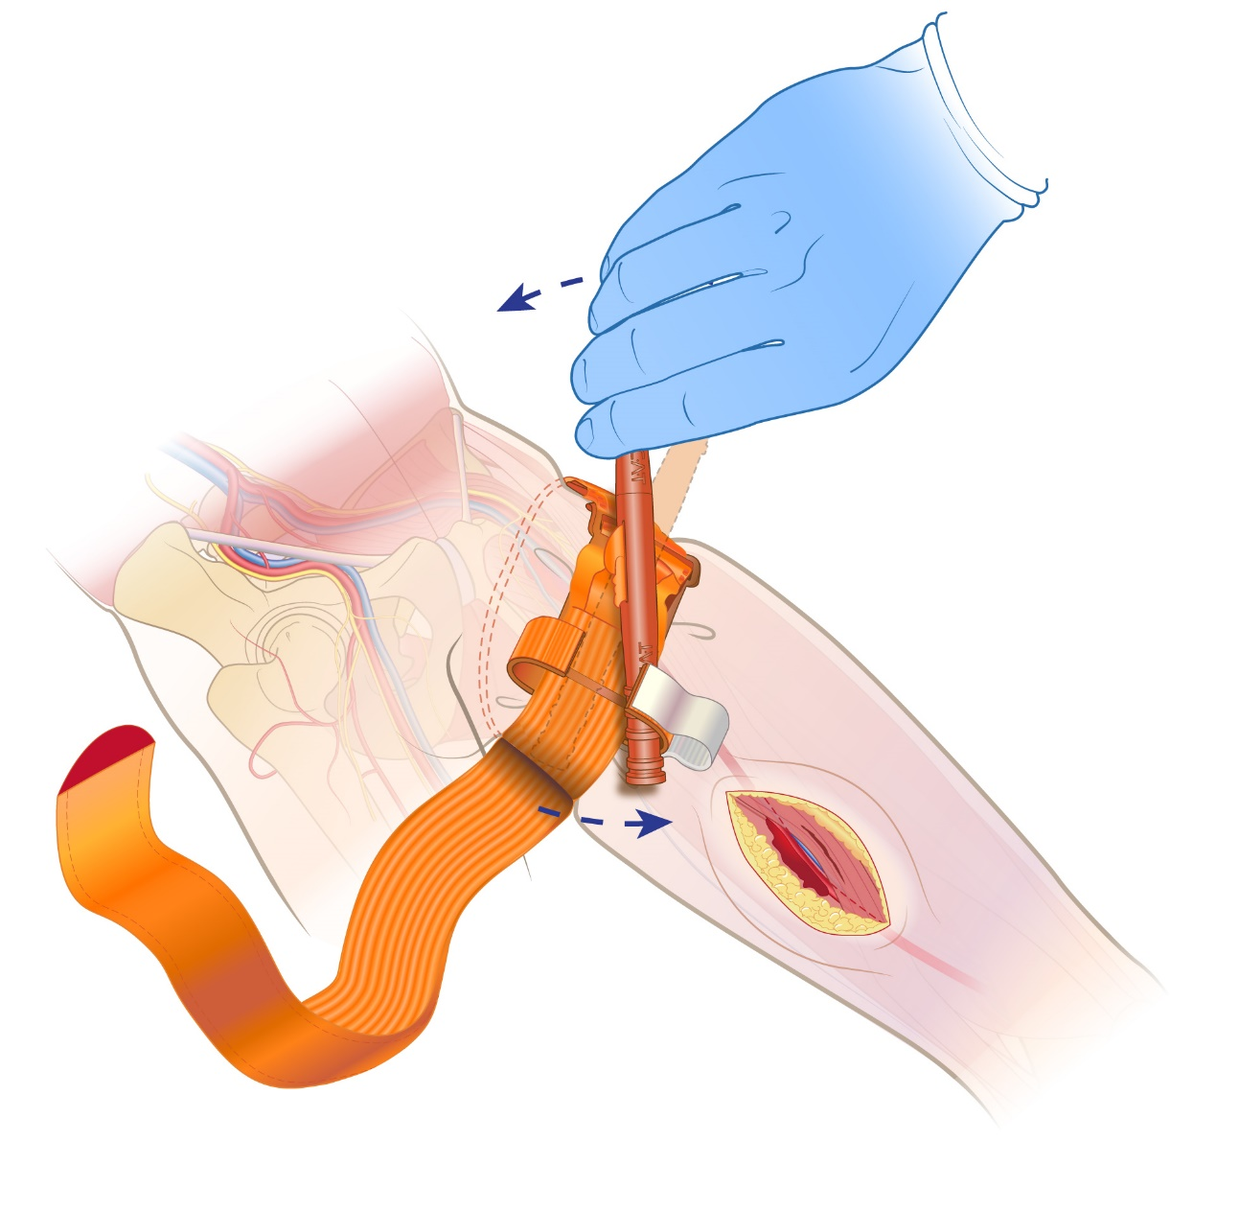
Objective 7: Discuss and demonstrate tourniquet usage for hemorrhage control.
Secure rod inside clip
to lock in place.
CHECK for bleeding
and distal pulse.
If bleeding NOT controlled, or distal pulse present, consider additional tightening or use of second tourniquet side-by-side
with first tourniquet.
Reassess!
Ensure blood flow
has completely
stopped
Important: DO NOT CUT excess tourniquet band!
Notes:
Tourniquets have been scientifically proven to be safe and effective when used to control life-threatening bleeding from small limbs.
Important steps:
Attempt to identify the source of bleeding AND maintain direct or digital pressure on the wound.
Route the tourniquet band around the limb. Pass the RED TIP through the buckle slit. POSITION the tourniquet 2-3 inches above the injury (or as high as possible on extremity if unsure where injury is located).
Ensure the tourniquet band is tight BEFORE turning rod. Band should be tight enough that tips of three (3) fingers CANNOT be slid between the band and limb. If the tips of three (3) fingers slide under band, retighten and re-secure tourniquet.
Twist the tourniquet rod until the bleeding stops (rod may be turned either direction).
Once bleeding has stopped, secure the rod inside the clip to lock in place. Confirm absence of bleeding and distal pulse. If bleeding is NOT controlled, or the distal pulse is present, consider additional tightening, or the use of second tourniquet, side-by-side with the first tourniquet.

Slide 37
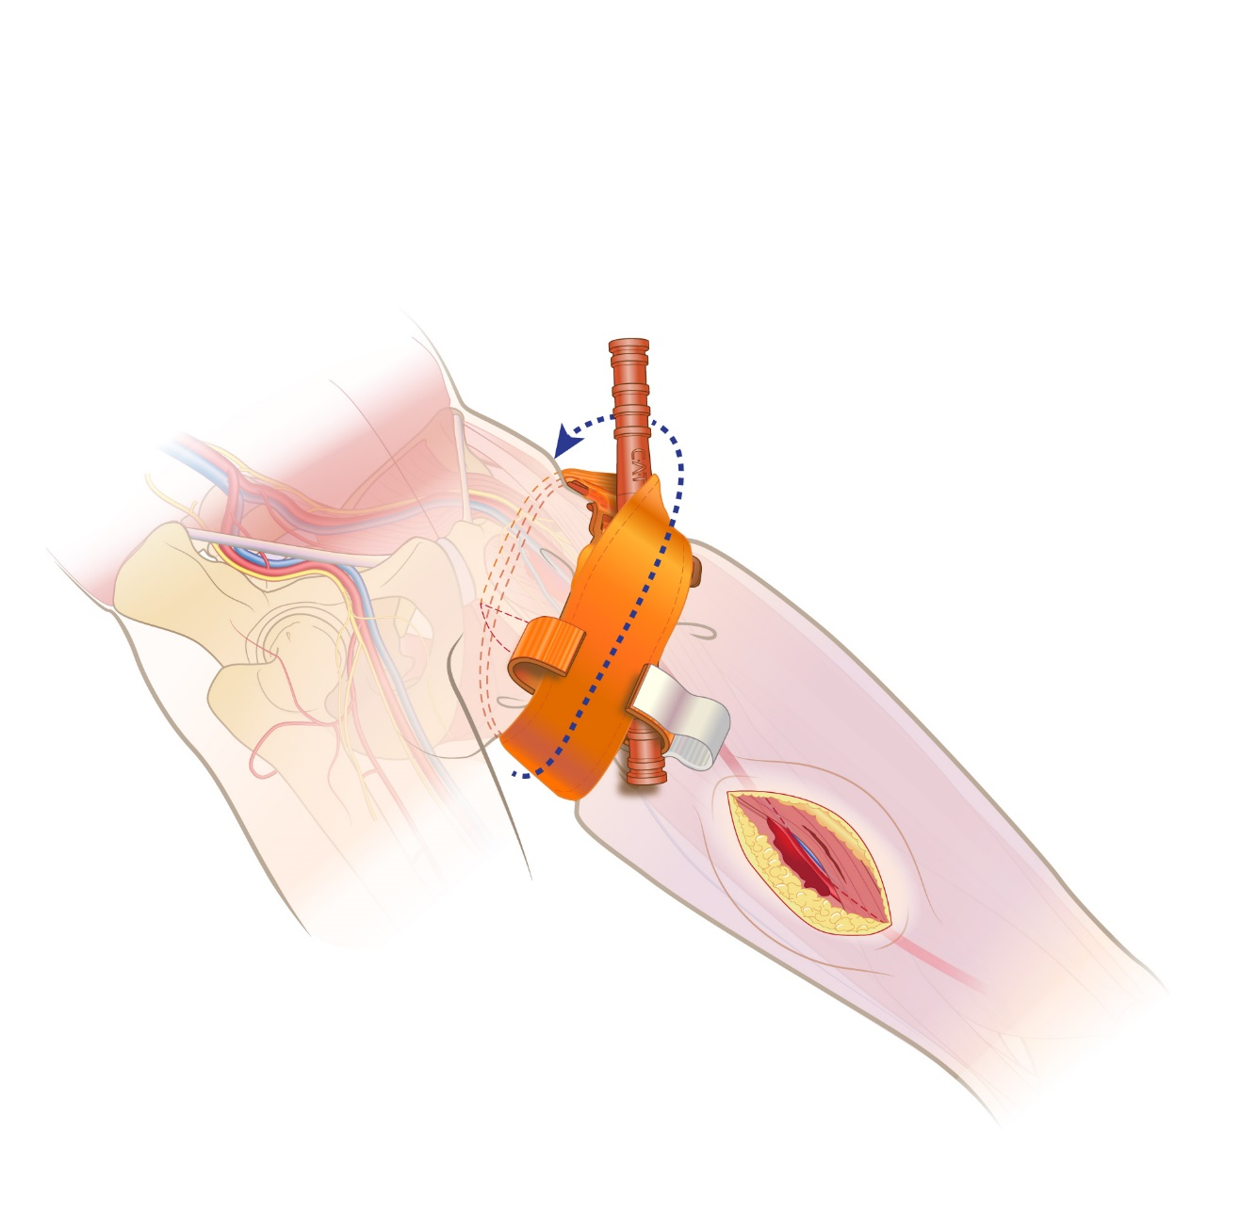
Objective 7: Discuss and demonstrate tourniquet usage for hemorrhage control.
Route band between clips
and over rod.
Monitor
for bleeding
Notes:
Tourniquets have been scientifically proven to be safe and effective when used to control life-threatening bleeding from small limbs.
Important steps:
Attempt to identify the source of bleeding AND maintain direct or digital pressure.
Route the tourniquet band around the limb. Pass the RED TIP through the buckle slit. POSITION the tourniquet 2-3 inches above the injury (or as high as possible on the extremity if unsure where the injury is located).
Ensure the tourniquet band is tight BEFORE turning windless. Band should be tight enough that tips of three (3) fingers CANNOT be slid between the band and limb. If the tips of three (3) fingers slide under band, retighten and re-secure tourniquet.
Twist the tourniquet rod until the bleeding stops (rod may be turned either direction).
Once bleeding has stopped, secure the rod inside the clip to lock in place. Confirm absence of bleeding and distal pulse. If bleeding is NOT controlled, or the distal pulse is present, consider additional tightening, or the use of second tourniquet, side-by-side with the first tourniquet.
Route band between clips and over rod (to ensure band does not inadvertently detach).
Important: DO NOT CUT Tourniquet Band!

Slide 38
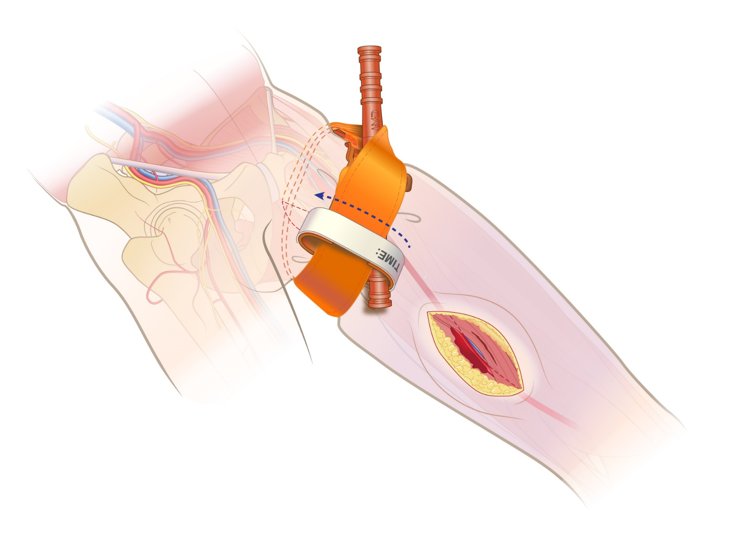
Objective 7: Discuss and demonstrate tourniquet usage for hemorrhage control.
Secure rod and band with TIME strap.
Record time of tourniquet application.
1231
Monitor
for bleeding
Notes:
Tourniquets have been scientifically proven to be safe and effective when used to control life-threatening bleeding from small limbs.
Important steps:
Attempt to identify the source of bleeding AND maintain direct or digital pressure on the wound.
Route the tourniquet band around the limb. Pass the RED TIP through the buckle slit. POSITION the tourniquet 2-3 inches above the injury (or as high as possible on the extremity if unsure where the injury is located).
Ensure the tourniquet band is tight BEFORE turning windless. Band should be tight enough that tips of three (3) fingers CANNOT be slid between the band and limb. If the tips of three (3) fingers slide under band, retighten and re-secure tourniquet.
Twist the tourniquet rod until the bleeding stops (rod may be turned either direction).
Once bleeding has stopped, secure the rod inside the clip to lock in place. Confirm absence of bleeding and distal pulse. If bleeding is NOT controlled, or the distal pulse is present, consider additional tightening, or the use of second tourniquet, side-by-side with the first tourniquet.
Route band between clips and over rod (to ensure band does not inadvertently detach).
Secure rod and band with TIME strap. Record time of tourniquet application (this can be written on the tourniquet or the patient). Monitor patient for bleeding.

Slide 39
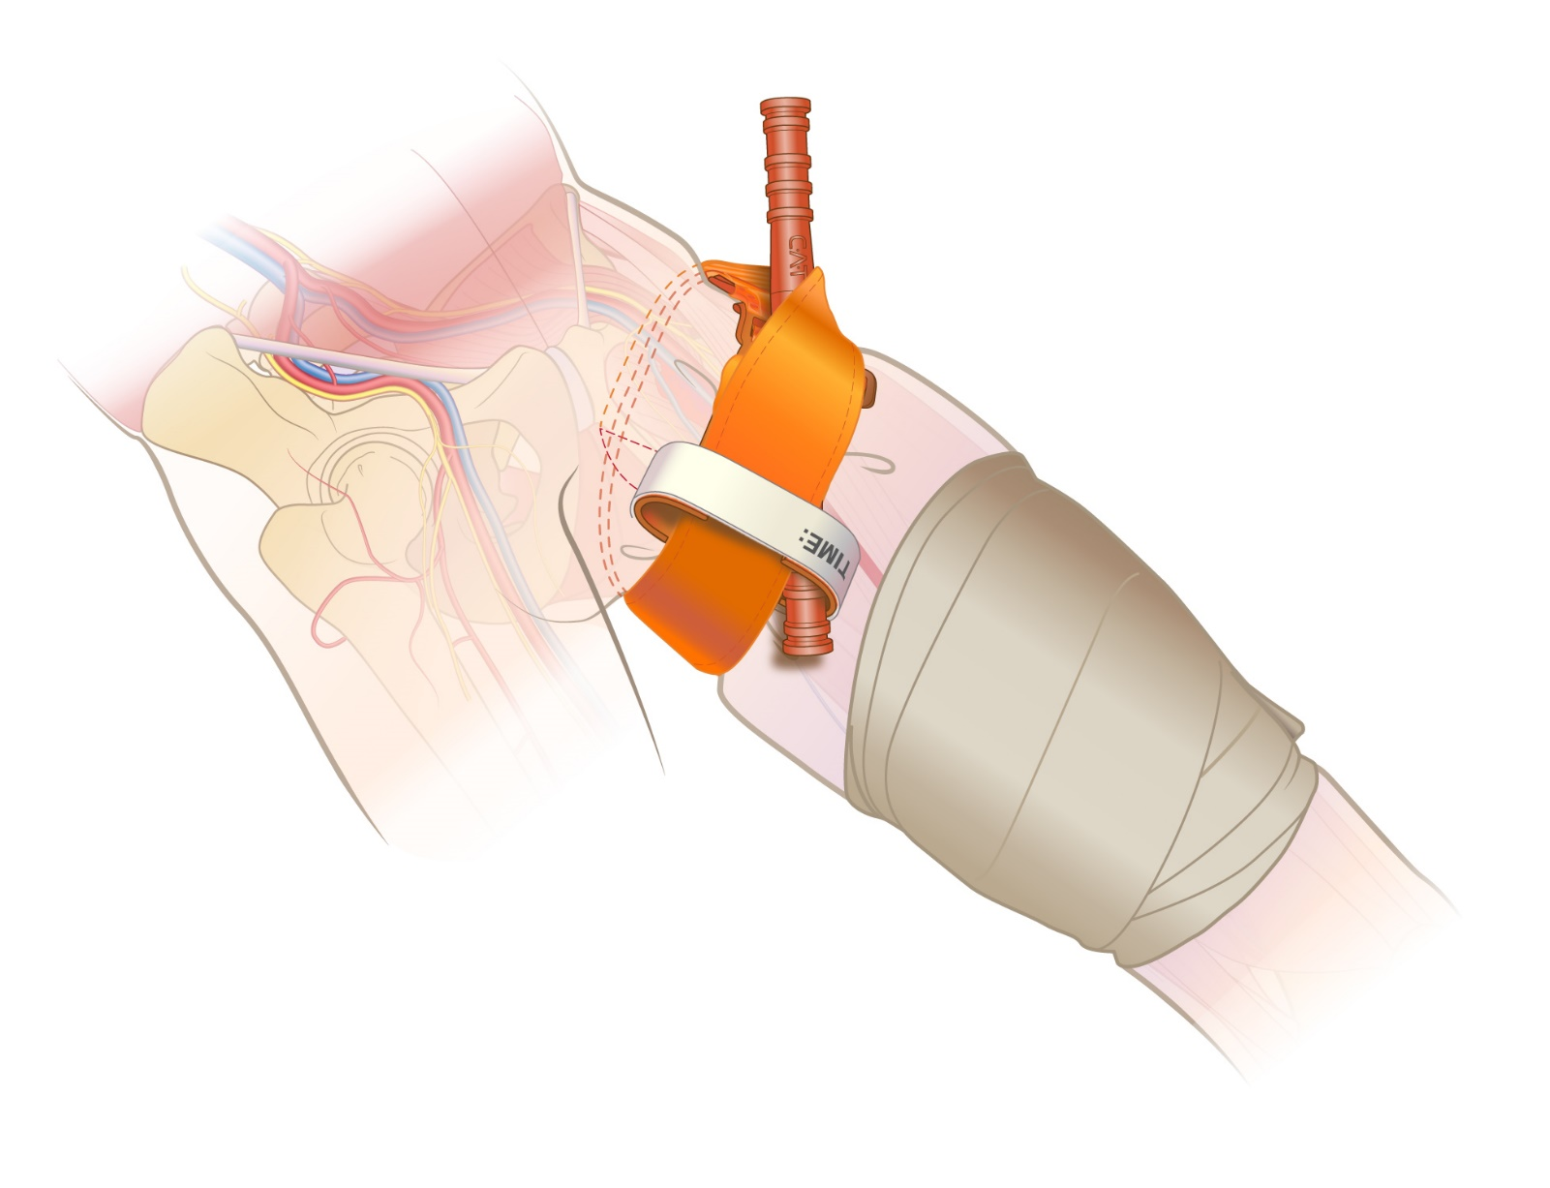
Objective 7: Discuss and demonstrate tourniquet usage for hemorrhage control.
Dress and bandage wound if situation and time permit.
1231
Continue monitoring
patient for bleeding
Notes:
Tourniquets have been scientifically proven to be safe and effective when used to control life-threatening bleeding from small limbs.
Important steps:
Attempt to identify the source of bleeding AND maintain direct or digital pressure on the wound.
Route the tourniquet band around the limb. Pass the RED TIP through the buckle slit. POSITION the tourniquet 2-3 inches above the injury (or as high as possible on the extremity if unsure where the injury is located).
Ensure the tourniquet band is tight BEFORE turning windless. Band should be tight enough that tips of three (3) fingers CANNOT be slid between the band and limb. If the tips of three (3) fingers slide under band, retighten and re-secure tourniquet.
Twist the tourniquet rod until the bleeding stops (rod may be turned either direction).
Once bleeding has stopped, secure the rod inside the clip to lock in place. Confirm absence of bleeding and distal pulse. If bleeding is NOT controlled, or the distal pulse is present, consider additional tightening, or the use of second tourniquet, side-by-side with the first tourniquet.
Route band between clips and over rod (to ensure band does not inadvertently detach).
Secure rod and band with TIME strap. Record time of tourniquet application (this can be written on the tourniquet or the patient). Monitor patient for bleeding.
If situation and time permit, pack wound and apply pressure dressing. As able, assess extremity for “breakthrough” bleeding.

Slide 40
Small Limb Specific Scientific Evidence
(1) Kragh, et al, Survey of Trauma Registry Data on Tourniquet Use in Pediatric War Casualties, reviewing 88 small limb war casualty cases determined TQs are effective on small limb patients.
(2) Zietlow, et al, Prehospital Use of Hemostatic Bandages and Tourniquets: Translation from Military Experience to Implementation in Civilian Trauma Care, showed the CAT had a 98.7% success rate. The sampling of patients included a small limb population. At least one of the TQs was applied to a one year old, based on the patient sampling age range.
(3) Villamaria et al, Wartime Vascular Injuries in the Pediatric Population of Iraq and Afghanistan: 2002-2001, identified tourniquets were used successfully to control bleeding in small limb casualties.
(4) Calloway, et al, published a Case Report, Life Saving Application of Commercial Tourniquet in Pediatric Extremity Hemorrhage, describing the CAT use on a 7-year old male.
(5) Simon, et al, Pediatric Extremity Hemorrhage and Tourniquet Use, suggesting current evidence supports direct pressure, as well as commercial and improvised tourniquets can adequately control small limb extremity hemorrhage.
(6) Harcke, et al. Adult Tourniquet for Use in School-Age Emergencies, effective to control of life-threatening bleeding.
Notes:
Pediatric related emergency medicine evidence (specifically trauma data) is difficult to obtain. This is secondary to the infrequency of injury, as well as the lack of published data.
Supportive evidence is always changing. It will be important to update the following slides every six months.

Slide 41
Additional Scientific Evidence
Retrieved from www.bleedingcontrol.org
Increasing survival, enhancing citizen resilience
David B. Hoyt, MD, FACS Executive Director, American College of Surgeons
This one-page article describes the process of the Hartford Consensus and summarizes its work and major principles. The leadership of Dr. Lenworth Jacobs in bringing about the Hartford Consensus is highlighted.
Letter from the Vice-President
Joseph R. Biden, Jr. Vice-President of the United States
This letter states that the lessons learned on the battlefield to control external hemorrhage must now be applied to civilian life. It concludes that the commonsense recommendations of the Hartford Consensus have the potential to equip citizens with the skills and confidence to save lives.
Presidential Policy Directive: National preparedness
Barack H. Obama President of the United States
This directive from the President of the United States outlines national preparedness goals and the necessary processes for building and sustaining preparedness. It highlights that preparedness for the United States is a shared responsibility of all levels of government, the private and nonprofit sectors, and individual citizens. A national preparedness system is described and roles and responsibilities within the federal government are outlined.
A systematic response to mass trauma: The public, organized first responders, and the American College of Surgeons
Andrew L. Warshaw, MD, FACS, FRCSEd(Hon) President (2014–2015), American College of Surgeons
This article summarizes the role of the American College of Surgeons in convening the Hartford Consensus and endorsing its recommendations. It describes the new, integrated response system that is needed to increase survival in active shooter and intentional mass casualty events.
Strategies to enhance survival in active shooter and intentional mass casualty events
Lenworth M. Jacobs, Jr., MD, MPH, FACS Chairman, Hartford Consensus; Vice-President, Academic Affairs, Hartford Hospital; Member, Board of Regents, American College of Surgeons
This article describes the purpose of the compendium, Strategies to Enhance Survival in Active Shooter and Intentional Mass Casualty Events, as a means of assisting President Obama’s directive to strengthen the security and resilience of U.S. citizens. Topics presented in the compendium are reviewed.
Roundtable meetings
A description of the roundtable meetings at the White House in 2015 is presented. The meetings served as educational platforms of those involved in the management and care of injured victims as well as organizations at risk for active shooter or intentional mass casualty events. Attendees included physician leaders of major medical organizations, those involved in emergency response, key federal personnel, and the National Security Council staff. Lists of attendees and organizations represented are provided.
The military experience and integration with the civilian sector
Jonathan Woodson, MD, FACS Assistant Secretary of Defense for Health Affairs, Department of Defense
This article reviews the success of the military health system in improving survival of those injured in a battle and how knowledge gained from the military can be incorporated into civilian partnerships. The integration of the military health system and the American College of Surgeons is highlighted.
The Department of Homeland Security’s role in enhancing and implementing the response to active shooter and intentional mass casualty events
Kathryn H. Brinsfield, MD, MPH, FACEP Assistant Secretary for Health Affairs and Chief Medical Officer, Department of Homeland Security
Ernest (Ernie) Mitchell, Jr., MPA U.S. Fire Administrator, Federal Emergency Management Agency, Department of Homeland Security
The Department of Homeland Security’s support of first responders is reviewed. The key themes in responding and managing casualties from active shooter and intentional mass casualty events are presented. These are early and aggressive hemorrhage control, the use of protective equipment by first responders, and greater response and incident management.
Initial management of mass-casualty incidents due to firearms: Improving survival
Lenworth M. Jacobs, MD, MPH, FACS; Karyl J. Burns, RN, PhD; the late Norman McSwain, MD, FACS; and Wayne Carver, MD
This article describes aspects of mass casualty firearm events that require a renewed examination of medical scene management and tactical emergency medical support. The implementation for military-like response to enhance the rapid assessment, treatment, and triage of victims is proposed.
Improving survival from active shooter events: The Hartford Consensus
The Joint Committee to Create a National Policy to Enhance Survivability from Mass Casualty Shooting Events
This is the document produced from the first Hartford Consensus meeting. The concept of THREAT (Threat suppression, Hemorrhage control, Rapid Extrication to safety, Assessment by medical providers, and Transport to definitive) highlights the critical response actions. The need for a fully integrated response is emphasized. Care of victims is identified as a shared responsibility of law enforcement, fire/rescue, and EMS.
Notes:
Supportive evidence is always changing. It will be important to update these slides every six months.

Slide 42
Additional Scientific Evidence
Retrieved from www.bleedingcontrol.org
Active shooter and intentional mass-casualty events: The Hartford Consensus II
The Joint Committee to Create a National Policy to Enhance Survivability from Mass Casualty Shooting Events
This is the document produced from the second meeting of the Hartford Consensus. A call to action to achieve the overarching goal of the Hartford Consensus that no one should die from uncontrolled bleeding is presented. Steps that need to be enacted by the public, law enforcement, EMS/fire/rescue, and definitive care are identified.
The Hartford Consensus III: Implementation of bleeding control
Lenworth M. Jacobs, Jr., MD, MPH, FACS, and the Joint Committee to Create a National Policy to Enhance Survivability from Intentional-Mass Casualty and Active Shooter Events
The third document of the Hartford Consensus identifies three levels of responders. These are immediate responders or civilians at the scene, professional first responders, and trauma professionals. Steps for building educational and equipment capabilities, and resources for bleeding control programs are presented.
The continuing threat of intentional mass casualty events in the U.S.: Observations of federal law enforcement
William P. Fabbri, MD, FACEP Director, Operational Medicine, Federal Bureau of Investigation
This article reviews statistics and characteristics of active shooter incidents in the United States. It discusses law enforcement response at the national level with highlights of what the Federal Bureau of Investigation has done to be prepared and to prepare police across country for active shooter events.
Public health education: The use of unique strategies to educate the public in the principles of the Hartford Consensus
Richard H. Carmona, MD, MPH, FACS 17th Surgeon General of the United States
This article focuses on what is needed to educate the public to be immediate responders to all-hazards threats. Retention of perishable skills, competency, and certification issues are discussed as is the need for developing health-literate and culturally competent content for an immediate responder curriculum.
The continuing threat of active shooter and intentional mass casualty events: Local law enforcement and hemorrhage control
Alexander L. Eastman, MD, MPH, FACS Major Cities Chiefs Police Association
This article presents hemorrhage control as a law enforcement responsibility and describes the progress that has been made to train and equip police officers across the country for hemorrhage control. The role of the Major Cities Chiefs Association in adopting the principles of the Hartford Consensus is discussed. An example of a local law enforcement response to an attempted mass casualty event is reviewed.
Military history of increasing survival: The U.S. military experience with tourniquets and hemostatic dressings in the Afghanistan and Iraq conflicts
Frank K. Butler, MD, FAAO, FUHM Chairman, Committee on Tactical Combat Casualty Care, Department of Defense, Joint Trauma Systems
The resurgence of tourniquet use in the U.S. military that originated from the Tactical Combat Casualty Care program is discussed as are the specific events that contributed to the expanded use of tourniquets in the military. Statistics regarding the decrease in preventable battlefield deaths in the from extremity hemorrhage are presented. The use of hemostatic dressings in the military is reviewed.
Hemorrhage control devices: Tourniquets and hemostatic dressings
John B. Holcomb, MD, FACS; Frank K. Butler, MD, FAAO, FUHM; and Peter Rhee, MD, MPH, FACS, FCCM Committee on Tactical Combat Casualty Care, Department of Defense, Joint Trauma Systems
This article draws from the military’s experience with tourniquet use to describe what type of trauma victims are appropriate for tourniquet use in a civilian setting. Teaching points about tourniquets are presented as are common mistakes regarding their use. The role of the Committee on Tactical Combat Casualty Care in recommending tourniquets and hemostatic dressings is reviewed.
Intentional mass casualty events: Implications for prehospital emergency medical services systems
Matthew J. Levy, DO, MSc, FACEP Senior Medical Officer, Johns Hopkins Center for Law Enforcement Medicine
This article describes what changes are needed in the prehospital emergency response to increase survival due to hemorrhage from active shooter and intentional mass casualty events. The necessary education, training, equipment, partnerships, and pre-planning are discussed.
Role of the American College of Surgeons Committee on Trauma in the care of the injured
Leonard J. Weireter, MD, FACS, and Ronald M. Stewart, MD, FACS Vice-Chair and Chair, respectively, American College of Surgeons Committee on Trauma
The history of the American College of Surgeons Committee on Trauma (COT) is reviewed as are its major functions. It is suggested that the COT, through its educational programs, can expand its outreach to teach bleeding control to anyone who might be in a position to stop bleeding. This is virtually everyone.
Integrated education of all responders
(the late) Norman E. McSwain, MD, FACS Medical Director, Prehospital Trauma Life Support
This article describes resources available to meet the recommendation of the Hartford Consensus, calling for multidisciplinary education. It emphasizes that for integrated emergency responses, all potential responders should train and drill together. The specific education needs of the public, law enforcement, EMS/fire/rescue, and definitive care are presented. Courses offered that teach hemorrhage control are presented and described.
Implementation of the Hartford Consensus initiative to increase survival from active shooter and intentional mass casualty events and to enhance the resilience of citizens
Lenworth M. Jacobs, MD, MPH, FACS Chairman, Hartford Consensus; Vice-President, Academic Affairs, Hartford Hospital; Member, Board of Regents, American College of Surgeons
This article calls for response systems that can be effective 24 hours a day, seven days a week in any locale at any level. To develop such systems it is critical to identify the organizations and government entities that are responsible for ensuring that a plan can be executed immediately. Strategies used to achieve the recommendations of the Hartford Consensus by Hartford Hospital, the City of Hartford, the metropolitan region of Greater Hartford, and the State of Connecticut are discussed.
Notes:
Supportive evidence is always changing. It will be important to update these slides every six months.

Slide 43
For additional information
about Bleeding Control
email: info@NARescue.com
Tel: 864.675.9800
Mail: 35 Tedwall Court
Greer, SC 29650-4791
Fax: 864.675.9880
Small Limb Hemorrhage Control
REV 020720
Notes:
Thank you for participating in the Small Limb Hemorrhage Control Program.
If you have any questions, concerns or would like additional information please contact:
North American Rescue®, LLC
email: info@NARescue.com
Tel: 864.675.9800
Mail: 35 Tedwall Court
Greer, SC 29650-4791
Fax: 864.675.9880

