Slide 1
BAC-Pack™
Surgical Airway
Management
B A C-Pack™
Bougie Aided Cricothyroidotomy Pack
REV C 120418
Notes:
The following program was created specifically for BAC-Pack™ Bougie Aided Cricothyroidotomy-Pack surgical airway system orientation and training.
For questions, concerns or additional information please contact:
North American Rescue®, LLC
email: info@NARescue.com
Tel: 864.675.9800
Mail: 35 Tedwall Court Greer, SC 29650-4791
Fax: 864.675.9880

Slide 2
The following materials were developed for the purpose of
BAC-Pack™ orientation and training.
Warranty: The BAC-Pack™ (Bougie Aided Cricothyroidotomy-Pack) surgical airway system constitutes a medical device, the use of which requires specific education and training. North American Rescue, LLC. warrants the BAC-Pack™ as merchantable expressly for the indication detailed. North American Rescue disclaims all other implied warranties relating to this product, to include use beyond this product’s identified purpose, and utilization by untrained personnel or legally unauthorized parties.
Caution: Federal Law restricts the BAC-Pack™ to sale by, or on the order of, a licensed physician.
Notes:
As with most modern medical devices, the BAC-Pack™ meets rigid safety standards, governmental mandates, and the demanding expectation of clinicians worldwide.
The BAC-Pack™ was developed with attention to the latest presented and published scientific evidence, as well as guidance from today’s leading experts in the fields of Emergency Medicine, Trauma Surgery, Pulmonology, Critical Care, and Combat Medicine.
The BAC-Pack™ Warranty and Caution should be read and understood as a component of this program.

Slide 3
The following materials were developed for the purpose of
BAC-Pack™ orientation and training.
Key Term: cricothyroidotomy (also referred to as cricothyrotomy, crike, or cric) an incision made through the skin and cricothyroid membrane to establish a patent airway
Indication: inability to ventilate or intubate by non-surgical methods
Contraindication: patient who can be ventilated by any means other than placement of a surgical airway
Caution: surgical airway training, Bac-Pack™ familiarization, and the adherence to established protocol are required to use this product
Notes:
The Key Term, Indication and Contraindication are further reinforced within this program.
Caution: As with all invasive medical devices, usage is predicated on proper training and equipment orientation, careful consideration of the indications, patient condition, review of potential contraindications, and a specific RISK versus BENEFIT analysis.
Failure to utilize this device according to the directions for use, didactic materials provided, and NAR recommended hands-on training MAY CAUSE FURTHER INJURY.

Slide 4
Objectives
At the conclusion of both didactic and hands-on training, the provider should be able to:
Identify key BAC-Pack™ components, and their function.
List the indications, contraindication, and expected therapeutic benefits of surgical airway management.
Define surgical airway challenges.
Discuss a simplified airway management algorithm in relation to the surgical airway.
Identify adult male and female gross anatomy and related landmarks for surgical airway placement.
List key steps to surgical airway placement.
Discuss potential findings of successful surgical airway placement.
List complications that warrant attention following surgical airway placement.
Discuss scientific evidence as it relates to surgical airway management.
Notes:
Program Objectives:
At the conclusion of this specifically developed BAC-Pack™ surgical airway system didactic and NAR recommended hands-on training, the clinician should be able to:
Identify key BAC-Pack™ components, and their function.
List the indications, contraindication, and expected therapeutic benefits of surgical airway management.
Define surgical airway challenges.
Discuss a simplified airway management algorithm in relation to the surgical airway.
Identify adult male and female gross anatomy and related landmarks for surgical airway placement.
List key steps to surgical airway placement.
Discuss potential findings of successful surgical airway placement.
List complications that warrant attention following surgical airway placement.
Discuss scientific evidence as it relates to surgical airway management.
At the conclusion of clinical training, consider both a written and skills competency evaluation.

Slide 5
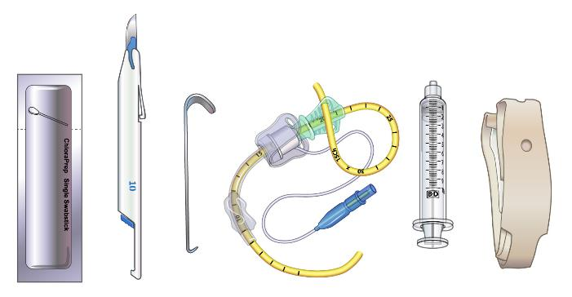
Objective 1: components and function
Chloraprep
Swabstick
Tracheostomy Kit
w/Bougie-introducer
Tracheal Tube
Holder
Tracheal Hook
10cc Syringe
#10 Scalpel (Penblade)
Notes:
Objective 1: Components and function
The BAC-Pack™ Bougie-Aided Cricothyroidotomy-Pack is a comprehensive solution that enables the clinician in the performance of a surgical airway in both complex and challenging environments. The kit is supplied in an easy-to-use pouch (or field expedient procedural tray) with each component arranged in sequence and retained in position with an elastic loop.
Within the BAC-PACK™ a clinician will find:
A ChloraPrep™ swabstick (alcohol pad, and gauze pad) for skin preparation.
A PenBlade scalpel. The latest innovation in scalpel safety, uniquely designed for challenging environments. The #10 blade has been identified as the correct surgical instrument for incision through varied external tissues, including the cricothyroid membrane.
A Tracheal Hook (a procedural specific alternative) for opening, elongating, and maintaining the cricoidthyroid membrane prior to and during tube insertion.
A specifically developed Tracheostomy Tube with a pre-positioned (yet adjustable) Bougie for rapid, tactilely confirmed, airway placement. The Bougie is retained in a pre-positioned, or clinician selected, length (based on patient presentation) by a novel Bougie Cap. The Tracheostomy Tube with Bougie-introducer meets and exceeds TCCC recommendations for the open surgical technique (flanged and cuffed airway cannula of less than 10 mm outer diameter, 6-7 mm internal diameter, and 5- 8 cm of intratracheal length).
A 10cc syringe is supplied for inflation of the tracheostomy tube distal cuff.
A tube-restraint is supplied for post procedure securing.

Slide 6
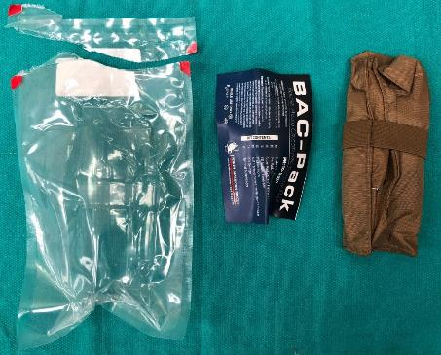
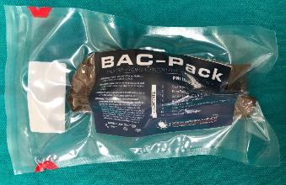
Objective 1: components and function
Directions
for Use
BAC-Pack™ supplied in a
vacuum sealed package
Bac-Pack™
Notes:
Objective 1: Components and Function
The BAC-Pack™ Bougie-Aided Cricothyroidotomy-Pack is a comprehensive solution that enables the clinician in the performance of a surgical airway in both complex and challenging environments. The kit is supplied in an easy-to-open, vacuum sealed, red-tabbed package.
Once open the clinician will find the Directions for Use (QUICK REFERENCE GUIDE) and a rolled pouch (or situationally expedient procedural tray) with each component arranged in sequence, as well as retained in their position with an elastic loop.
To open:
Grasp pouch above and below red tabs.
Tear open pouch.
Remove all contents from pouch.

Slide 7
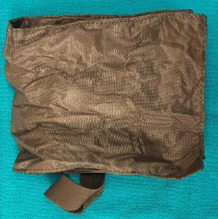
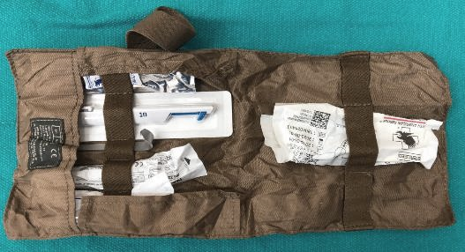
Objective 1: components and function
Elastic band removed
from pack
Pack opened - revealing organized contents
Notes:
Objective 1: Components and Function
When the Bac-Pack™ (or field expedient procedural tray) is open, it will reveal each of the components arranged in sequence, as well as retained in their position with an elastic loop.
To open:
Grasp pouch above and below red tabs.
Tear open pouch.
Remove all contents from pouch.
Release elastic band surrounding Pack.
Flip open pack, exposing surgical airway supplies.

Slide 8
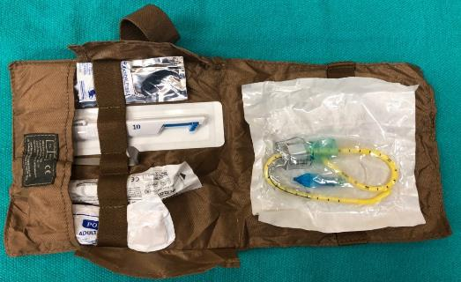
Objective 1: components and function
Bougie Aided Cricothyroidotomy assembly removed from elastic retainer
Notes:
Objective 1: Components and Function
Contents can be pulled from each elastic loop and quickly opened for usage.
To open:
Grasp pouch above and below red tabs.
Tear open.
Remove contents.
Release elastic band surrounding Pack.
Flip open pack, exposing surgical supplies.
Remove items from their elastic bands and open for immediate use.

Slide 9
Objective 2: indications & contraindication
Indications:
all ventilation attempts are unsuccessful
airway obstruction cannot be relieved
maxillofacial trauma (or like presentation) prevents non-surgical approach
loss of airway is imminent without secure ventilation option
Contraindication:
patient can be ventilated by any method other than a surgical airway
Notes:
Objective 2: Indications and Contraindication
Indications:
all ventilation attempts are unsuccessful
airway obstruction cannot be relieved
maxillofacial trauma (or like presentation) prevents non-surgical approach
loss of airway is imminent without secure ventilation option
Contraindication:
patient can be ventilated by any method other than a surgical airway

Slide 10
Objective 2: indications & contraindication
BAC-Pack™ is intended for the placement of a surgical airway
when all positioning, basic, and advanced ventilation attempts have failed
this situation can be summarized in four words:
can’t ventilate can’t intubate
from which only two options remain:
a successful surgical airway
or
death
Notes:
Objective 2: Indications and Contraindication – reality check
The BAC-Pack™ was specifically designed as a final solution to a failed airway. While scientific evidence supports the procedure and design of this kit, the final reality rests in the clinician’s assessment and procedural ability.
Indications:
all ventilation attempts are unsuccessful
airway obstruction cannot be relieved
maxillofacial trauma (or like presentation) prevents non-surgical approach
loss of airway is imminent without secure ventilation option
Contraindication:
patient can be ventilated by any method other than a surgical airway

Slide 11
Objective 2: therapeutic benefits
A surgical airway should improve one or more of the following:
relief from upper airway obstruction (secondary to trauma or other causes)
secure airway (from loss, or aspiration of fluids and debris)
ventilation control (from inability to ventilate, severe respiratory distress, or necessity)
improvement in oxygen saturation (from inability to ventilate, or airway related circulatory compromise)
Notes:
Objective 2: Therapeutic Benefits
Correct placement of a surgical airway should improve one or more of the following:
Relief from upper airway obstruction (secondary to trauma or other causes)
Secure airway (from loss, or aspiration of fluids and debris)
Ventilation control (from inability to ventilate, severe respiratory distress, or necessity)
Improvement in oxygen saturation (from inability to ventilate, or airway related circulatory compromise)

Slide 12
Objective 3: challenges - reality check
Challenges (rarely discussed)
You may be in an undesirable position or location
The patient may be an acquaintance
Anatomy may be distorted or at greater anatomical depth than anticipated (trauma, excessive adipose tissue, edema, mass or tumor, scaring)
Patient may be attempting to breathe or swallow (structural movement during procedure)
Profuse bleeding may occur during procedure (deoxygenated “darker” blood, which will likely obscure field)
Loss of visual references may occur during procedure (forcing conversion to tactile anatomy identification, placement, and confirmation)
Notes:
Objective 3: Challenges – reality check
The following challenges are rarely discussed in surgical airway training programs.
Each item is worthy of elaboration and frank discussion.
You may be in an undesirable position or location.
The patient may be an acquaintance.
Anatomy may be distorted or at greater anatomical depth than anticipated (secondary to trauma, excessive adipose tissue, edema, mass, tumor, or scaring).
Patient may be attempting to breathe or swallow (causing structural movement during procedure).
Profuse bleeding may occur during procedure (deoxygenated “darker” blood, which will likely obscure field).
Loss of visual references may occur during procedure (forcing conversion to tactile anatomy identification, placement, and confirmation. This challenge could be secondary to a multitude of factors, including lighting, the environment, bleeding, or distorted anatomy).

Slide 13
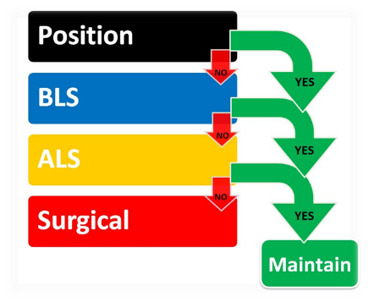
Objective 4: simplified airway algorithm
Consider ventilation options
Can’t ventilate can’t intubate
YES
Notes:
Objective 4: Simplified Airway Algorithm
Position if successful maintain
Consider all ventilation options BLS if successful maintain
ALS if successful maintain
If assessment dictates, or all non-surgical options fail, the clinician will arrive at a:
Can’t Ventilate Can’t Intubate Surgical Airway maintain
Success is your ONLY option

Slide 14
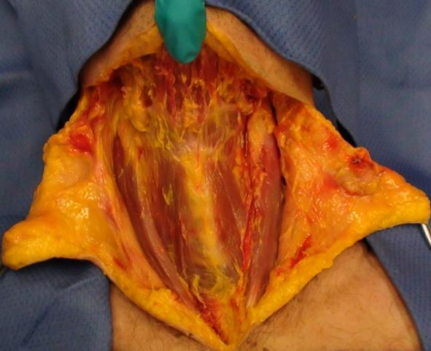
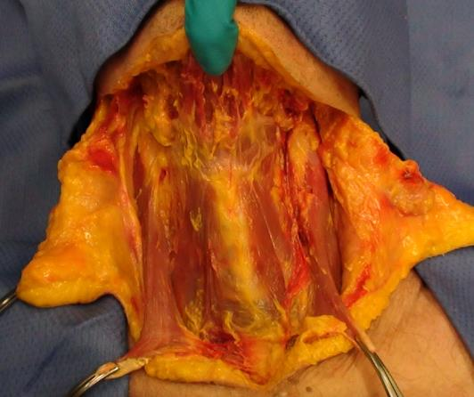
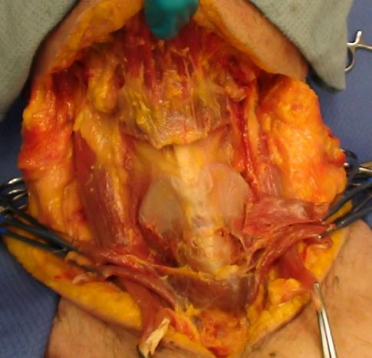
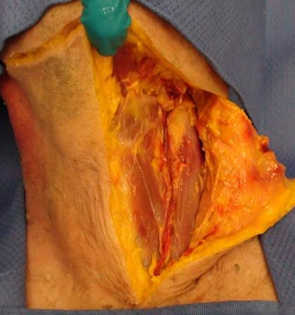
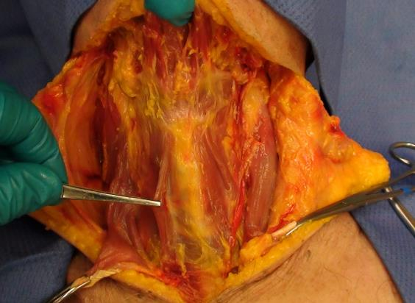
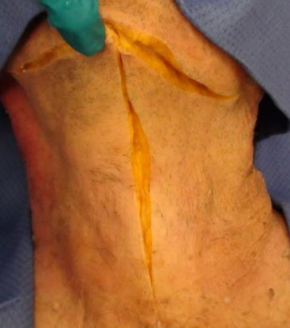
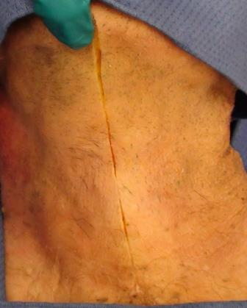
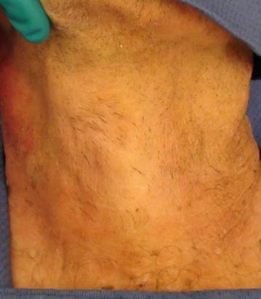
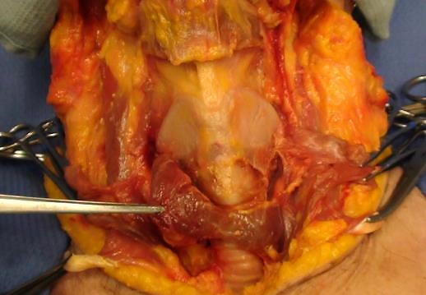
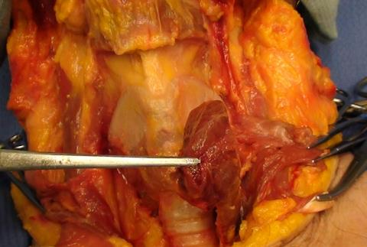
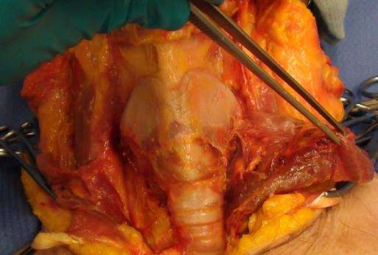
anterior
structures may
be difficult to
palpate
thyroid gland
elevated
note depth of this
specimen’s
anatomical
structures (24% BMI)
thyroid gland
reflected
thyroid cartilage
cricothyroid
membrane
cricoid cartilage
(ring)
epidermis, dermis
and subcutaneous
tissue reflected
sternocleidomastoids
elevated
hyoid muscle
elevated
Objective 5: gross anatomy - anterior neck dissection
14
Notes:
Objective 5: Gross Anatomy – Dissections
This slide (which is designed to “build in presentation mode”) walks the participant through specific anterior anatomy as reflections progress.
Labeling is designed to identify key structures related to the surgical airway.

Slide 15
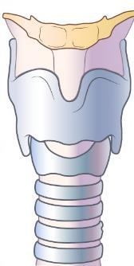
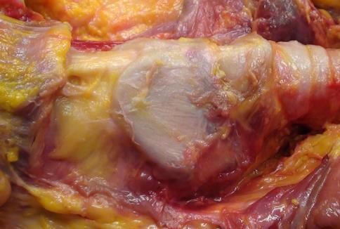
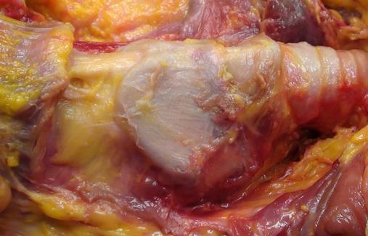
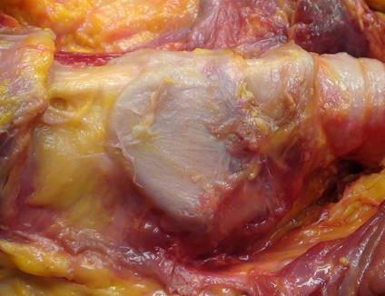
thyroid cartilage
cricothyroid
membrane
cricoid cartilage
(ring)
hyoid
hyothyroid ligament
hyoid
trachea
thyroid cartilage
cricothyroid
membrane
hyothyroid
ligament
cricoid cartilage (ring)
trachea
Objective 5: gross anatomy - anterior neck dissection
Notes:
Objective 5: Gross Anatomy – Dissections
This slide (which is designed to “rotate in presentation mode”) orients the participant to specific structural anatomy.
Labeling is designed to identify key structures related to the surgical airway.

Slide 16
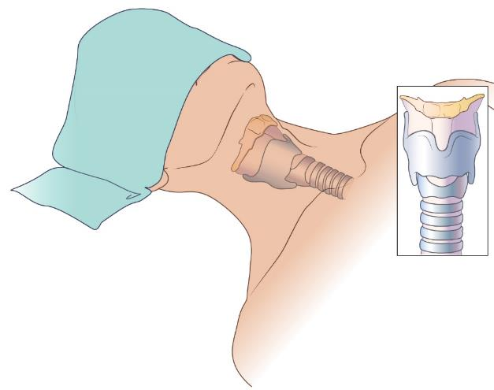
hyoid
hyothyroid ligament
men
thyroid cartilage
cricothyroid
membrane
cricoid cartilage (ring)
women
trachea
The “Adam's apple” is an anterior anatomical structure that is often most prominent in adult males; whereas the cricoid cartilage (ring) is often the only “relatively prominent” anterior structure in females
Objective 5: landmarks - anterior anatomic variations
Notes:
Objective 5: Landmarks – Anterior Anatomic Variations
This slide is unique. It is one of the first locations you will see the introduction of an identified difference (which is vitally important) between the adult male and adult female anterior anatomy.

Slide 17
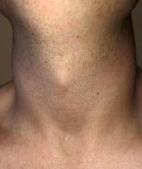
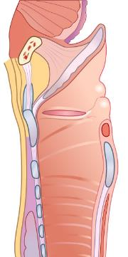
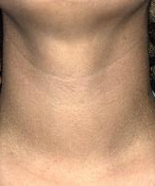
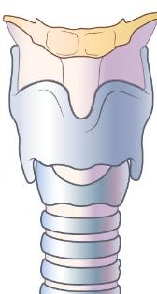
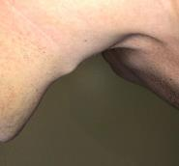
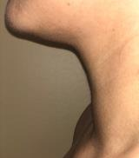
Objective 5: landmarks – anterior anatomic variations
hyoid
hyothyroid
ligament
thyroid
cartilage
male
female
cricothyroid
membrane
cricoid
cartilage (ring)
trachea
dotted line indicates
section location
anterior
posterior
“Adam’s Apple” is often the
most palpable structure on men
Cricoid cartilage is often the only palpable structure on women
Notes:
Objective 5: landmarks - anterior anatomical variations
This slide is unique. It is one of the first places you will see an identified, side-by-side comparative between the adult male and adult female anterior anatomy.
Important note: This slide offers illustrations and images to emphasize the difference between adult male and adult female anterior neck anatomy.
Training efforts should highlight this difference as well as patients who may present with anatomical variation or excessive adipose tissue.
Instructors should note that manikins present a “thin male patient” which may NOT be representative of the actual situation.

Slide 18
Objective 6: insertion steps – QUICK REFERENCE GUIDE
STEP 1. Prepare equipment
Notes:
Objective 6: Insertion Steps – QUICK REFERENCE GUIDE explained
STEP 1.
With the BAC-PACK™ open, remove and prepare each item:
A ChloraPrep™ swabstick.
A PenBlade scalpel (Note Green Arrows - blade extends and locks open when blue lever is pushed into handle. Blade is retracted by depressing and releasing white lever.)
A Tracheal Hook (a procedural specific alternative) for opening, elongating, and maintaining the cricothyroid membrane prior to and during tube insertion. Clinicians may optionally choose to use their index finger.
A specifically developed Tracheostomy Tube with a pre-positioned (yet adjustable) Bougie for rapid, tactilely confirmed, airway placement. The Bougie is retained in a pre-positioned, or clinician selected, length (based on patient presentation) by a novel Bougie Cap.
A 10cc syringe is for inflation of the tube’s distal cuff. Ensure that cuff is not over or under inflated.
A tube-restraint is for post procedure securing.

Slide 19
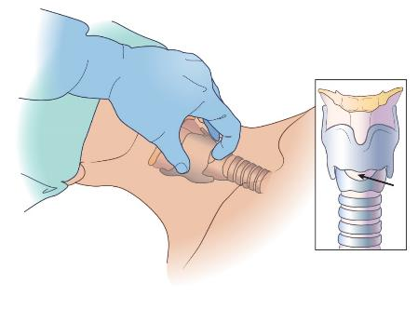
Objective 6: insertion steps
cricothyroid
membrane
STEP 2. Stabilize and locate anatomy
*this slide depicts a RIGHT-HANDED operator on patient’s RIGHT SIDE
Notes:
STEP 2:
Stabilize and locate the cricothyroid membrane.
It is NOT advisable to hyper-extend the patients neck (meaning DO NOT aggressively chin-lift or place the patient in an “exaggerated sniffing” position). Doing so will “tighten” anterior skin AND alter or obscure the clinician's ability to palpate sub-structures.
Note that image and illustration show that patient in a neutral position.

Slide 20
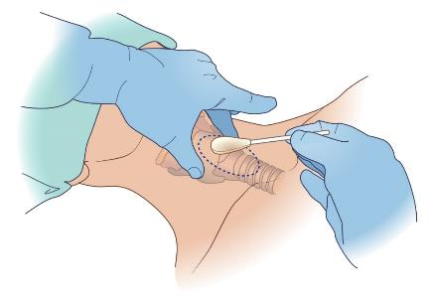
Objective 6: insertion steps
STEP 3. Cleanse site
*this series depicts a RIGHT-HANDED operator on patient’s RIGHT SIDE
Notes:
STEP 3:
Cleanse the surgical site according to protocol or standard.

Slide 21
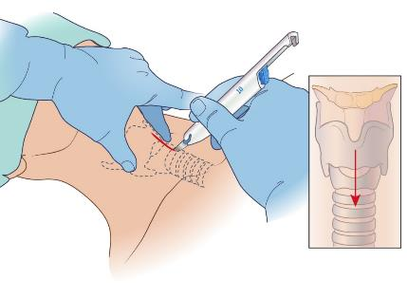
Objective 6: insertion steps
STEP 4. Vertically incise external tissues
*this slide depicts a RIGHT-HANDED operator on patient’s RIGHT SIDE
Notes:
STEP 4: Vertically incise external tissues
With the thumb and middle finger stabilizing structures (as well as spreading and flattening the tissue over the incision site) gently incise external tissues vertically between the mid-thyroid and the cricoid ring (patients who present with excessive adipose tissue may need an extended incision).
Ensure that you DO NOT incise through the cartilaginous structures.
Be prepared for bleeding, at which point visual reference may be lost.

Slide 22
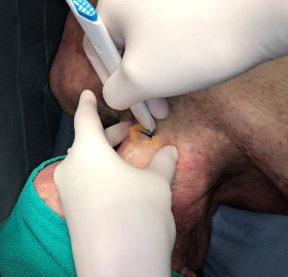
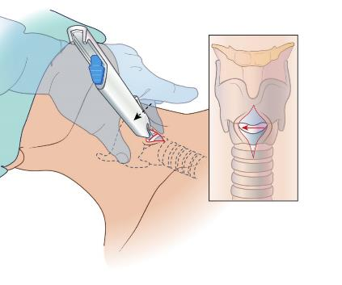
Objective 6: insertion steps
STEP 5. Horizontally incise cricothyroid membrane
*this slide depicts a RIGHT-HANDED operator on patient’s RIGHT SIDE
Notes:
STEP 5: Horizontally incise the cricothyroid membrane
With the thumb and middle finger of non-dominant hand stationary, yet holding the vertical incision open, and with the index finger of the non-dominant hand confirming location of the cricothyroid membrane, bring scalpel into position and gently horizontally incise the cricothyroid membrane.
The incision width should be no greater than what is needed to accommodate the tip of the clinician’s index finger or tracheostomy tube.

Slide 23
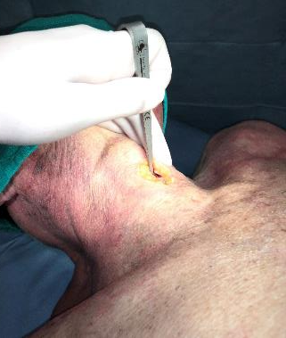
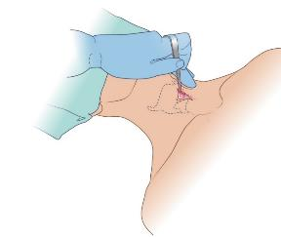
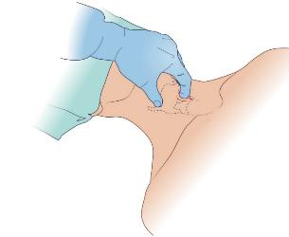
Objective 6: insertion steps
STEP 5a: Insert tracheal hook
through cricothyroid membrane
gently lift thyroid cartilage
STEP 5b: Insert finger
through cricothyroid membrane
stabilize structures
23
*this slide depicts a RIGHT-HANDED operator on patient’s RIGHT SIDE
Notes:
Two methods should be considered to maintain the opening of the cricothyroid membrane during procedure.
STEP 5a:
With the structures stabilized and open (remove scalpel) and place tracheal hook into cricothyroid membrane (trachea) through the horizontal incision. Rotate the tracheal hook into position and allow hook to grasp inferior aspect of internal thyroid cartilage. Gently lift to elongate structures. Some evidence suggests that the clinician SHOULD NOT remove the scalpel without a method to maintain contact with the cricothyroid incision (opening) at all times.
STEP 5b:
With the structures stabilized and open, place index fingertip of non-dominant hand into cricothyroid membrane (trachea). Some evidence suggests that the clinician SHOULD NOT remove the scalpel without a method to maintain contact with the cricothyroid incision (opening) at all times.

Slide 24
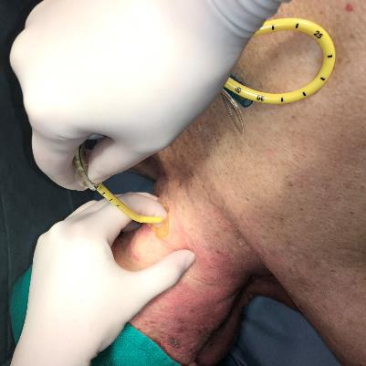
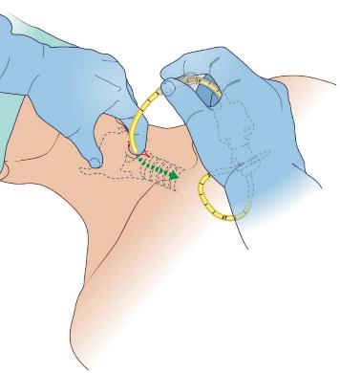
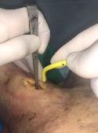
Objective 6: insertion steps
associated with STEP 5b
use of tracheal hook
associated with STEP 5a
STEP 6. Insert bougie through cricothyroid membrane
*this slide depicts a RIGHT-HANDED operator on patient’s RIGHT SIDE
Notes:
STEP 6: Insert bougie through cricothyroid membrane
With either the tracheal hook (step 5a – shown in image insert) or index finger (step 5b - shown in larger image and illustration) holding cricothyroid membrane open, insert bougie (tube assembly) through cricothyroid membrane into trachea.
Note that the tube is inserted caudally (toward the feet) with the bougie tip facing anteriorly (to appreciate the tracheal rings).
IMPORTANT POINT: The NEXT SLIDE offers KEY facets about bougie confirmation and usage. These points are NEW, founded in research, and critical to placement confirmation in the complex or challenging environment.

Slide 25
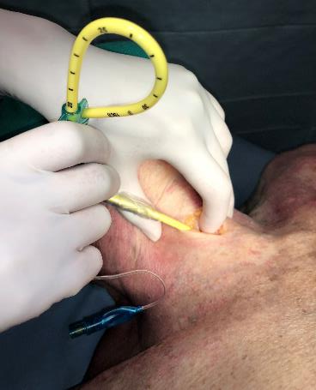
Objective 6: insertion steps
STEP 6. Insert bougie with tactile confirmation
*this slide depicts a RIGHT-HANDED operator on patient’s RIGHT SIDE
Notes:
STEP 6: Continued
With either the tracheal hook, or index finger (shown) holding the membrane open, insert bougie (tube assembly) into trachea.
Note that the tube is inserted caudally (toward the feet) with the bougie tip facing anteriorly.
KEY POINTS:
Note that the bougie (Cadeau) tip is anteriorly (front) facing.
As you insert the bougie, note that the assembly should be slightly left or right of the patient’s chin (to allow the distal tip to progress forward and contact the internal/anterior tracheal rings).
To confirm bougie is IN THE TRACHEA move the assembly inferiorly and superiorly (back and forth) to appreciate “tracheal clicking” or “tactile feedback” (offering an assurance that the trachea has been accessed).

Slide 26
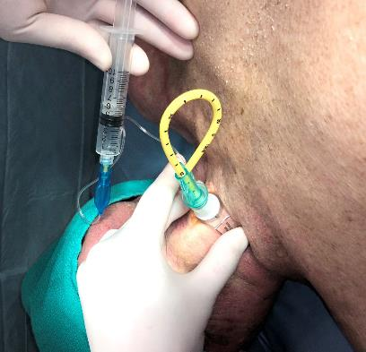
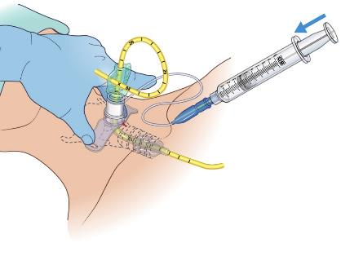
Objective 6: insertion steps
STEP 7. Advance tube & inflate cuff
*this slide depicts a RIGHT-HANDED operator on patient’s RIGHT SIDE
Notes:
STEP 7: Advance tube into position and inflate cuff
Once trachea has been confirmed, advance tube into position and stabilize digitally. Inflate cuff to prevent aspiration.
Ensure that only a minimal amount of air is placed into the cuff to achieve adequate seal.
In some clinical situations, directly following placement of the bougie tube assembly into trachea, one may logically prefer to remove the bougie, ventilate and THEN inflate the cuff.
It is also appropriate (as defined in the insertion steps) to inflate cuff directly after bougie tube assembly placement and then remove bougie and ventilate
Each of these options are patient specific, clinician directed decisions based on an individual presentation.

Slide 27
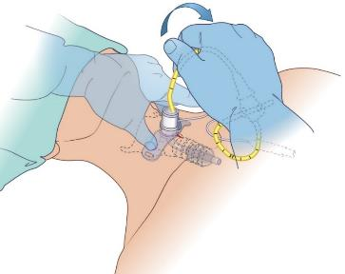
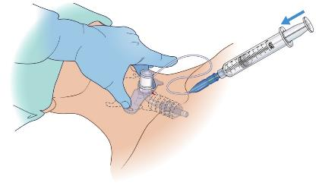
Objective 6: insertion steps
Optional maneuver – after advancing tube,
immediately remove bougie, ventilate and inflate cuff
Notes:
Optional maneuver: Digitally stabilize tube and remove bougie. Begin ventilation, inflate cuff to prevent aspiration.
Ensure that only a minimal amount of air is placed into the cuff to achieve adequate seal.
In some clinical situations, directly following placement of the bougie tube assembly into trachea, one may logically prefer to remove the bougie, ventilate and THEN inflate the cuff.
It is also appropriate (as defined in the insertion steps) to inflate cuff directly after bougie tube assembly placement and then remove bougie and ventilate
Each of these options are patient specific, clinician directed decisions based on an individual presentation.

Slide 28
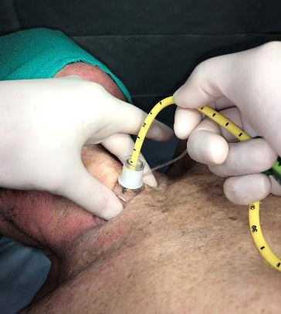
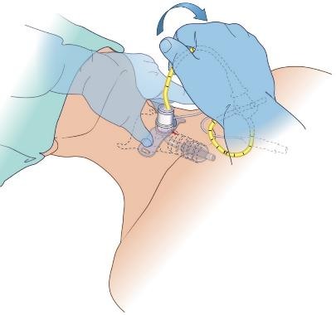
Objective 6: insertion steps
STEP 8. Remove bougie
*this slide depicts a RIGHT-HANDED operator on patient’s RIGHT SIDE
Notes:
STEP 8: Remove bougie
Once tube is in position, stabilized, cuff is inflated, remove bougie and cap (as a single unit), while ensuring tube remains in position.
In some clinical situations, directly following placement of the bougie tube assembly into trachea, one may logically prefer to remove the bougie, ventilate and THEN inflate the cuff.
It is also appropriate (as defined in the insertion steps) to inflate cuff directly after bougie tube assembly placement and then remove bougie and ventilate
Each of these options are patient specific, clinician directed decisions based on an individual presentation.

Slide 29
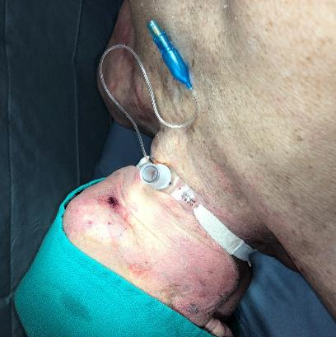
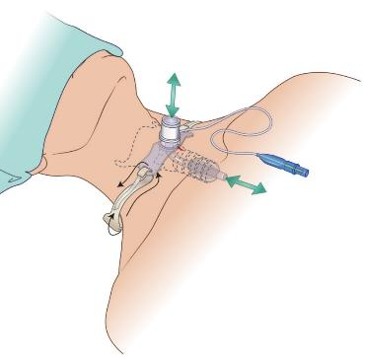
Objective 6: insertion steps
STEP 9. Secure tube and ventilate
Notes:
STEP 9: Secure tube and (continue to) ventilate
Once tube is in position, stabilized, cuff is inflated, and bougie is removed, begin ventilation and SECURE TUBE.

Slide 30
Objective 7: successful surgical airway placement
Confirmation and reconfirmation of correctly placed surgical airway may include, but should not be limited to:
Tracheal “clicking or tactile feedback” from inserted bougie
Chest rise and fall with ventilation
Presence of bilateral breath sounds with auscultation
Absence of epigastric sounds with auscultation
Negative finding with esophageal (false passage) detection device
Evidence of sustained ETCO₂ with ventilation
Improving oxygen saturation
Notes:
Objective 7: Successful surgical airway placement confirmation
Confirmation and reconfirmation of a correctly placed surgical airway may include multiple methods, but should not be limited to:
Tracheal “clicking or tactile feedback” from inserted bougie
Chest rise and fall with ventilation
Presence of bilateral breath sounds with auscultation
Absence of epigastric sounds with auscultation
Negative finding with esophageal (false passage) detection device
Evidence of sustained ETCO₂ with ventilation
Improving oxygen saturation

Slide 31
Objective 8: complications
Complications of surgical airway include:
hypoxemia
false passage
aspiration
bleeding
damage to associated tissues
subcutaneous and mediastinal emphysema
perforation of posterior trachea
cardiac arrest
infection
Notes:
Objective 8: Complications
Complications from surgical airway delays (multiple causes), improper training or technique, or poor post surgical care can be lethal. These include:
Hypoxemia pre-procedure ventilation, rapid decision-making process
False passage bougie aided insertion, confirmation assurances
Aspiration poor initial airway management or procedure
Bleeding minimal to moderate bleeding is expected in perfusing patient. Dress site post procedure.
Damage to associated tissues usually the result of poor procedural practice and lack of scalpel discipline. Be gentle.
Subcutaneous and mediastinal emphysema disrupted trachea, false passage, inadequately filled cuff.
Perforation of posterior trachea usually the result of poor procedural practice and lack of scalpel discipline. Be gentle.
cardiac arrest If this is secondary to hypoxia it is likely due to delay in ventilation or aspiration
Infection poor procedural technique or post procedure management
Mitigation strategies should be discussed and considered.

Slide 32
Objective 9: scientific evidence
The BAC-Pack™ (Bougie Aided Cricothyroidotomy-Pack) and this presentation were developed utilizing the latest published evidence, independent research, and support of dedicated Military and Civilian medical professionals in Emergency Medicine, Trauma Surgery, Pulmonology, and Pathology.
Clinical providers, regardless of their position, must dedicate themselves to the unrelenting reality that critical care is an evolution on behalf of those in need.
Scientific Highlights
300 years of related airway discussion: 1667 Hooke
200 years of cricothyroidotomy debate with procedural updates and refinement
20th Century: Jackson et al - developed four basic principles reducing procedural complications
1976: Brantigan et al - 655 cases of cricothyroidotomy demonstrating 6% complication rate
Numerous studies discuss efficacy and relative safety of surgical airway procedure
Current evidence (Mabry et al) illuminates increase in complications as training, equipment, and conditions become less than optimal
Notes:
Objective 9: scientific evidence
The BAC-Pack™ (Bougie Aided Cricothyroidotomy-Pack) and this presentation were developed utilizing the latest published evidence, independent research, and support of dedicated Military and Civilian medical professionals in Emergency Medicine, Trauma Surgery, Pulmonology, and Pathology.
Clinical providers, regardless of their position, must dedicate themselves to the unrelenting reality that critical care is an evolution on behalf of those in need.
Scientific Highlights
300 years of related airway discussion: 1667 Hooke
200 years of cricothyroidotomy debate and procedure
20th Century: Jackson et al - developed four basic principles reducing procedural complications
1976: Brantigan et al - 655 cases of cricothyroidotomy demonstrating 6% complication rate
Numerous studies discuss efficacy and procedures relative safety
Current evidence (Mabry et al) illuminates increase in complications as training, equipment, and conditions become less than optimal

Slide 33
Objective 9: scientific evidence - references
Schaumann N, Lorenz V, Schellongowski P, et al. Evaluation of Seldinger technique emergency cricothyroidotomy versus standard surgical cricothyroidotomy in 200 cadavers. Anesthesiology 2005; 102:7.
Mutzbauer TS, Munz R, Helm M, et al. [Emergency cricothyrotomy--puncture or anatomical preparation? Peculiarities of two methods for emergency airway access demonstrated in a cadaver model]. Anaesthesist 2003; 52:304.
Brofeldt BT, Panacek EA, Richards JR. An easy cricothyrotomy approach: the rapid four-step technique. Acad Emerg Med 1996; 3:1060.
Holmes JF, Panacek EA, Sakles JC, Brofeldt BT. Comparison of 2 cricothyrotomy techniques: standard method versus rapid 4-step technique. Ann Emerg Med 1998; 32:442.
Benkhadra M, Lenfant F, Nemetz W, et al. A comparison of two emergency cricothyroidotomy kits in human cadavers. Anesth Analg 2008; 106:182.
Chan TC, Vilke GM, Bramwell KJ, et al. Comparison of wire-guided cricothyrotomy versus standard surgical cricothyrotomy technique. J Emerg Med 1999; 17:957.
Schober P, Hegemann MC, Schwarte LA, et al. Emergency cricothyrotomy-a comparative study of different techniques in human cadavers. Resuscitation 2009; 80:204.
Kanji H, Thirsk W, Dong S, et al. Emergency cricothyroidotomy: a randomized crossover trial comparing percutaneous techniques: classic needle first versus "incision first". Acad Emerg Med 2012; 19:E1061.
McGill J, Clinton JE, Ruiz E. Cricothyrotomy in the emergency department. Ann Emerg Med 1982; 11:361.
Johnson DR, Dunlap A, McFeeley P, et al. Cricothyrotomy performed by prehospital personnel: a comparison of two techniques in a human cadaver model. Am J Emerg Med 1993; 11:207.
Gillespie MB, Eisele DW. Outcomes of emergency surgical airway procedures in a hospital-wide setting. Laryngoscope 1999; 109:1766.
Mace, SE, Hedges, JR. Cricothyrotomy and Translaryngeal Jet Ventilation. In: Clinical Procedures in Emergency Medicine, 4th ed, Roberts, JR, Hedges, JR, Chanmugam, AS, et al (Eds), Saunders, Philadelphia 2004. p.115.
Eisenburger P, Laczika K, List M, et al. Comparison of conventional surgical versus Seldinger technique emergency cricothyrotomy performed by inexperienced clinicians. Anesthesiology 2000; 92:687.
Bair AE, Laurin EG, Karchin A, et al. Cricoid ring integrity: implications for cricothyrotomy. Ann Emerg Med 2003; 41:331.
Davis DP, Bramwell KJ, Vilke GM, et al. Cricothyrotomy technique: standard versus the Rapid Four-Step Technique. J Emerg Med 1999; 17:17.
Spaite DW, Joseph M. Prehospital cricothyrotomy: an investigation of indications, technique, complications, and patient outcome. Ann Emerg Med 1990; 19:279.
Gerling MC, Davis DP, Hamilton RS, et al. Effect of surgical cricothyrotomy on the unstable cervical spine in a cadaver model of intubation. J Emerg Med 2001; 20:1.
Notable:
Eastridge, B.J., Mabry, R.L., Seguin, P. et al, Death on the battlefield (2001-2011): implications for the future of combat casualty care. J Trauma. 2012;73:S431–S437.
Mabry, R.L., Edens, J.W., Pearse, L. et al, Fatal airway injuries during Operation Enduring Freedom and Operation Iraqi Freedom. Prehosp Emerg Care. 2010;14:272–277.
Mabry, R., Frankfurt, A., Kharod, C. et al, Emergency cricothyroidotomy in Tactical Combat Casualty Care. J Spec Oper Med. 2015;15:11–19
Mabry, R., Nichols, M., Shiner, D. et al, A comparison of two open surgical cricothyroidotomy techniques by military medics using a cadaver model. Ann Emerg Med. 2014;63:1–5.
EBG B, Ervin AT, Mabry RL, Bebarta VS. Prehospital and en route cricothyrotomy performed in the combat setting: a prospective, multicenter, observational study. J Spec Oper med. 2014;14(4):35–9.
Mabry RL. An analysis of battlefield cricothyrotomy in Iraq and Afghanistan. J Spec Oper med. 2012;12(1):17–23.
Jackson, C . Tracheotomy. Laryngoscope 1909; 18:285.
Jackson, C. High tracheotomy and other errors the chief cause of chronic laryngeal stenosis. Surg Gyneco Obstet 1921; 32:392.
Brantigan CO, Grow JB Sr. Cricothyroidotomy: elective use in respiratory problems requiring tracheotomy. J Thorac Cardiovasc Surg 1976; 71:72.
Bair AE, Panacek EA, Wisner DH, et al. Cricothyrotomy: a 5-year experience at one institution. J Emerg Med 2003; 24:151.
Erlandson MJ, Clinton JE, Ruiz E, Cohen J. Cricothyrotomy in the emergency department revisited. J Emerg Med 1989; 7:115.
Fortune JB, Judkins DG, Scanzaroli D, et al. Efficacy of prehospital surgical cricothyrotomy in trauma patients. J Trauma 1997; 42:832.
Chang RS, Hamilton RJ, Carter WA. Declining rate of cricothyrotomy in trauma patients with an emergency medicine residency: implications for skills training. Acad Emerg Med 1998; 5:247.
Scrase I, Woollard M. Needle vs surgical cricothyroidotomy: a short cut to effective ventilation. Anaesthesia 2006; 61:962.
Schroeder AA. Cricothyroidotomy: when, why, and why not? Am J Otolaryngol 2000; 21:195.
Bramwell KJ, Davis DP, Cardall TV, et al. Use of the Trousseau dilator in cricothyrotomy. J Emerg Med 1999; 17:433.
Strange, GR, Niederman, LG. Surgical Cricothyrotomy. In: Textbook of Pediatric Emergency Procedures, Henretic, FM, King, C (Eds), Williams and Wilkens, Baltimore 1997. p.351.
Salvino CK, Dries D, Gamelli R, et al. Emergency cricothyroidotomy in trauma victims. J Trauma 1993; 34:503.
Aslani A, Ng SC, Hurley M, et al. Accuracy of identification of the cricothyroid membrane in female subjects using palpation: an observational study. Anesth Analg 2012; 114:987.
Elliott DS, Baker PA, Scott MR, et al. Accuracy of surface landmark identification for cannula cricothyroidotomy. Anaesthesia 2010; 65:889.
You-Ten KE, Desai D, Postonogova T, Siddiqui N. Accuracy of conventional digital palpation and ultrasound of the cricothyroid membrane in obese women in labour. Anaesthesia 2015; 70:1230.
Hiller KN, Karni RJ, Cai C, et al. Comparing success rates of anesthesia providers versus trauma surgeons in their use of palpation to identify the cricothyroid membrane in female subjects: a prospective observational study. Can J Anaesth 2016; 63:807.
Bair AE, Chima R. The inaccuracy of using landmark techniques for cricothyroid membrane identification: a comparison of three techniques. Acad Emerg Med 2015; 22:908.
Nicholls SE, Sweeney TW, Ferre RM, Strout TD. Bedside sonography by emergency physicians for the rapid identification of landmarks relevant to cricothyrotomy. Am J Emerg Med 2008; 26:852.
Curtis K, Ahern M, Dawson M, Mallin M. Ultrasound-guided, Bougie-assisted cricothyroidotomy: a description of a novel technique in cadaveric models. Acad Emerg Med 2012; 19:876.
Siddiqui N, Arzola C, Friedman Z, et al. Ultrasound Improves Cricothyrotomy Success in Cadavers with Poorly Defined Neck Anatomy: A Randomized Control Trial. Anesthesiology 2015; 123:1033.
Kristensen MS, Teoh WH, Rudolph SS, et al. A randomised cross-over comparison of the transverse and longitudinal techniques for ultrasound-guided identification of the cricothyroid membrane in morbidly obese subjects. Anaesthesia 2016; 71:675.
Kristensen MS, Teoh WH, Rudolph SS. Ultrasonographic identification of the cricothyroid membrane: best evidence, techniques, and clinical impact. Br J Anaesth 2016; 117 Suppl 1:i39.
Hill C, Reardon R, Joing S, et al. Cricothyrotomy technique using gum elastic bougie is faster than standard technique: a study of emergency medicine residents and medical students in an animal lab. Acad Emerg Med 2010; 17:666.
Notes:
Objective 9: scientific evidence
The BAC-Pack™ (Bougie Aided Cricothyroidotomy-Pack), and this presentation, were developed utilizing the latest published evidence, independent research, and support of dedicated Military and Civilian medical professionals in Emergency Medicine, Trauma Surgery, Pulmonology, and Pathology.
Clinical providers, regardless of their position, must dedicate themselves to the unrelenting reality that critical care is an evolution on behalf of those in need.
This list of references is not intended to be all inclusive. It does, however represent a beginning to the evidence based surgical airway procedure, and a directional beacon toward the future of emergent care.
Scientific Highlights
300 years of related airway discussion: 1667 Hooke
200 years of cricothyroidotomy debate and procedure
20th Century: Jackson et al - developed four basic principles reducing procedural complications
1976: Brantigan et al - 655 cases of cricothyroidotomy demonstrating 6% complication rate
Numerous studies discuss efficacy and procedures relative safety
Current evidence (Mabry et al) illuminates increase in complications as training, equipment, and conditions become less than optimal

Slide 34
For additional information
about the BAC-Pack™
email: info@NARescue.com
Tel: 864.675.9800
Mail: 35 Tedwall Court Greer, SC 29650-4791
Fax: 864.675.9880
BAC-Pack™
Bougie Aided Cricothyroidotomy-Pack
REV C 120418
Notes:
Thank you for participating in the BAC-Pack™ Bougie Aided Cricothyroidotomy - Pack Surgical Airway orientation and training.
If you have any questions, concerns or would like additional information please contact:
North American Rescue®, LLC
email: info@NARescue.com
Tel: 864.675.9800
Mail: 35 Tedwall Court Greer, SC 29650-4791
Fax: 864.675.9880

